Slide 1
CUCC Expo
Expeditions to the SMK system, Loser Plateau
1976 – 2019 and plans for 2020

Slide 2
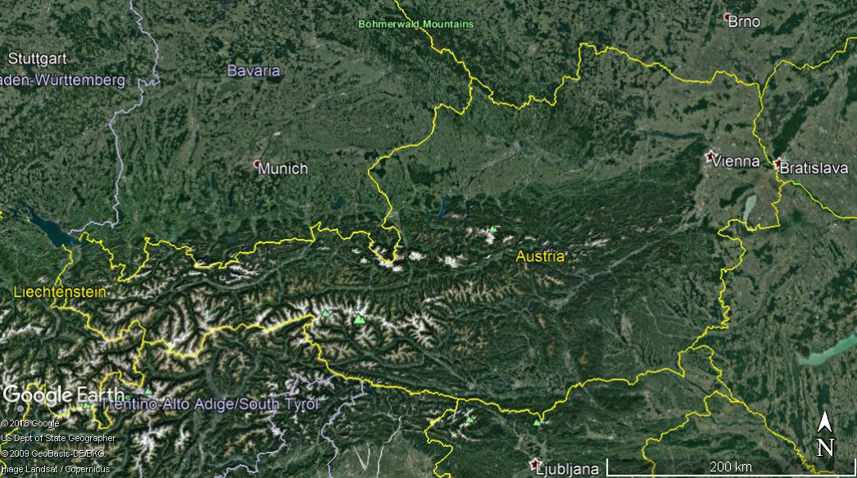

Slide 3
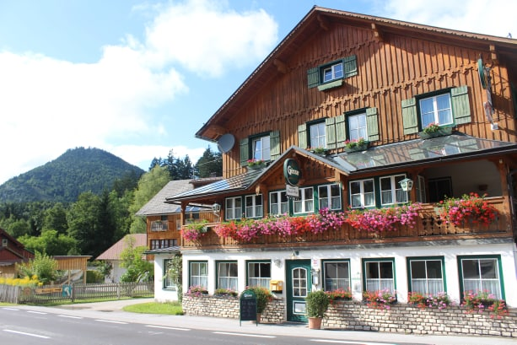

Slide 4
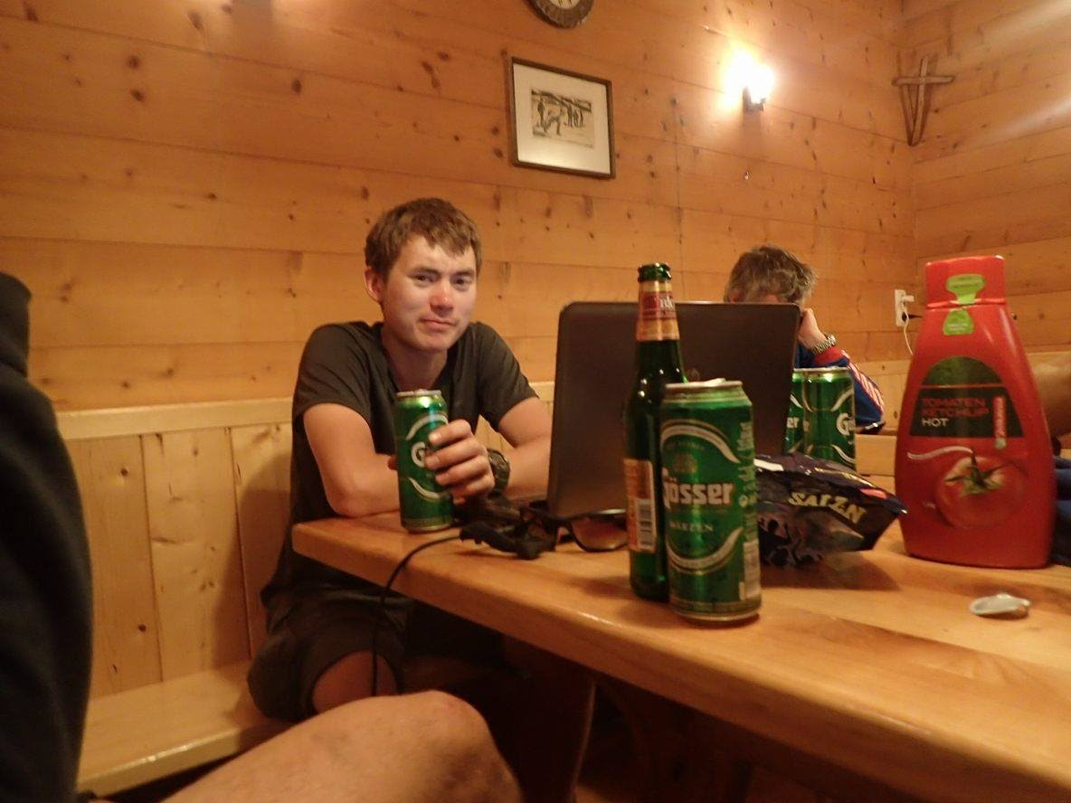
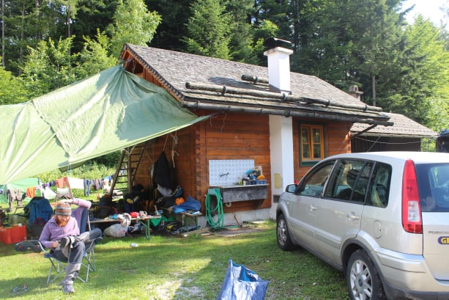
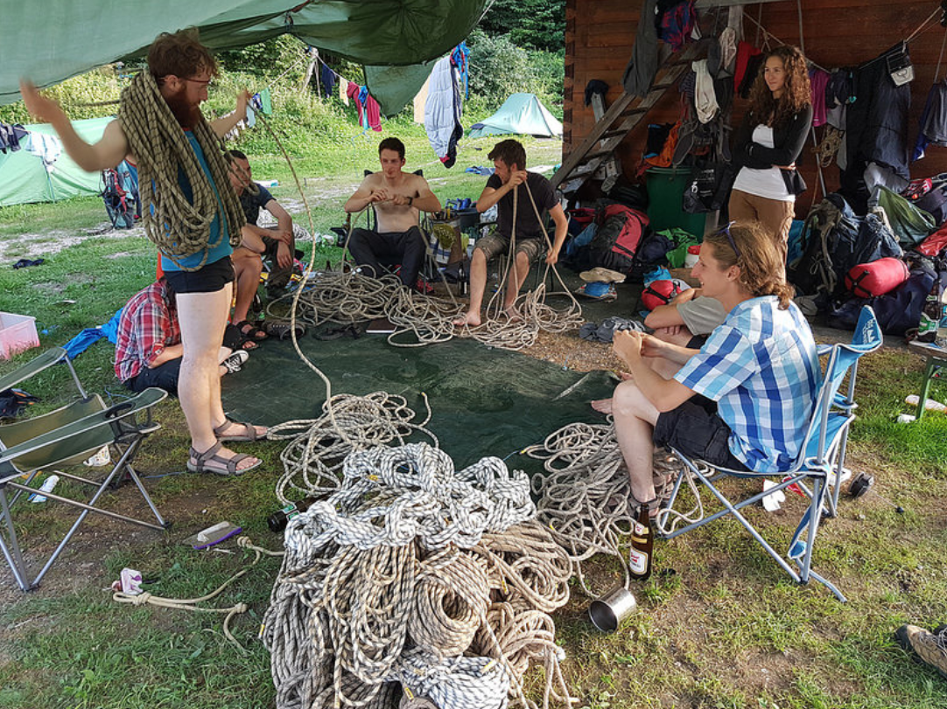
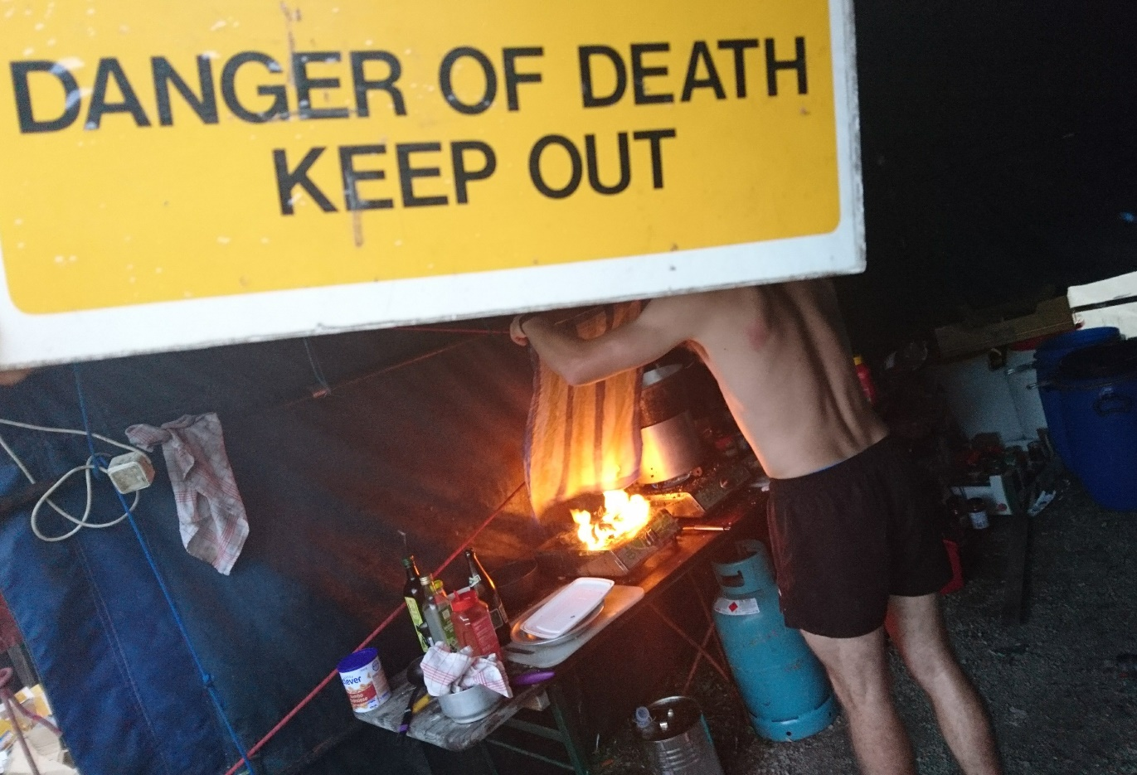

Slide 6
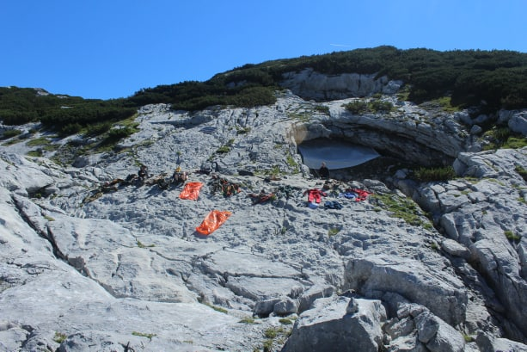
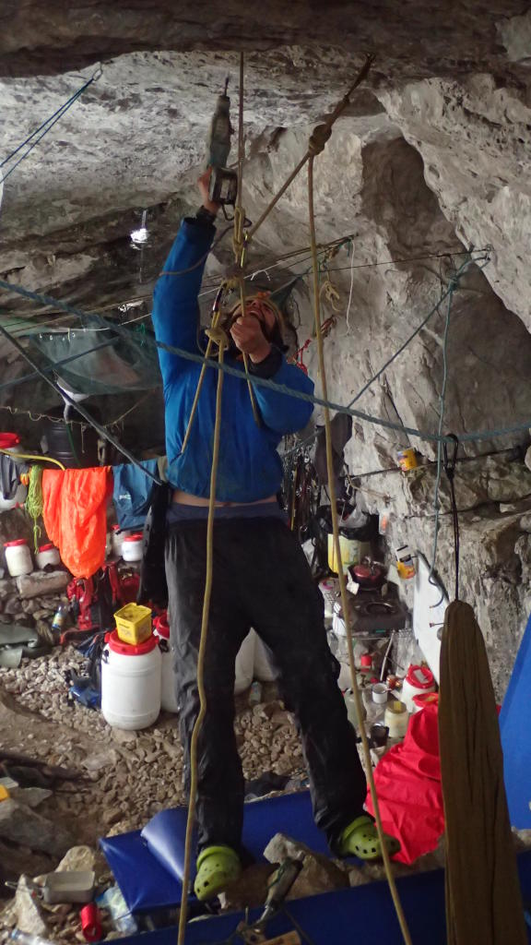
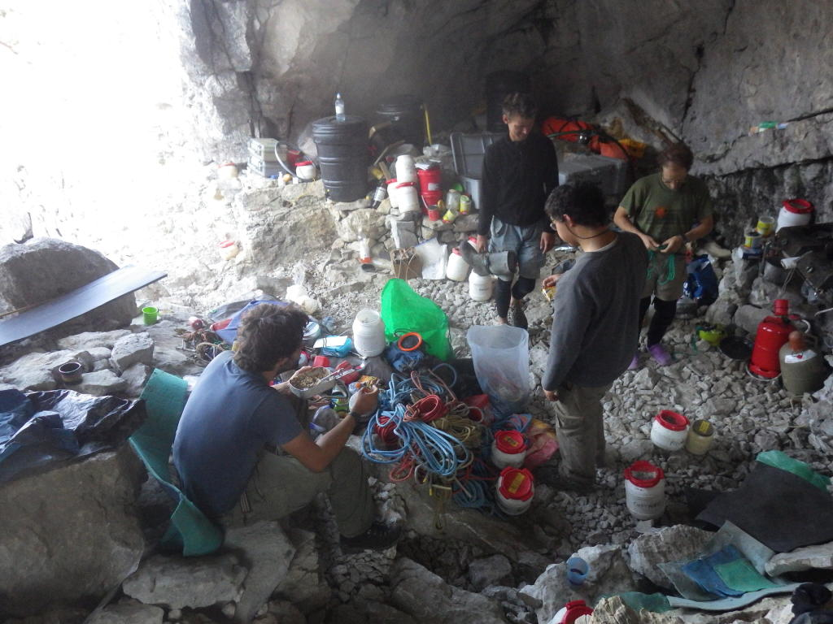
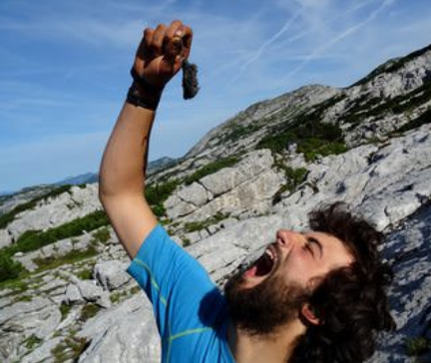
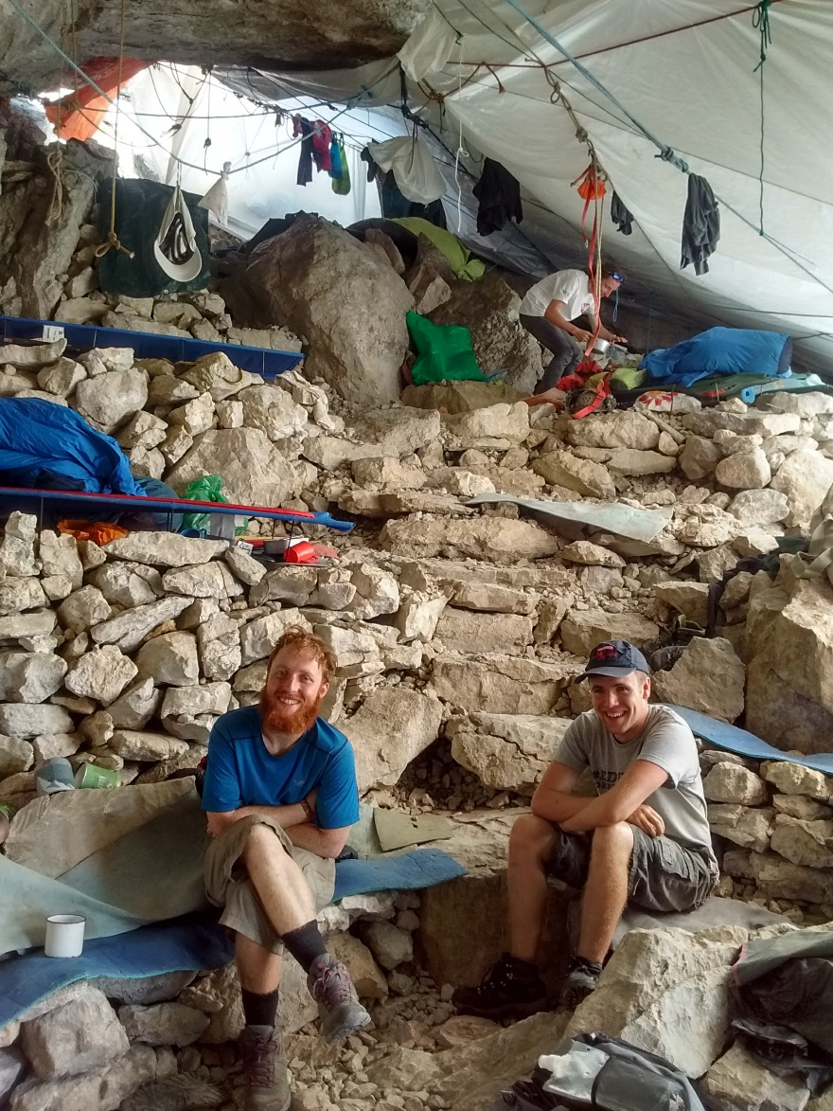

Slide 7
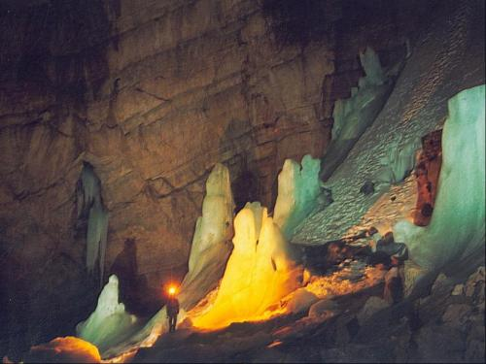
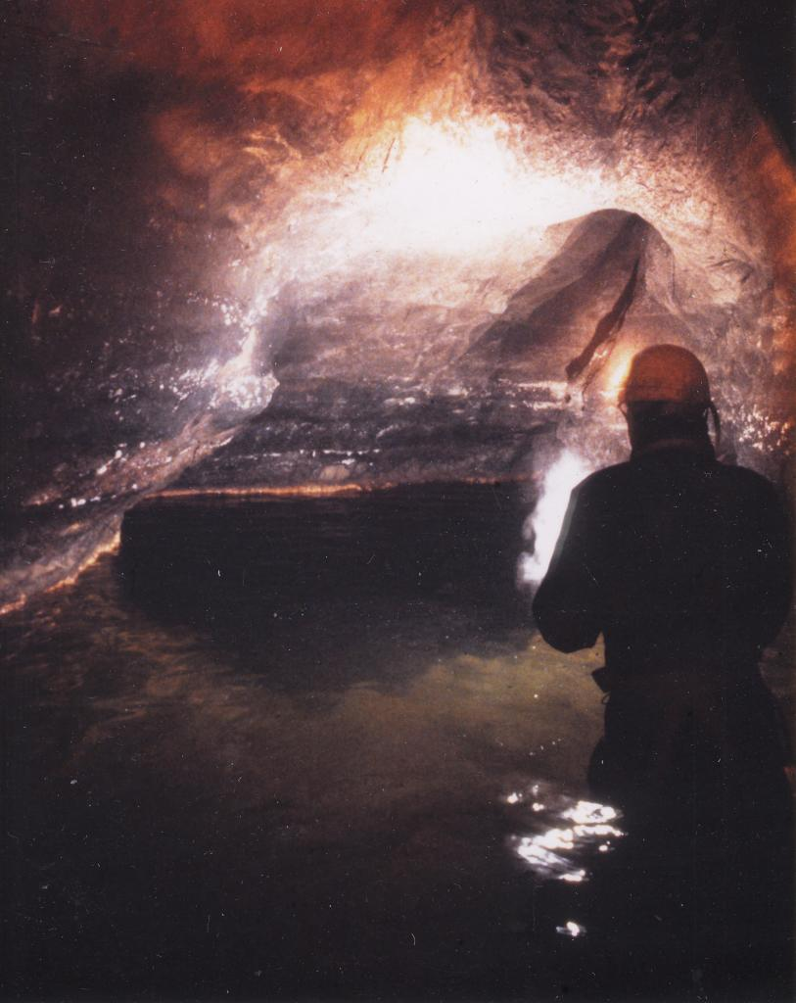
Stellerweg, 1982 - 1983:
Dartford Tunnel: big stuff from the beginning
Duck at -800m, no wetsuit: hard af.
Sump at altitude of Altausee lake: little potential for further finds.
Eishohle: caves are very cold, though ice disappearing rapidly nowadays

Slide 8
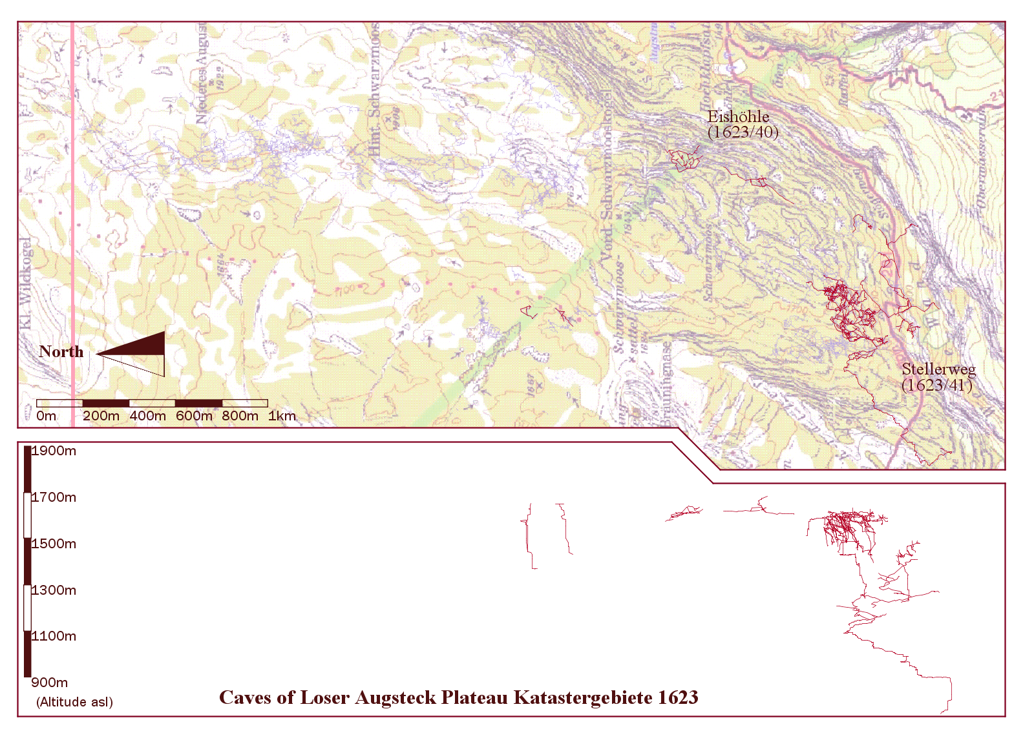

Slide 9
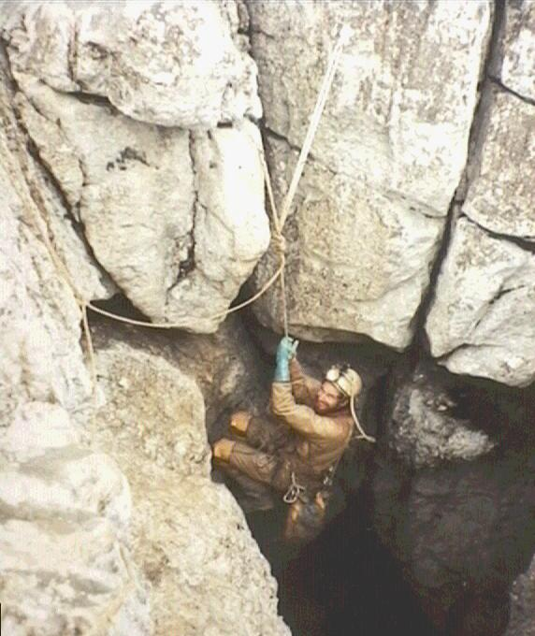
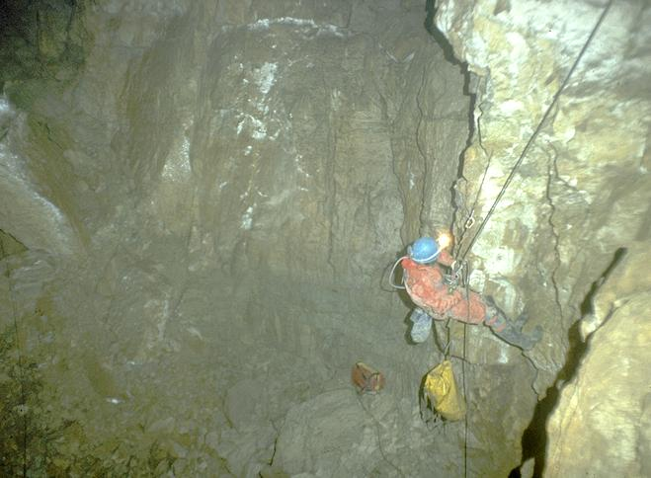
Kaninchenhohle, 1988 - 1996
extensive horizontal discoveries + vertical gain: connecting up entrances across the system is a viable exploratory goal

Slide 10
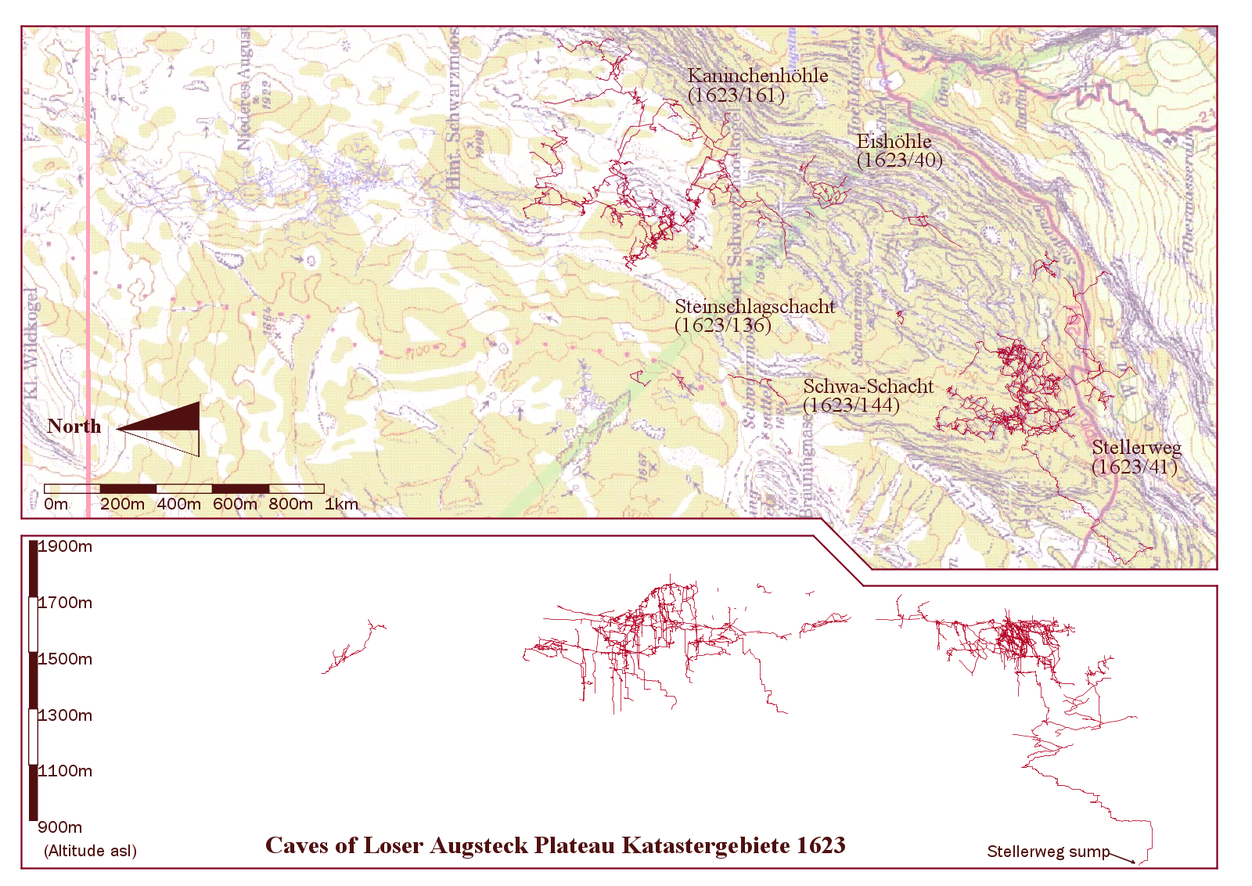

Slide 11
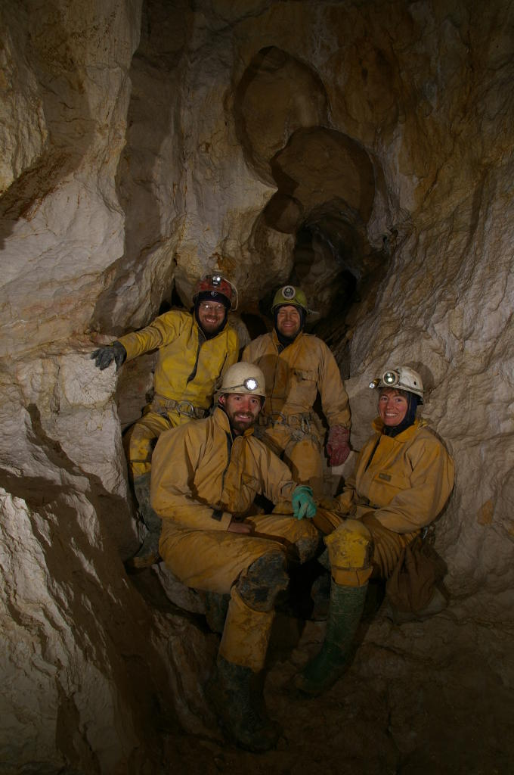
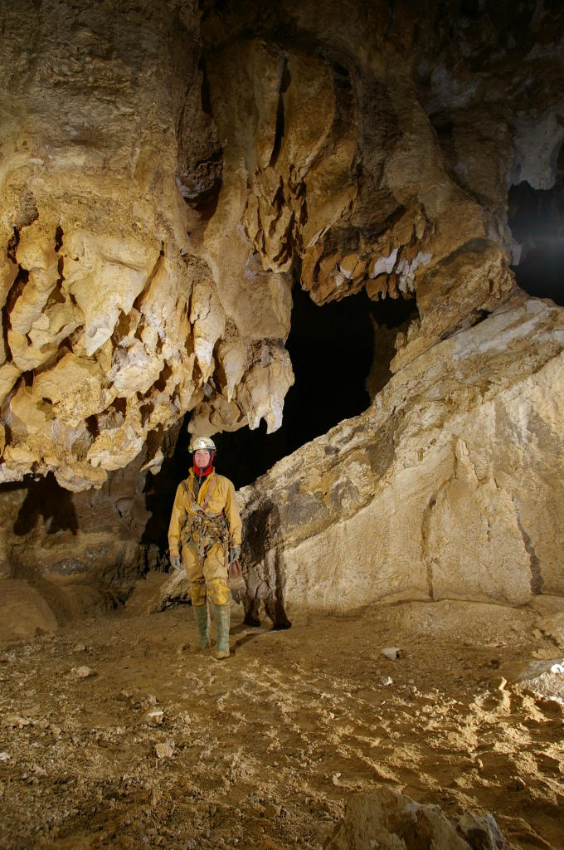
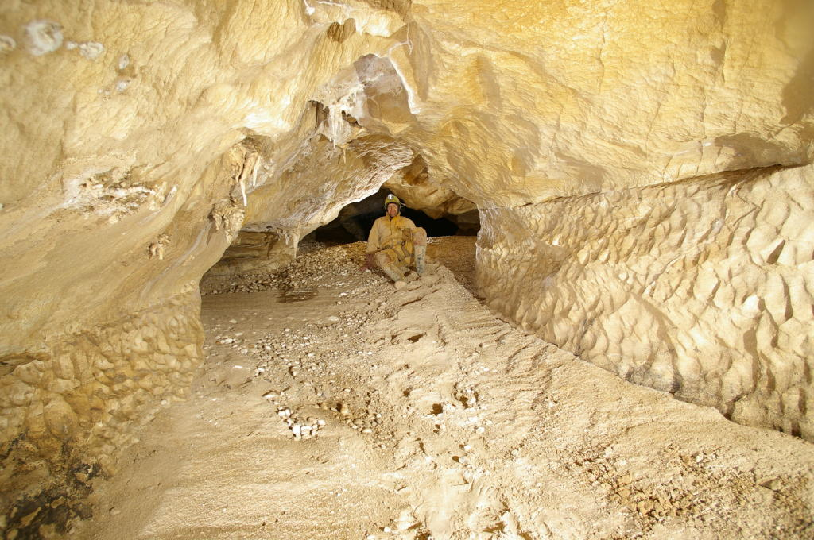
Steinbruckenhohle, 1999 - 2007
Entrance right next to stone bridge.
More deep stuff leading to another streamway and sump – Subway and Razordance

Slide 12
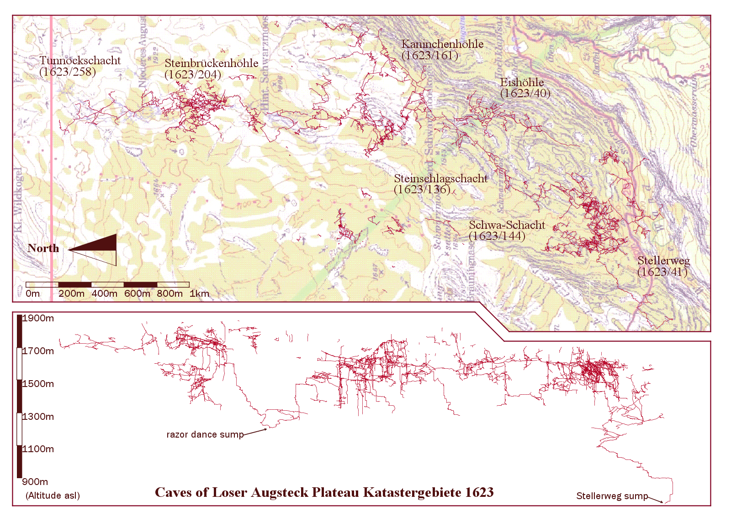

Slide 13
The millennial era: 2008 - present
Originally : outreach of CUCC to other university clubs, particularly ULSA and UBSS
Now CUCC, ULSA, UBSS, NUCC, SUSS
Whats next?
Introduce young cavers to alpine exploratory caving - challenging but worth it!
Keep making the system longer and deeper: currently the fourth longest and deepest (combined measure) in the world
Connect to neighbouring Schoenberg system to create an alpine ‘supercave’

Slide 14
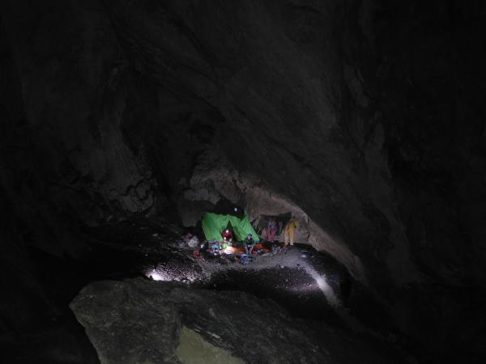
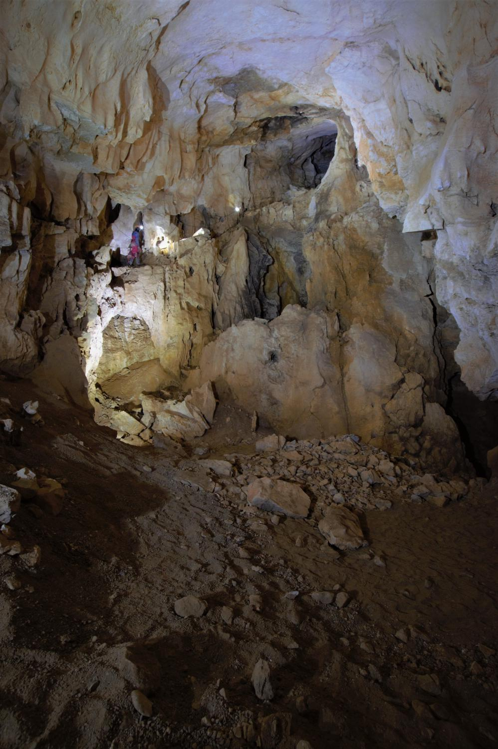
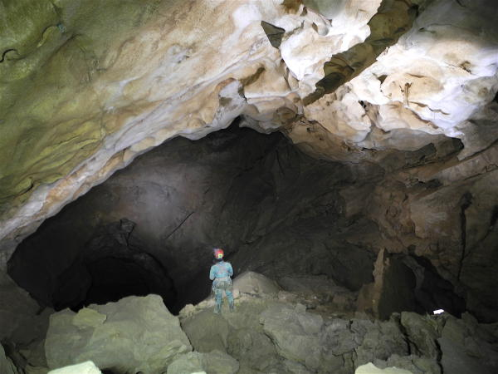
Tunnockschacht, 2006 - 2018
Over 20km long and 900m deep
‘Tunnocks Corp’: keeps merging and taking over other caves in SMK system

Slide 15
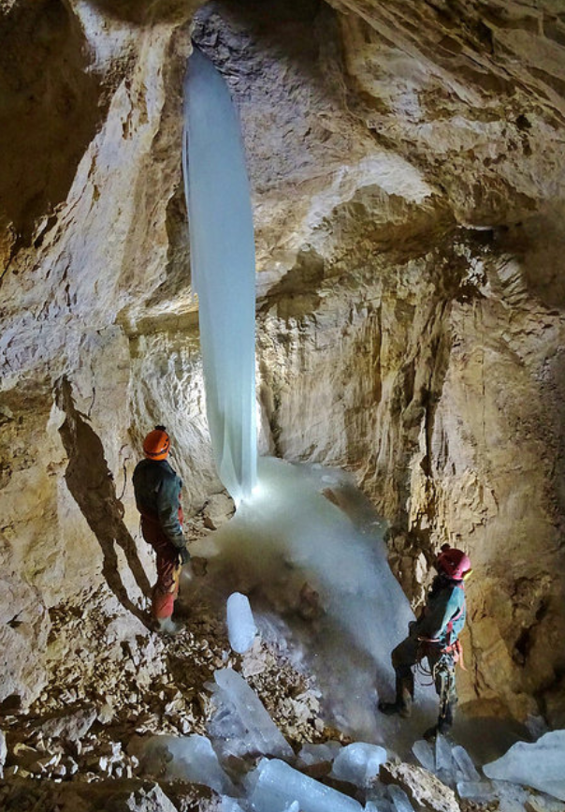
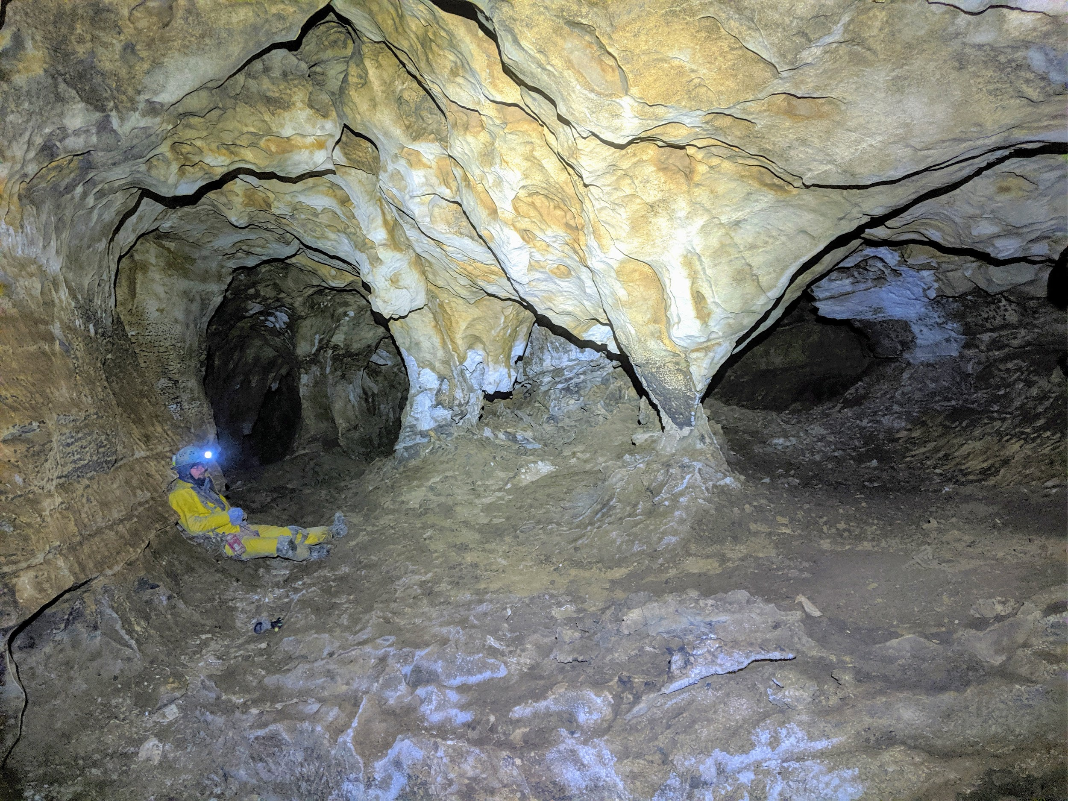
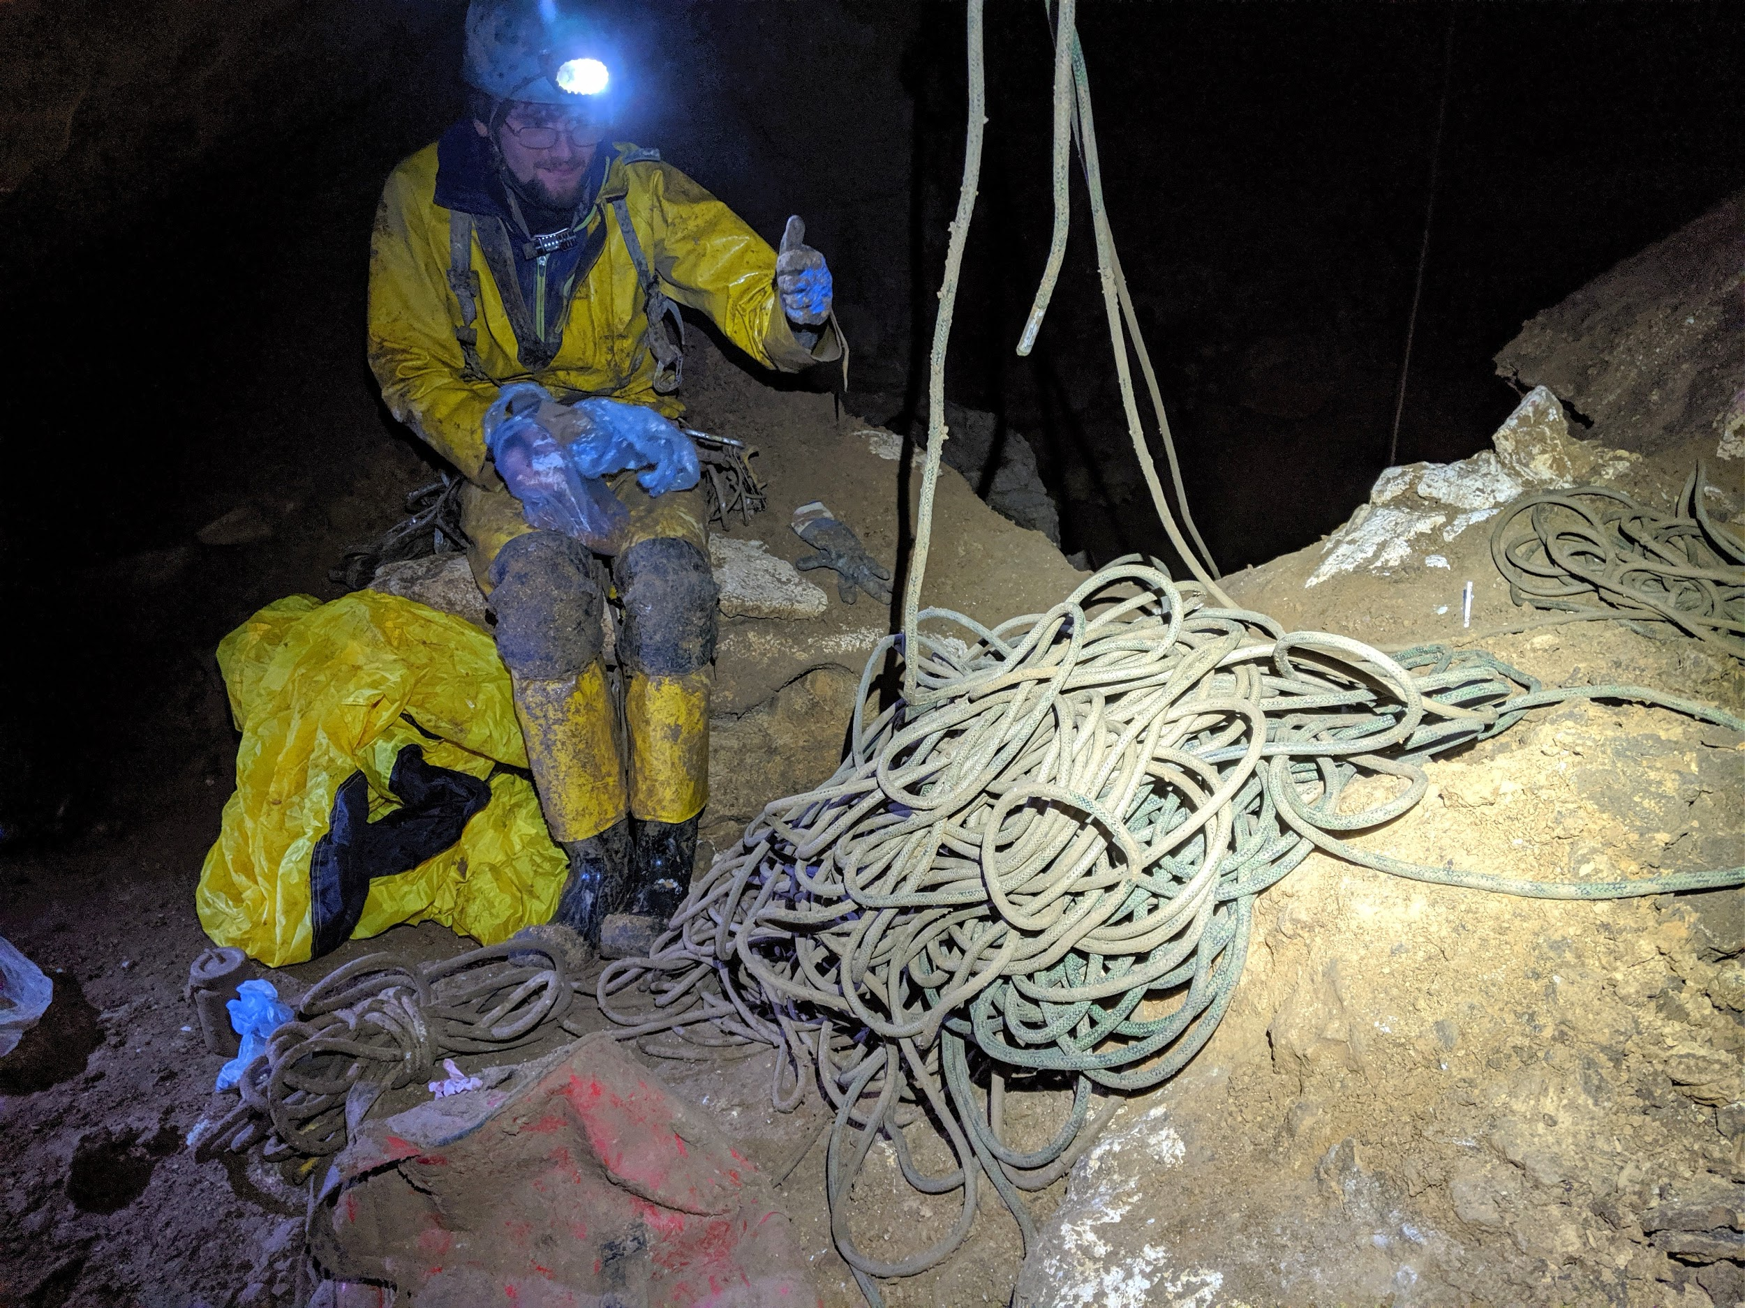
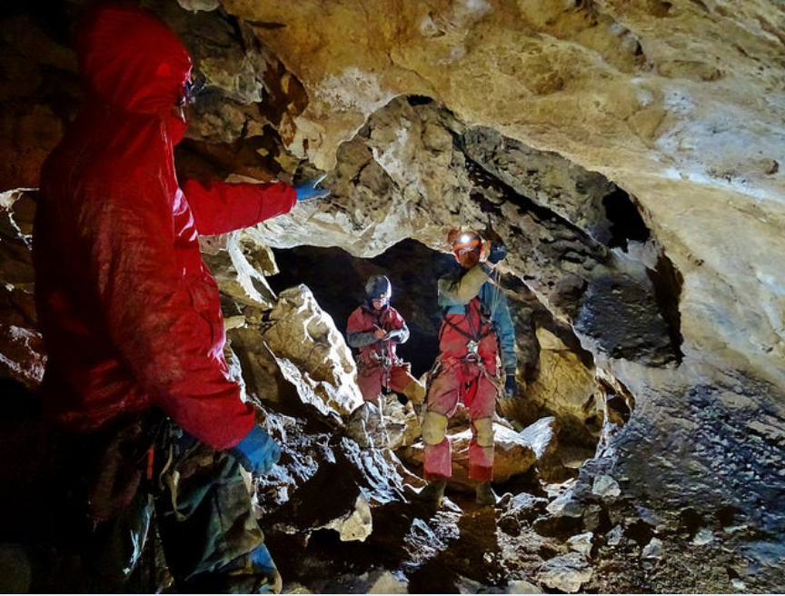
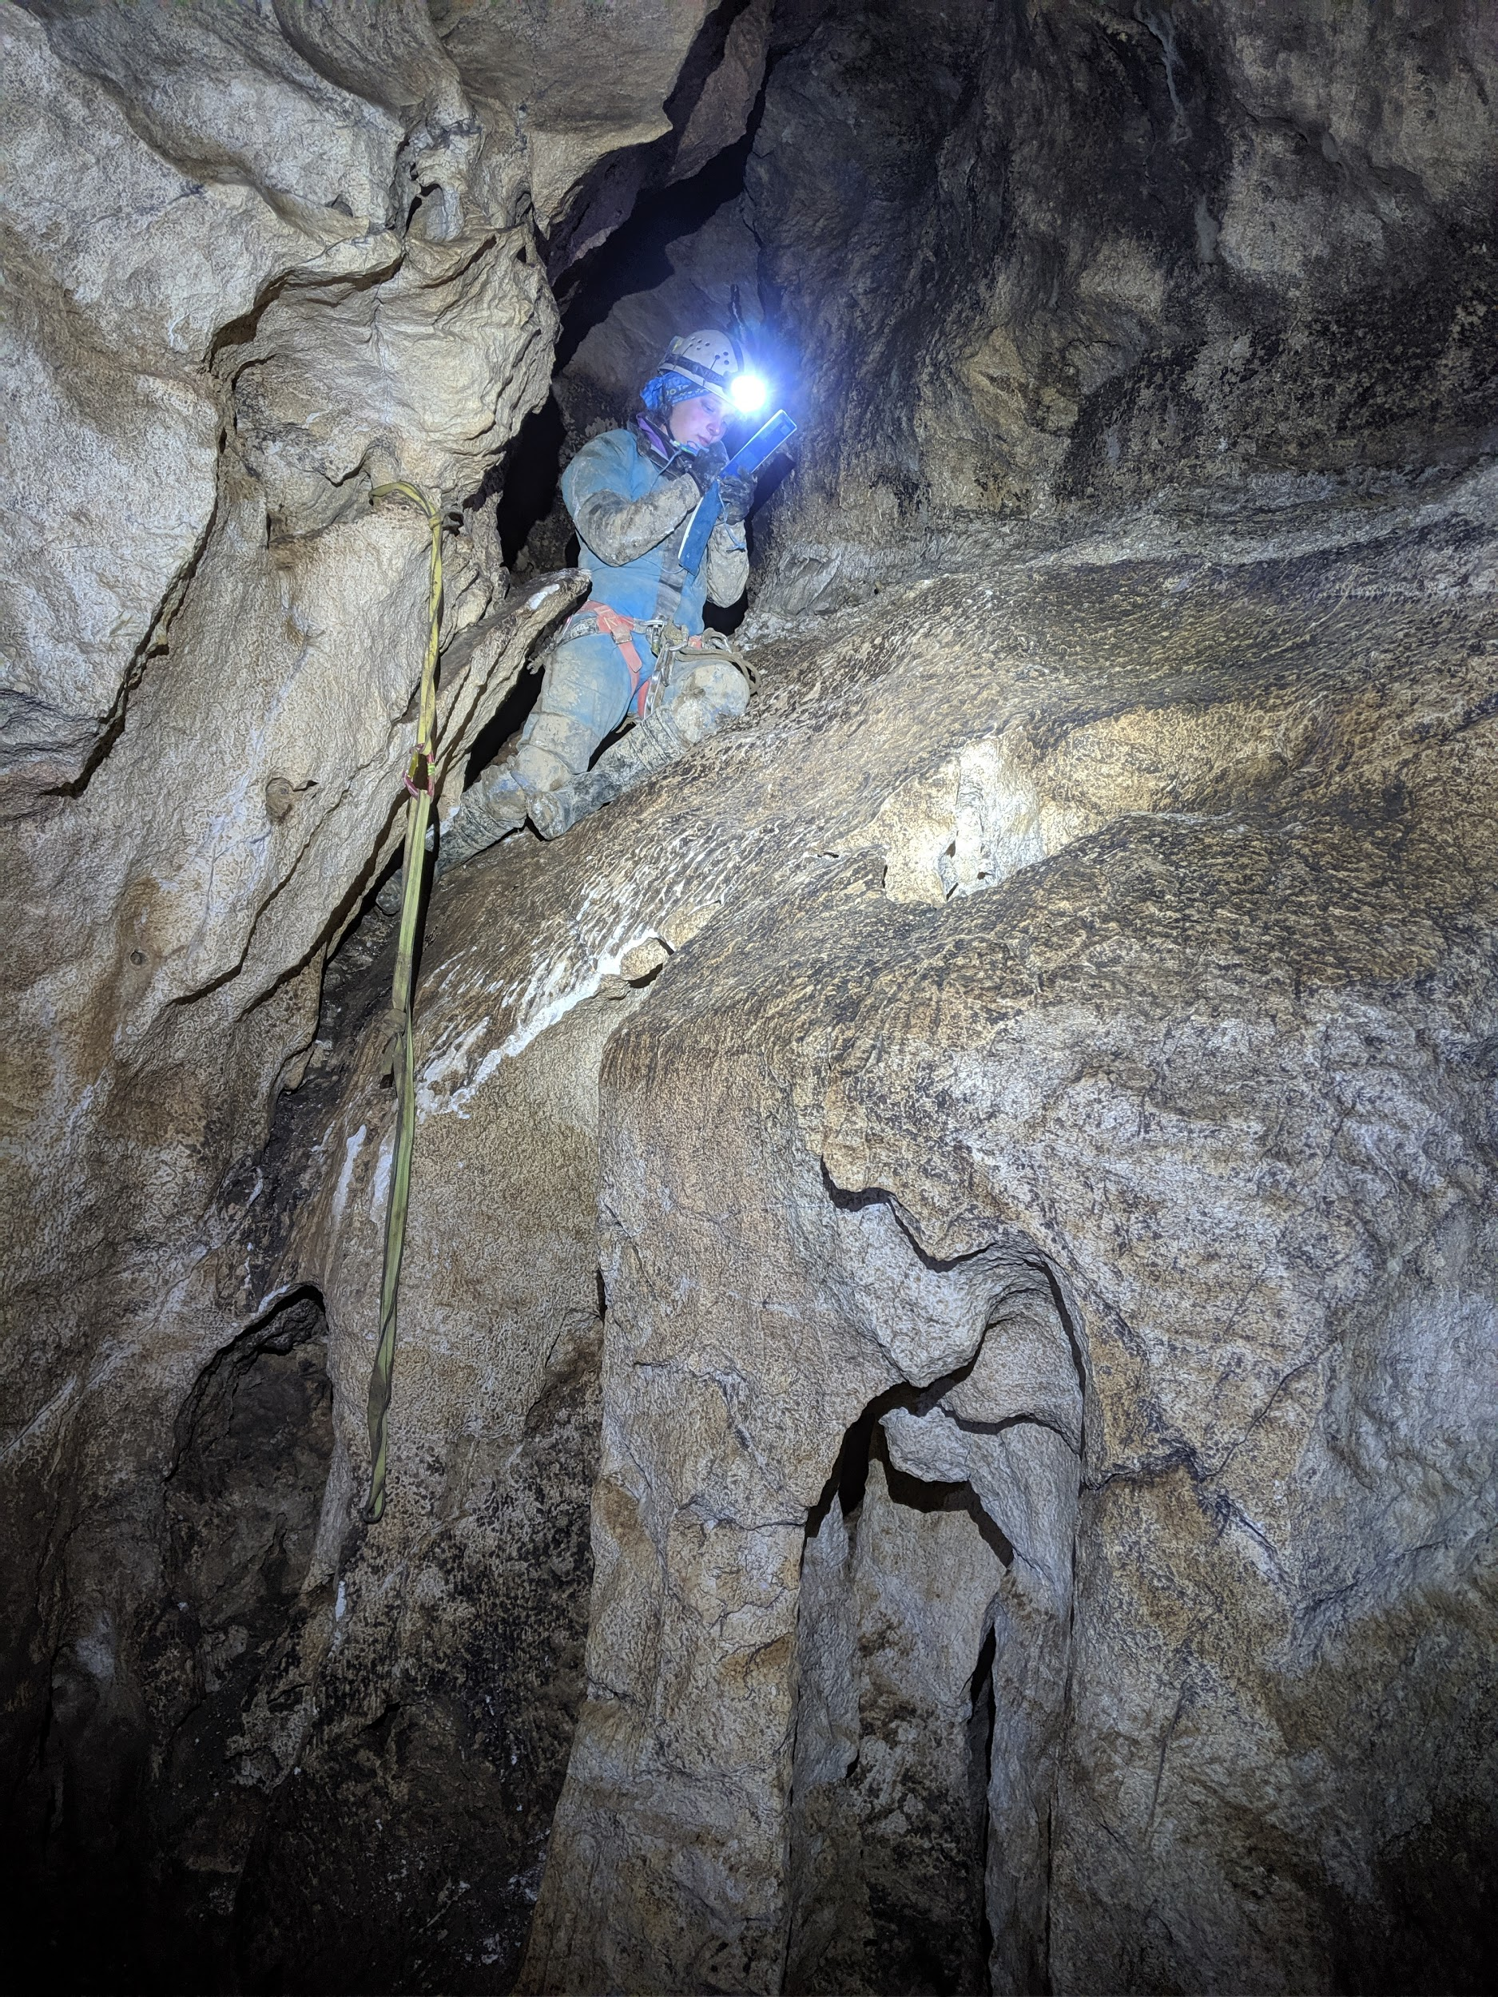
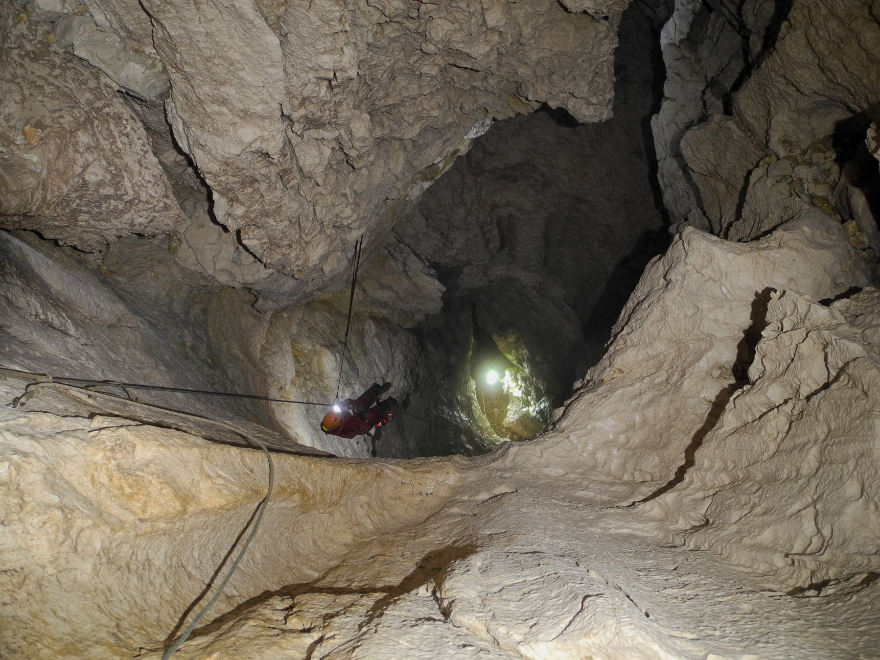
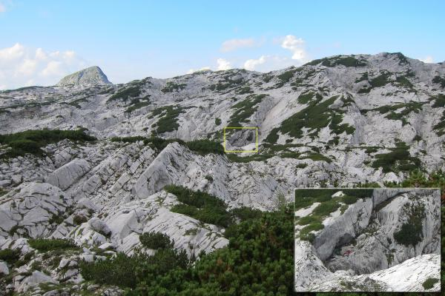
Balkonhohle 2014 - Present
Entrance ‘rediscovered’ 3 times before actually bolting the entrance series in 2014
Connected to Tunnocks in 2015
Combined Length: 36km
Combined Depth: -912m
Still plenty of leads to go at.

Slide 16
Heading west:
to the Schoenberg system!

Slide 17
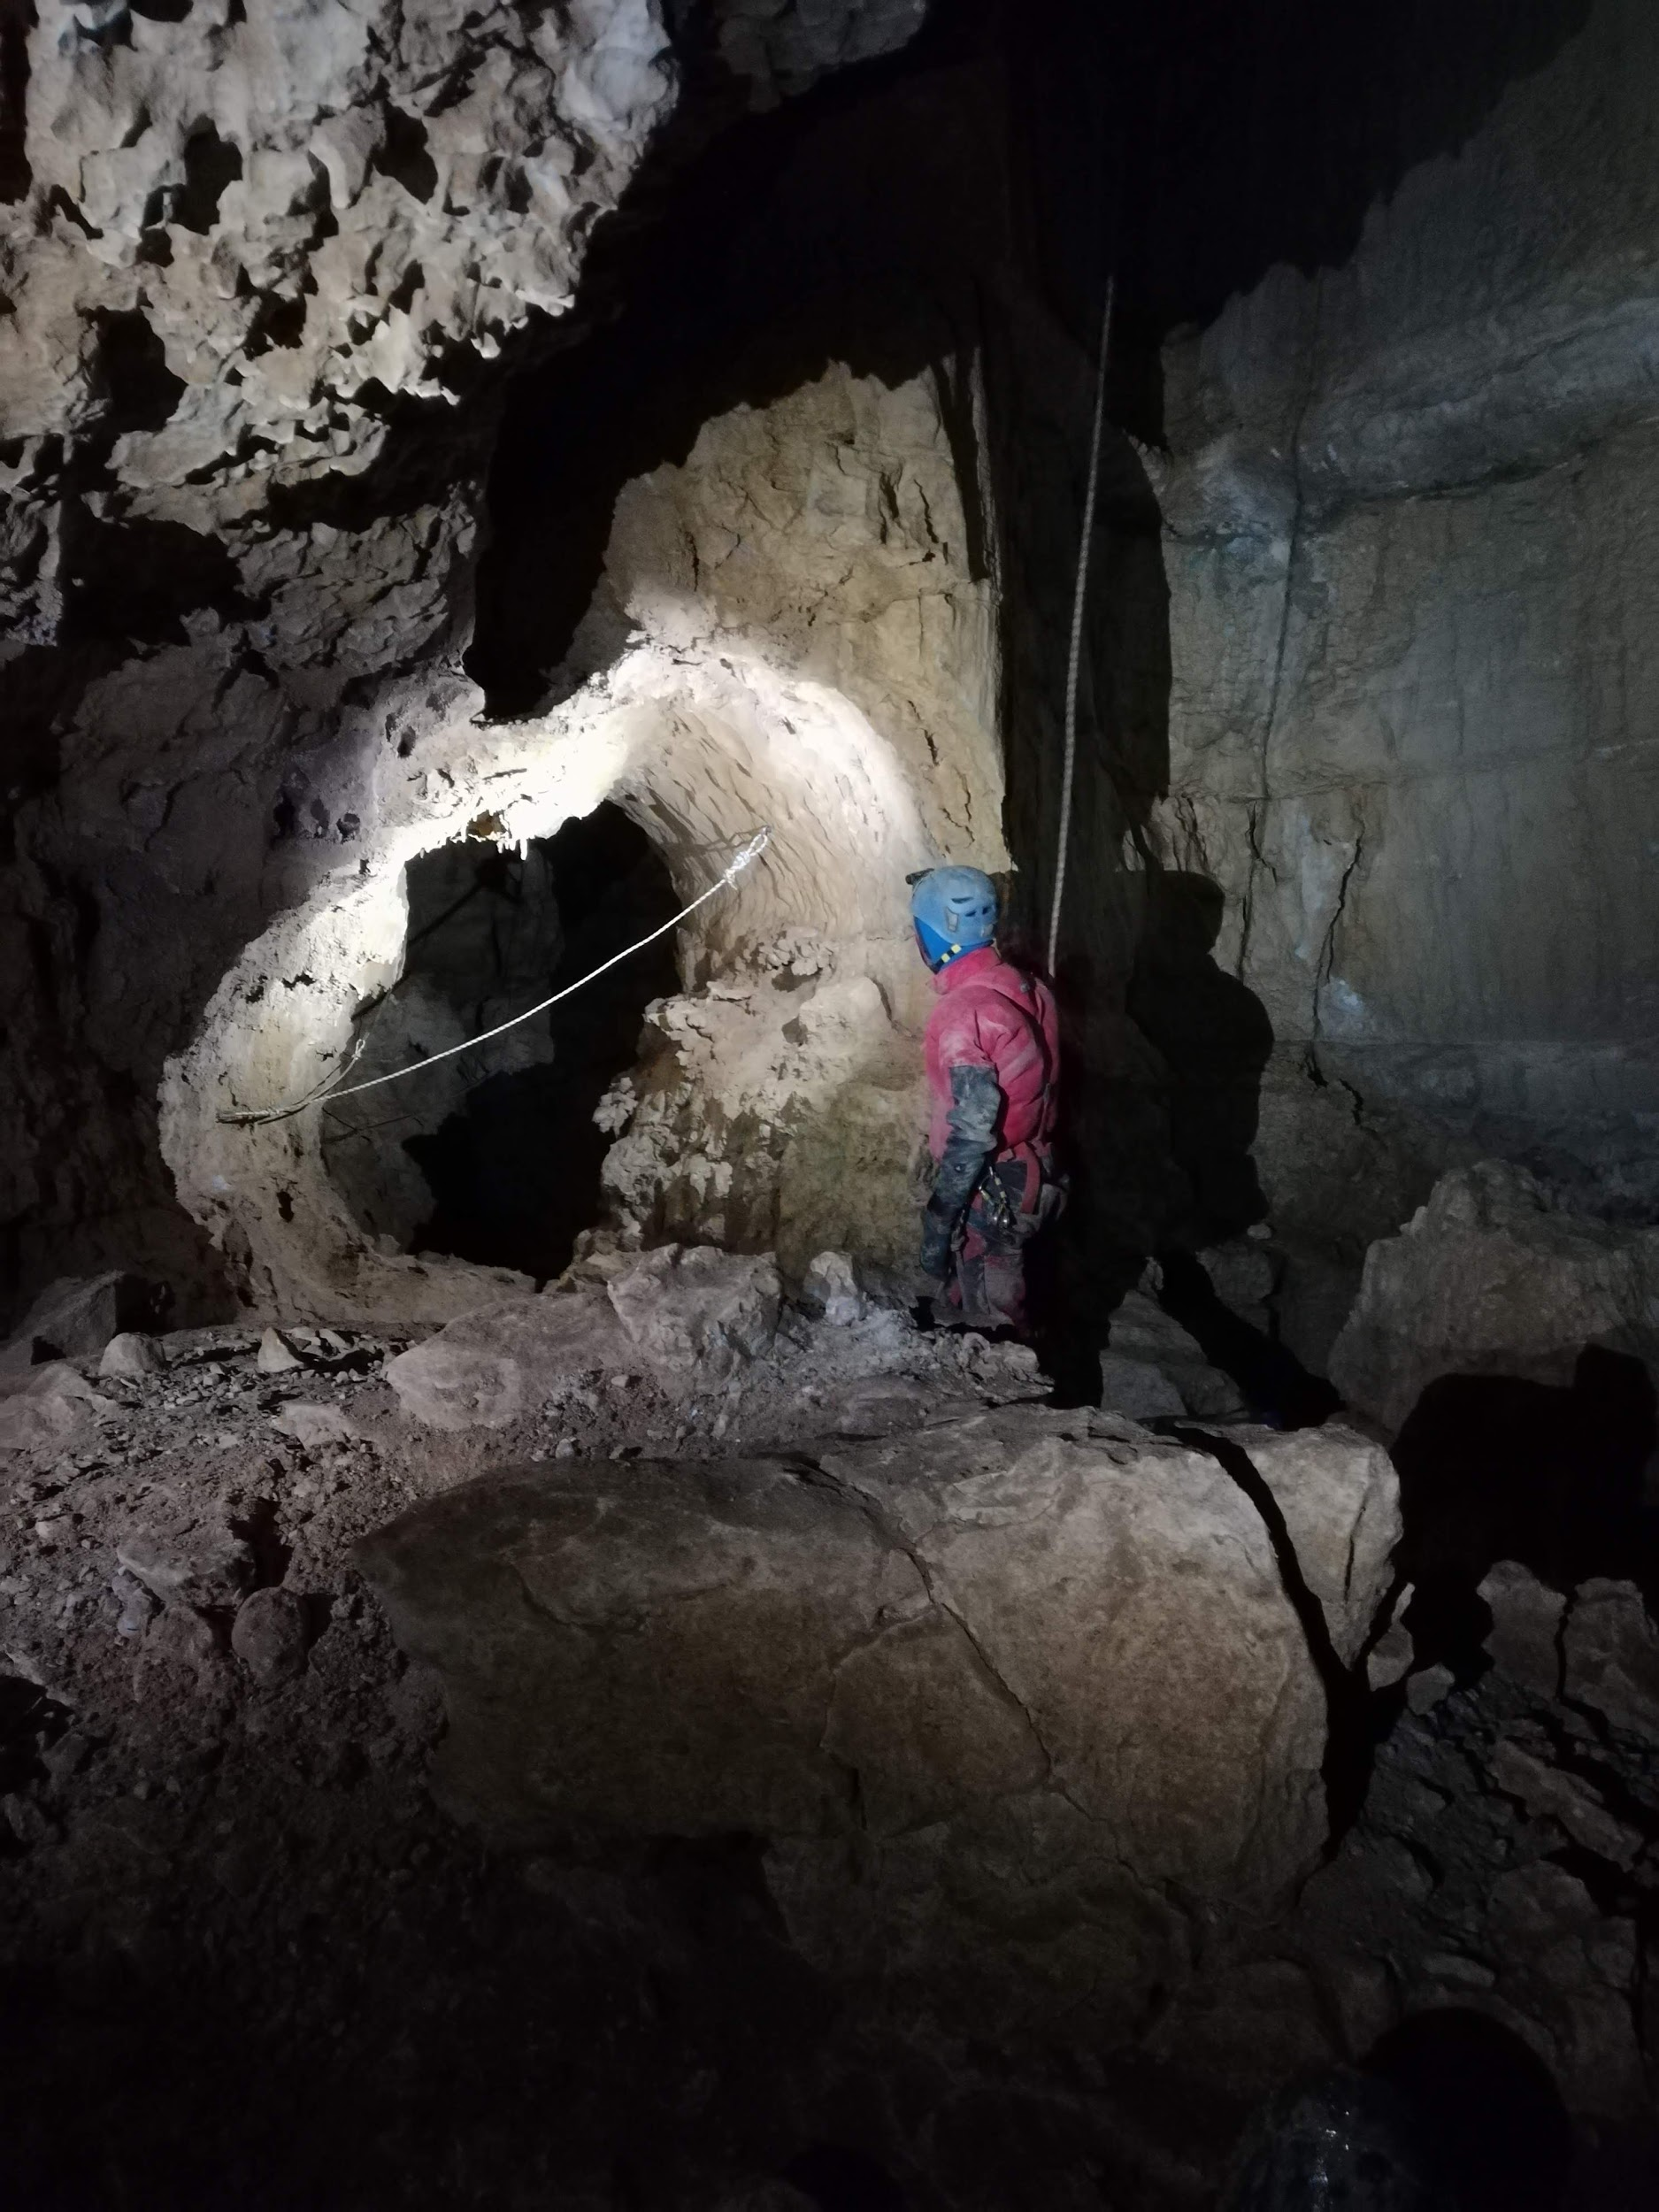
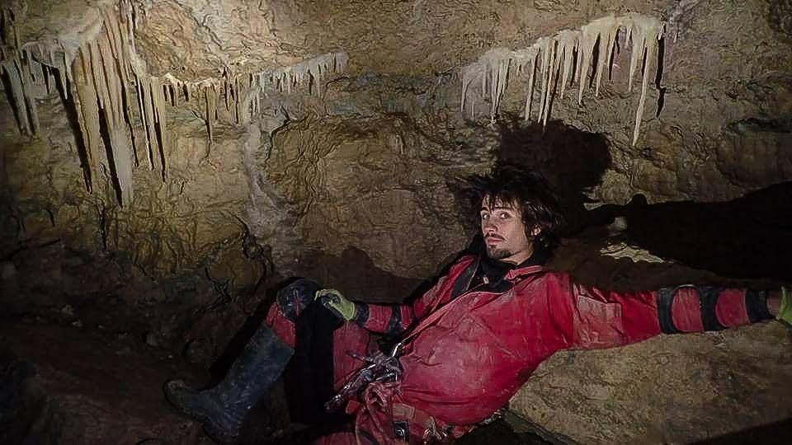
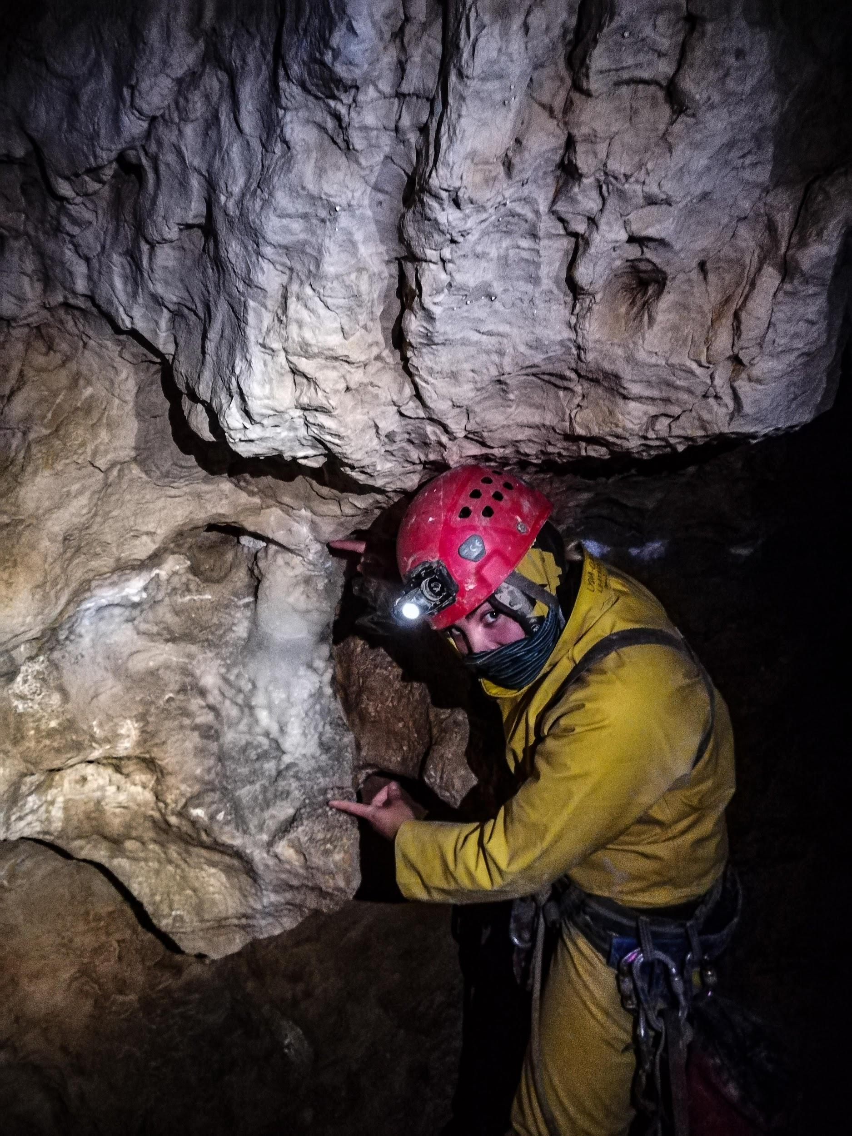
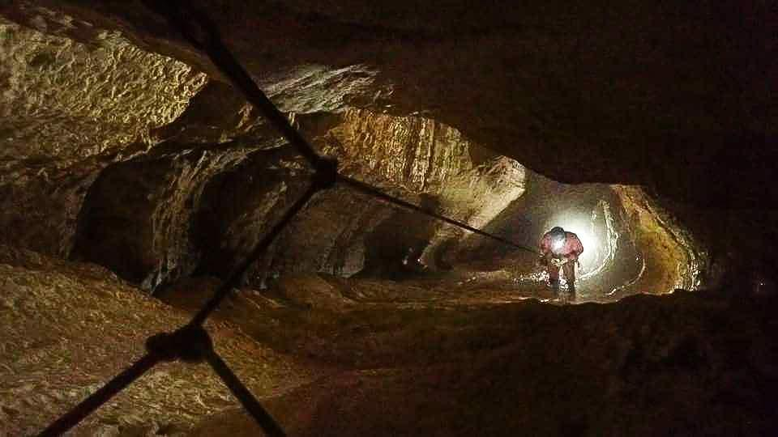
Fischgesicht Hohle 2017 - now

Slide 18
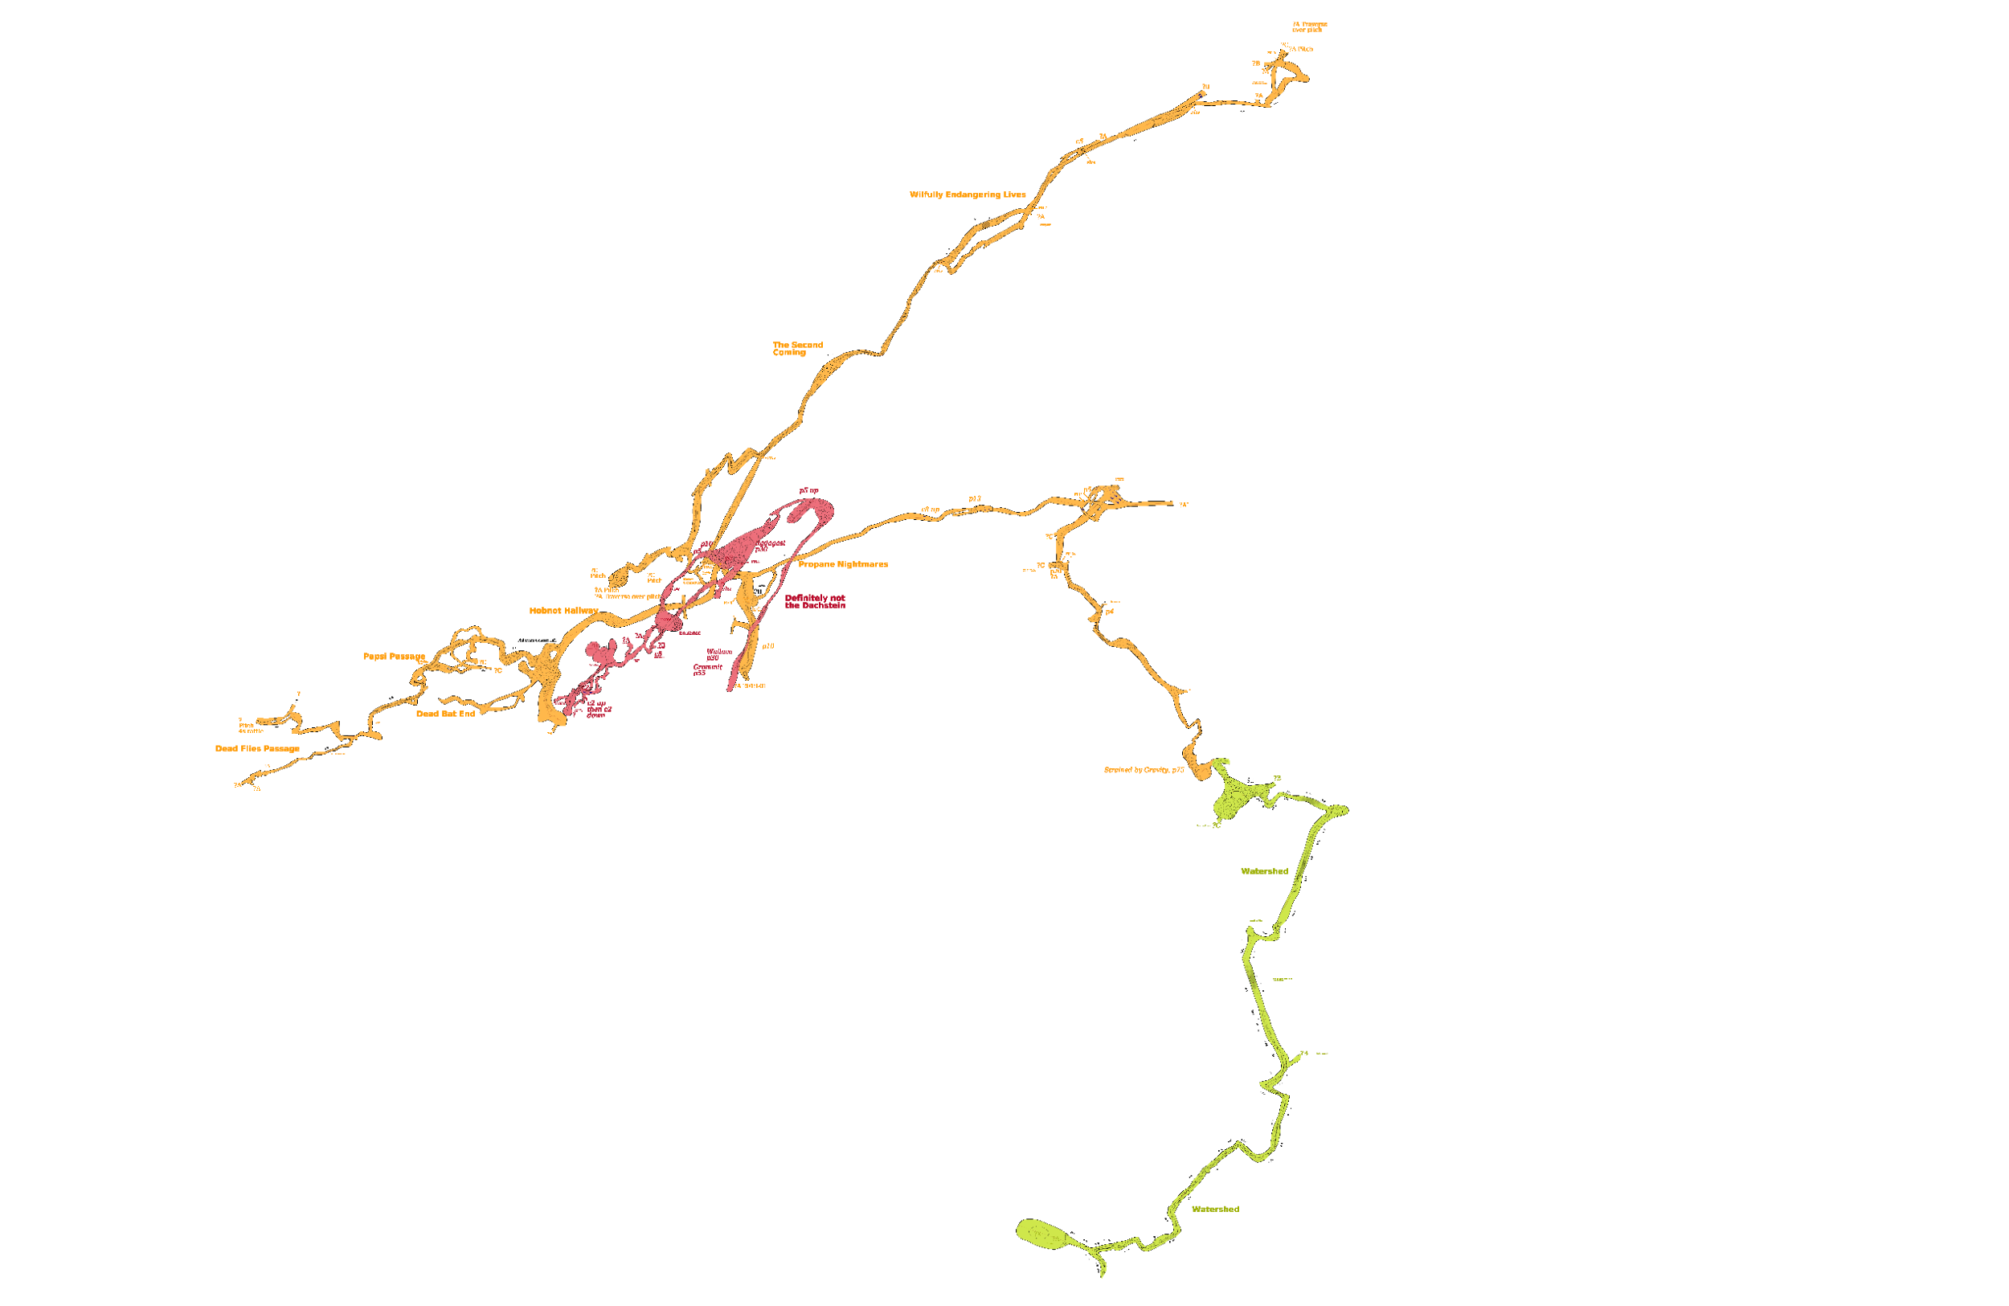
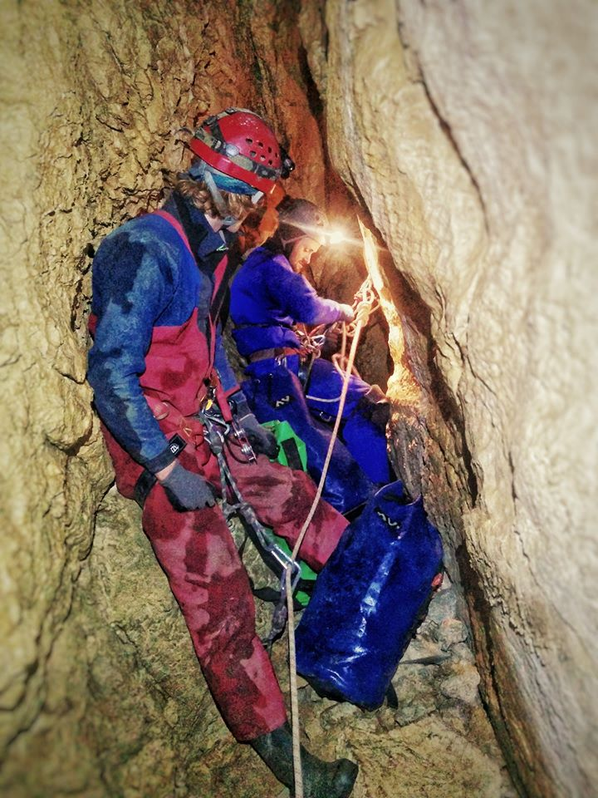
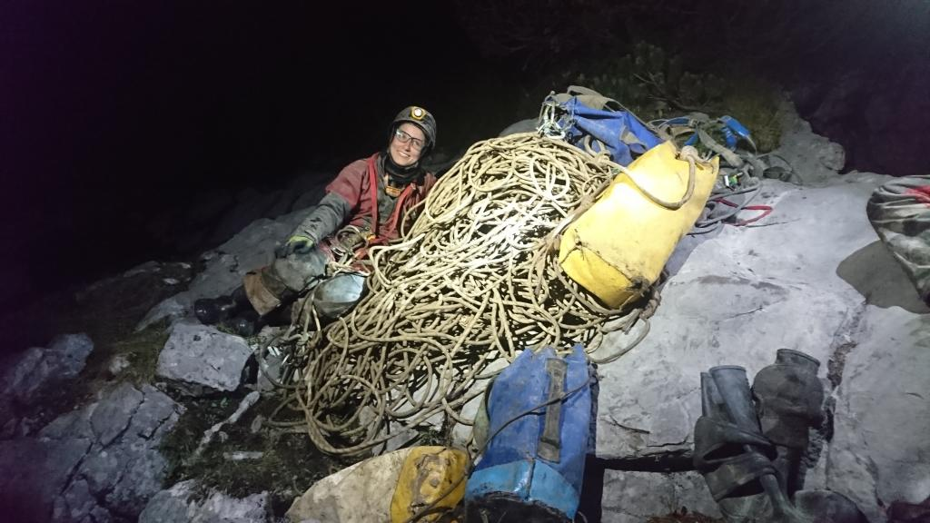
Homecoming 2018 - now

Slide 19
Expo 2020 - Objectives and moving forward
Cave Objectives: still under discussion but principally two options:
Continue to push Balkonhoehle from Steinbrucken
Focus more attention on caves further west and more focussed prospecting missions
Some combination of both? Hard to abandon any lead as they are all of such high quality!
Be as inclusive as possible: maintain a diverse and young attendance
Mentor system: experienced expo-goers will mentor new attendees throughout their attendance to ensure they get as much quality caving done and learn as many new skills as possible

Slide 20
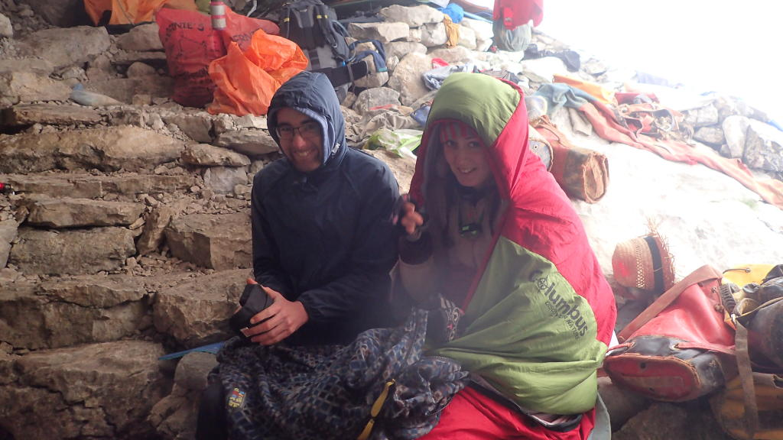
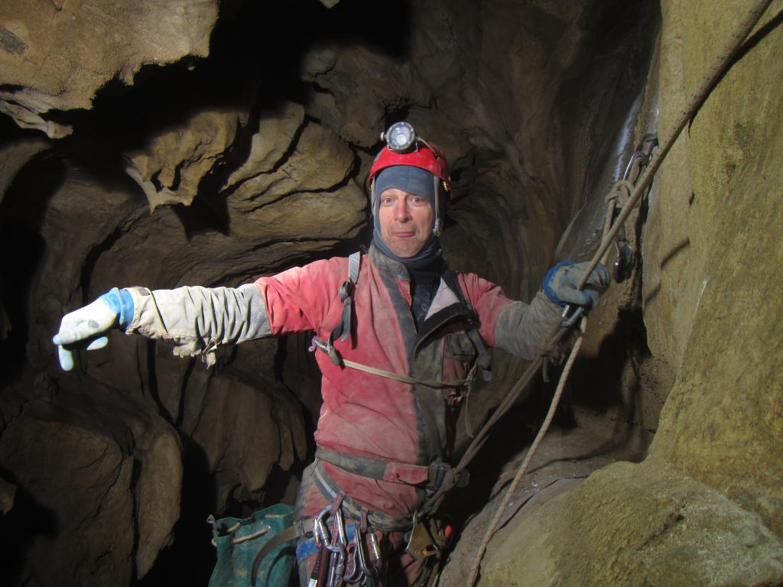
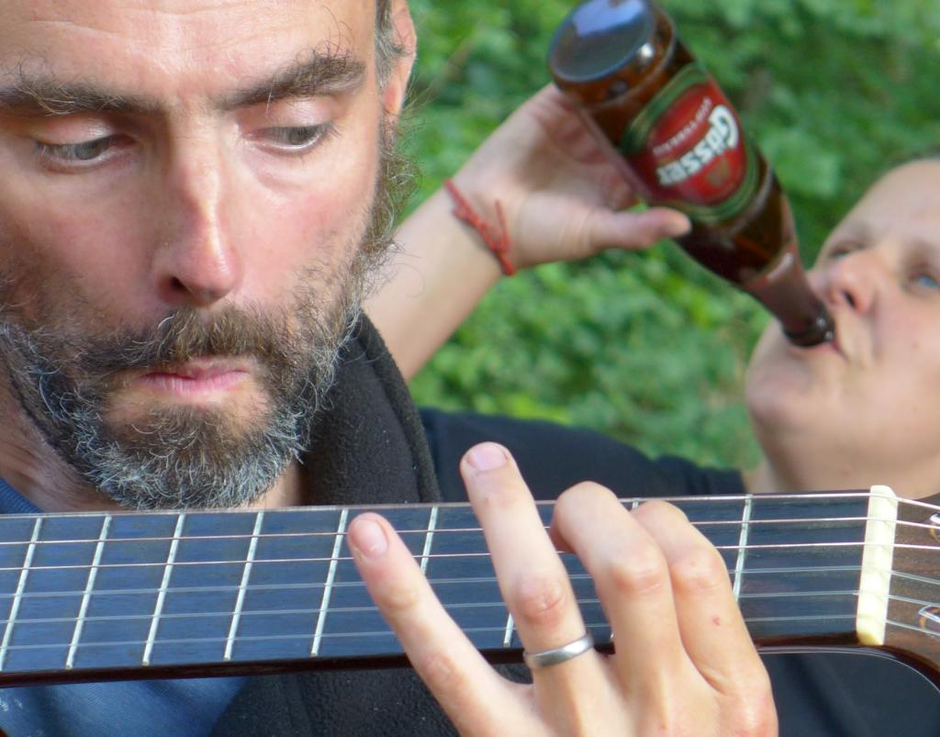
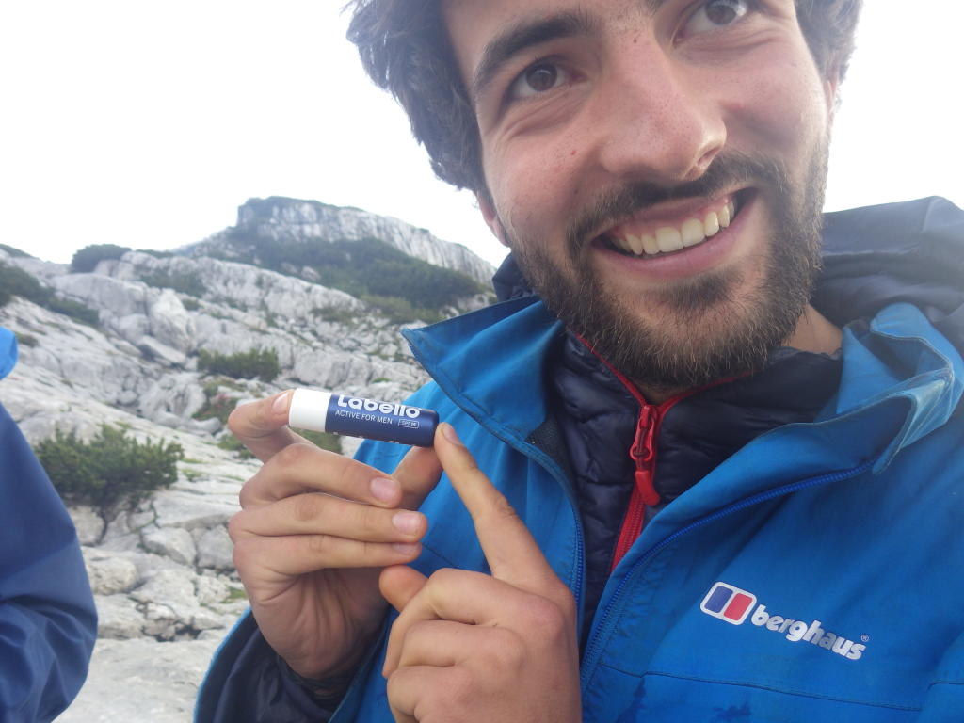
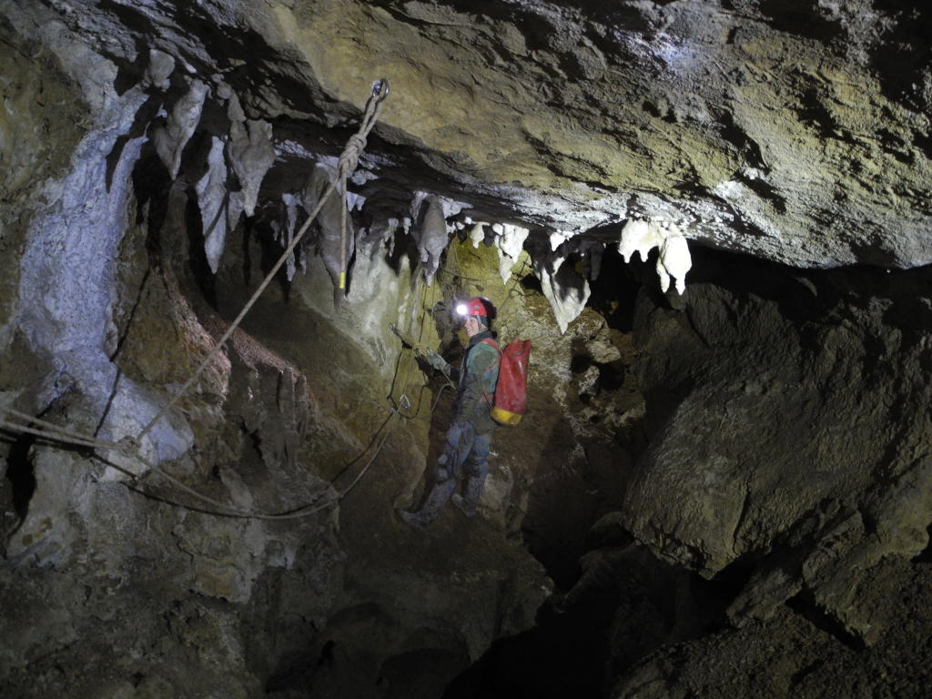
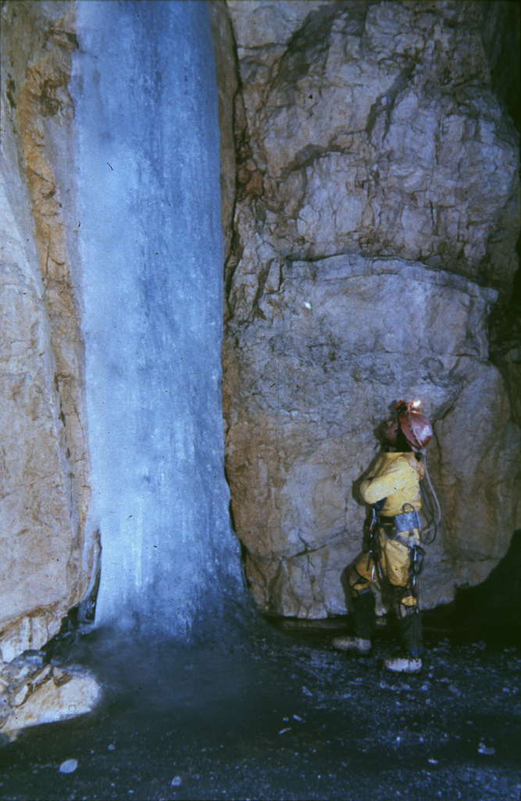
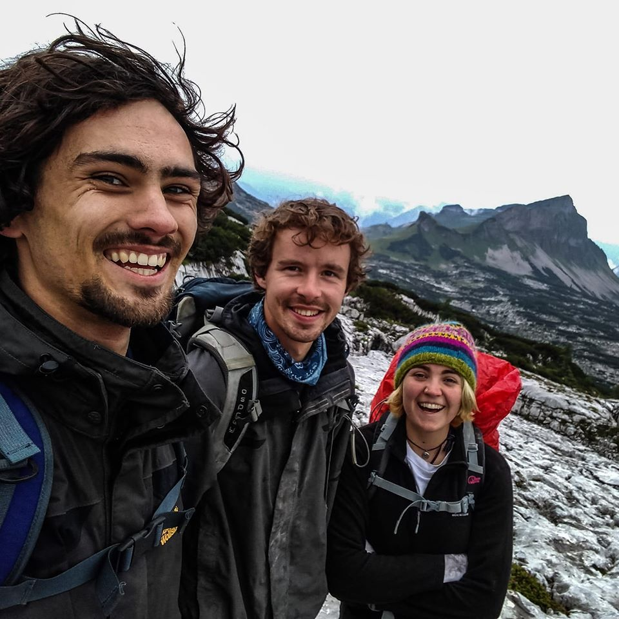
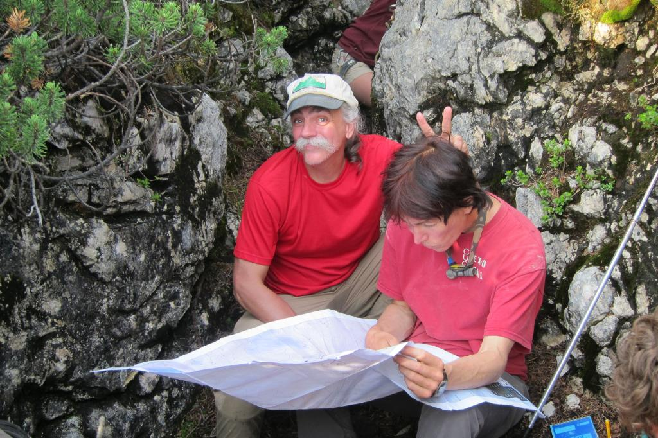
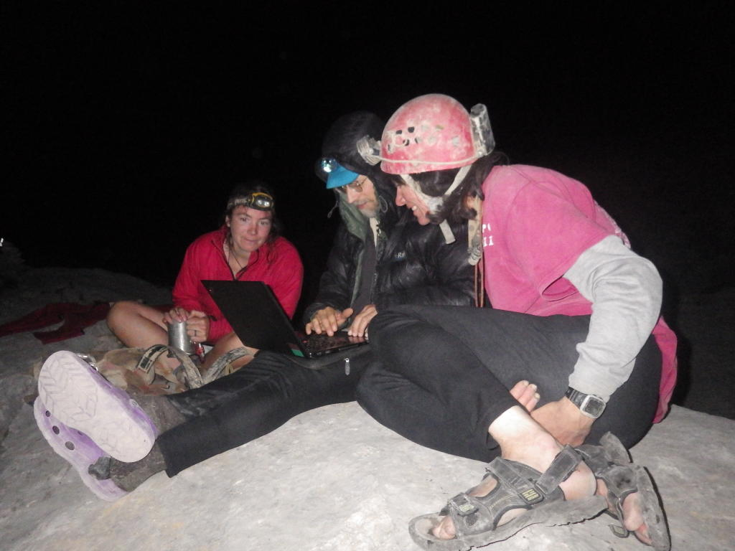
Thanks for listening - please talk to us about expo!

