Slide 1
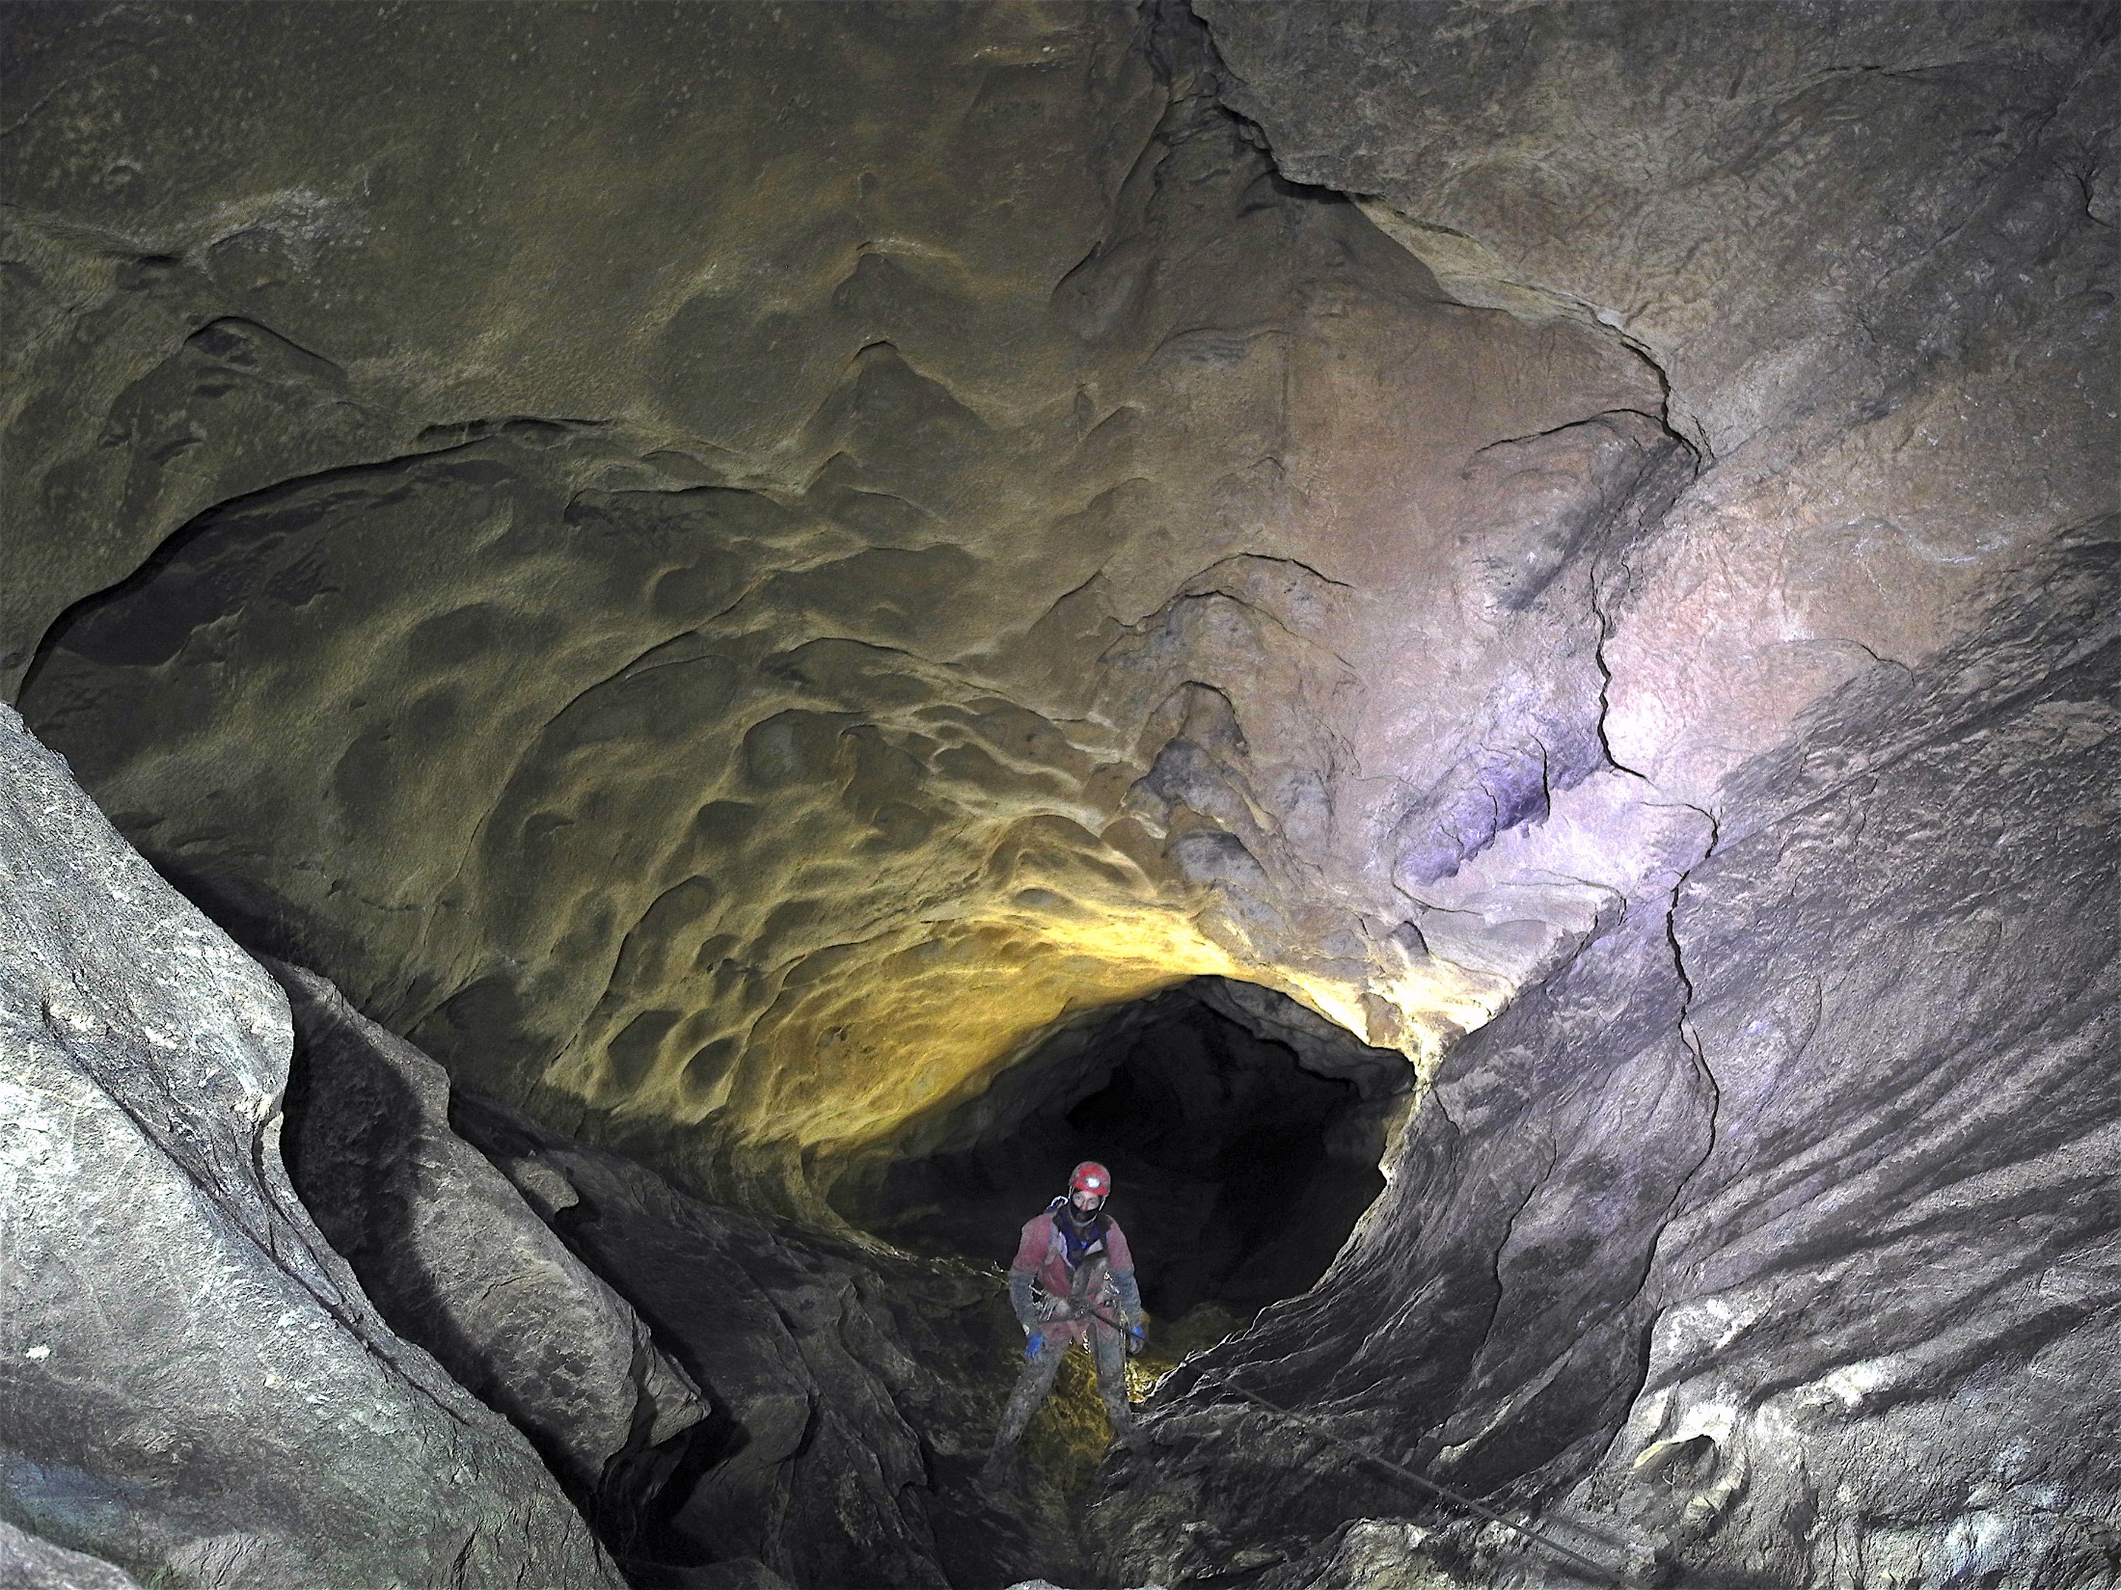
CUCC Expeditions to the SMK system, Loser Plateau, 1976 – 2017: discovering a European Supercave

Slide 4
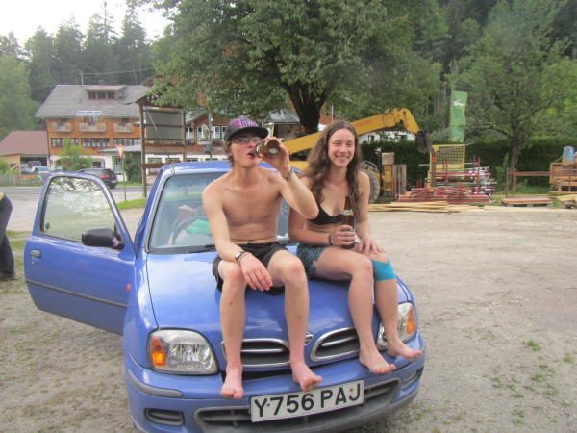
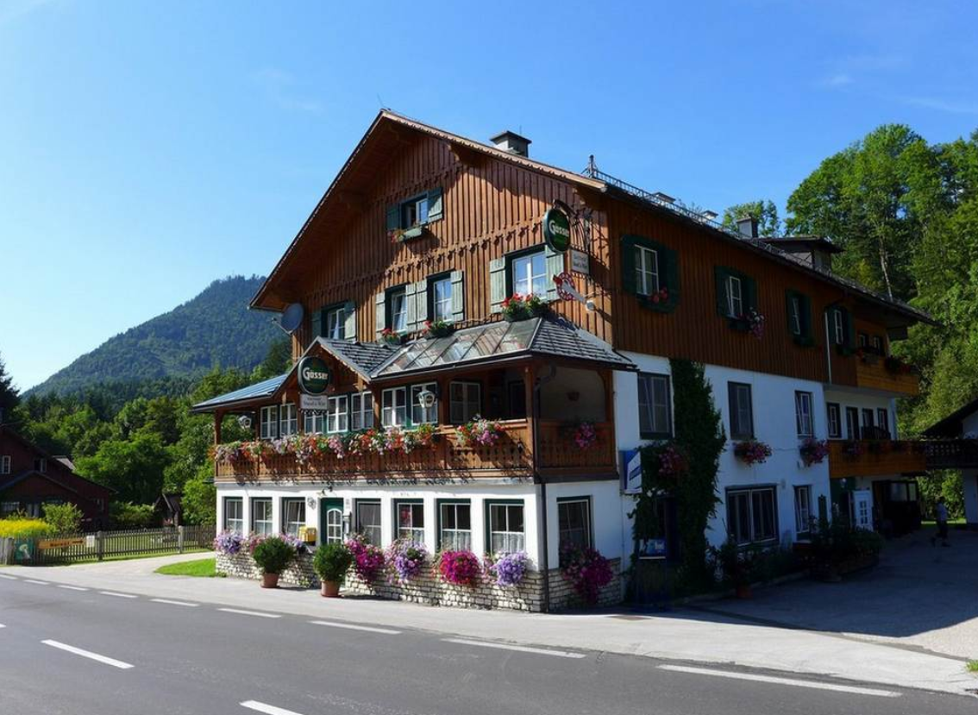
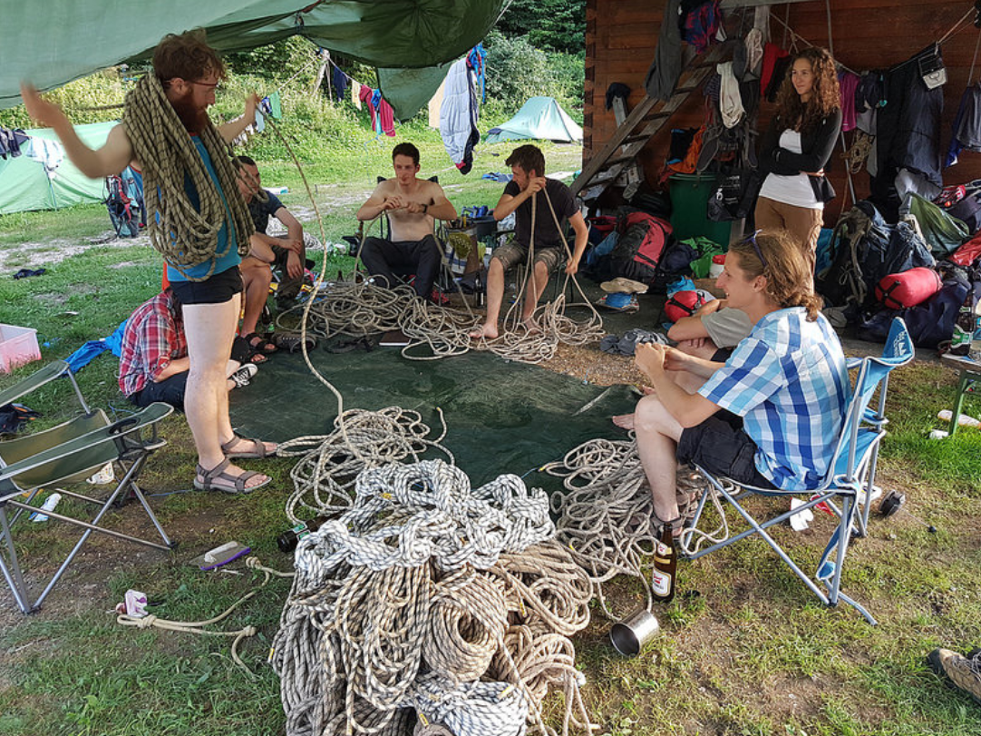
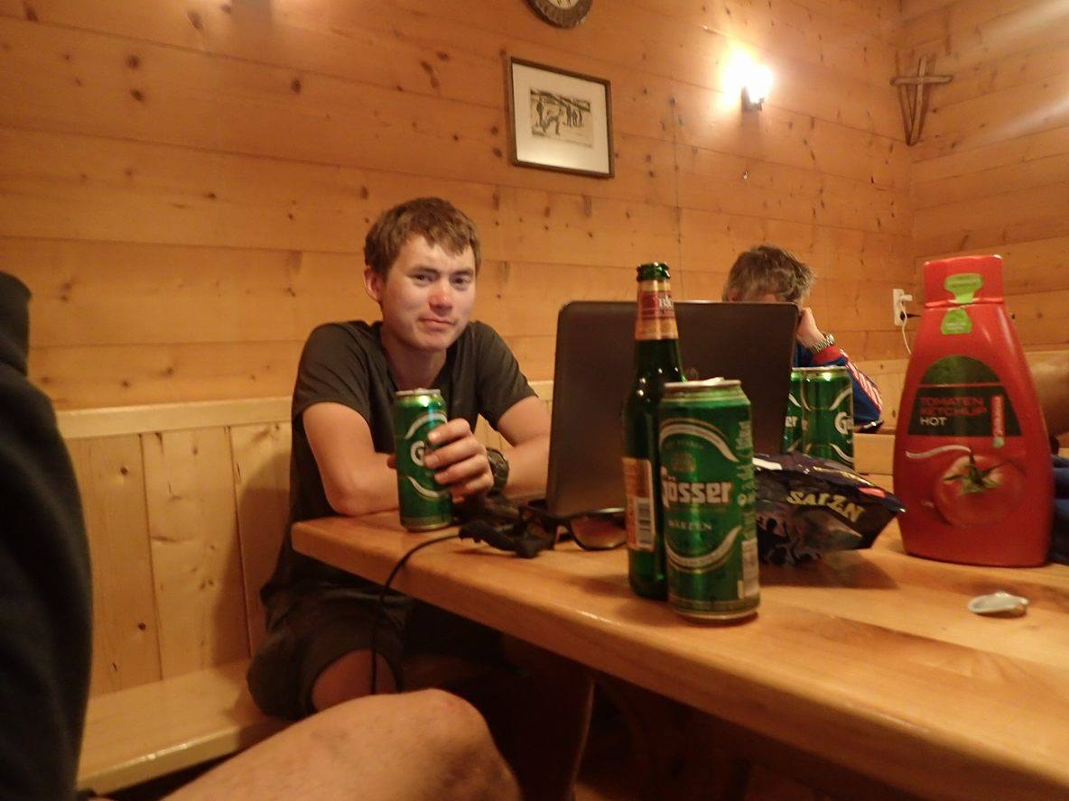
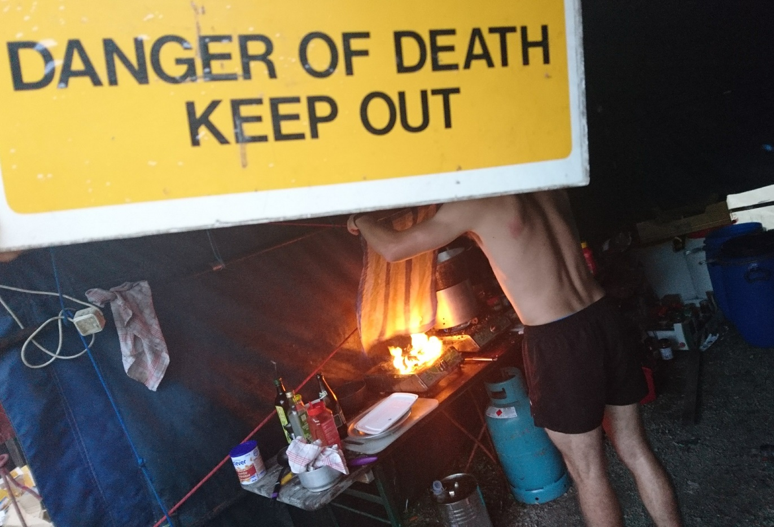
Gasthof Staud’n’wirt

Slide 5
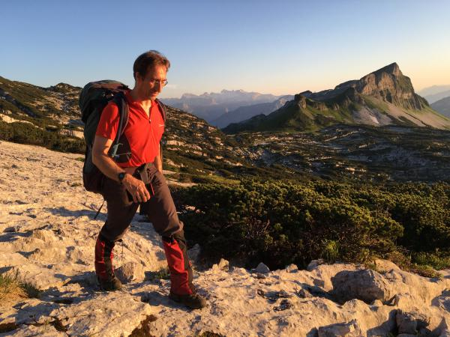
Steinbrucken bivvy
Altausee Lake - resurgence

Slide 6
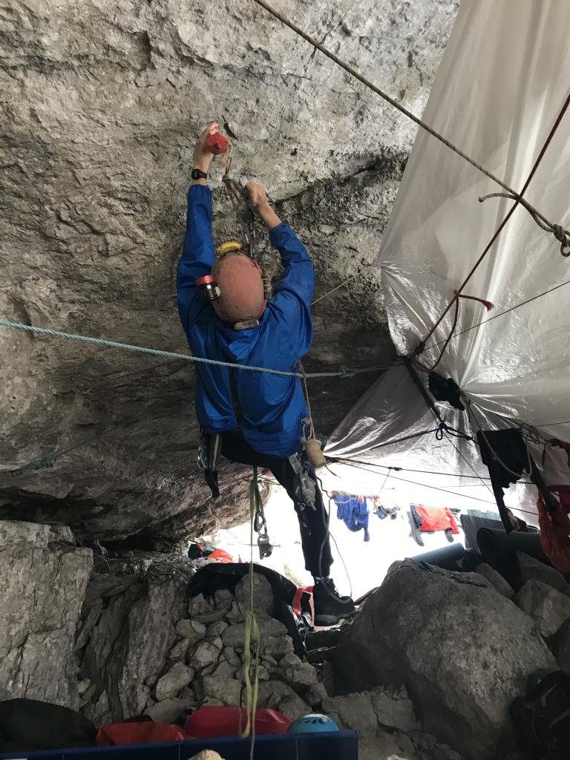
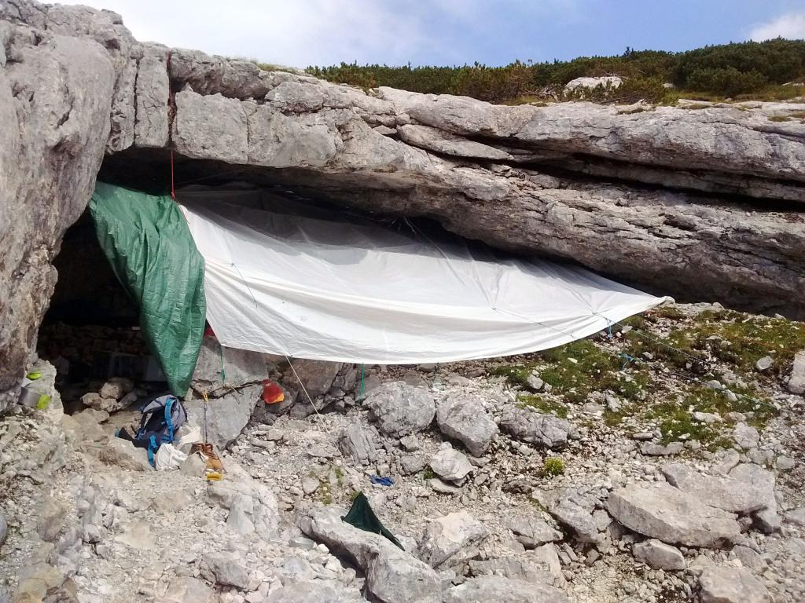
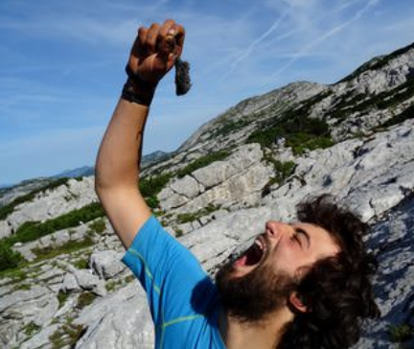
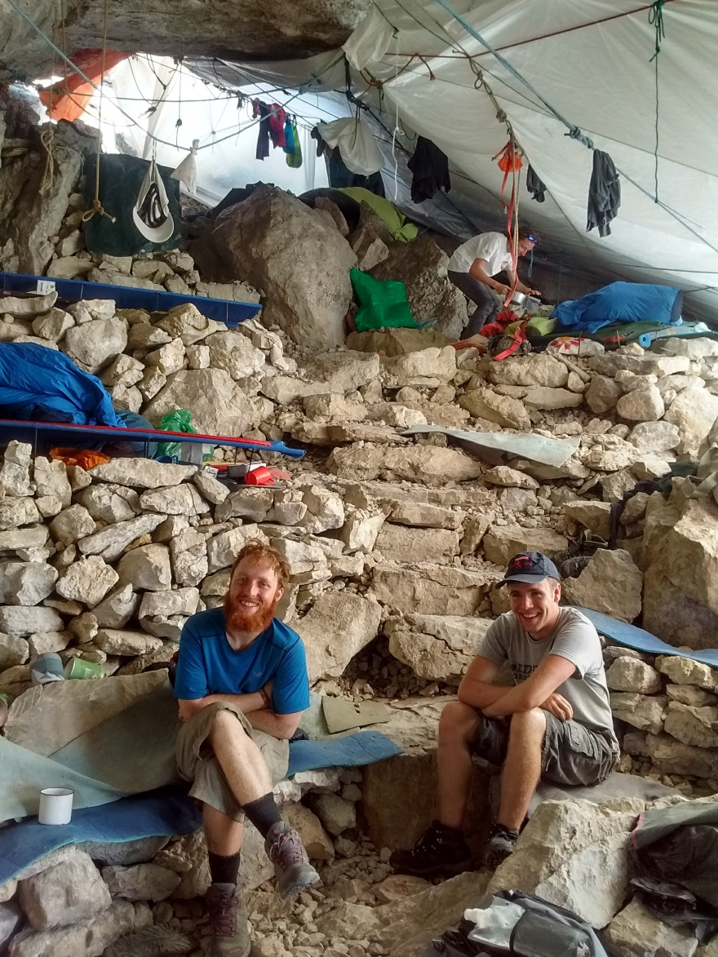

Slide 7
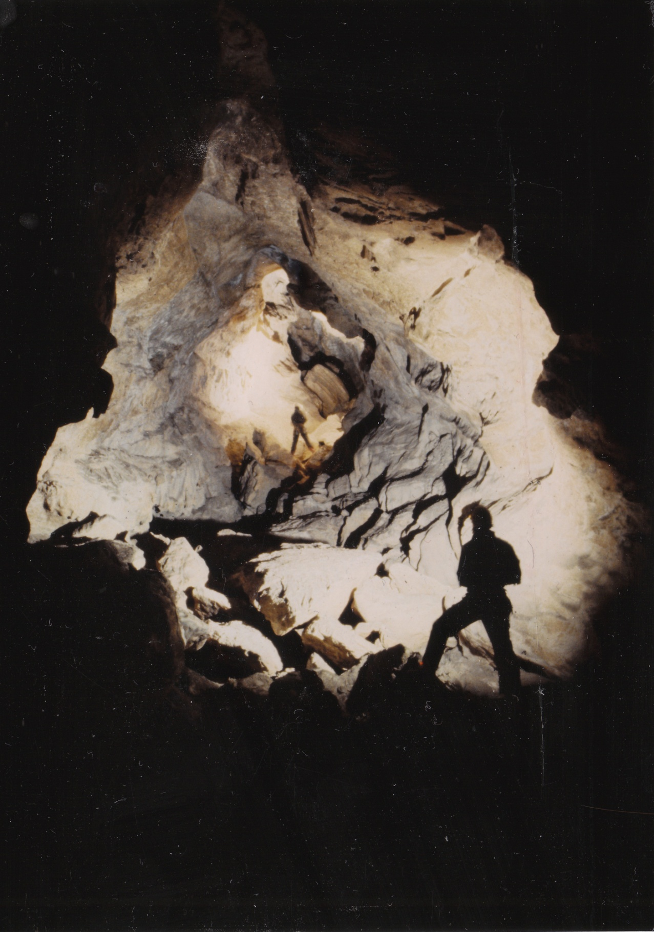
A bit of history… Stellerweg, 1982 - 1983:
Dartford Tunnel: big stuff from the beginning
Swimming duck at -800m, no wetsuit: they were hard
Sump at the end at altitude of Altausee lake: little potential for further finds here
Eishohle: caves are very cold, though ice disappearing rapidly nowadays

Slide 8
1982

Slide 9
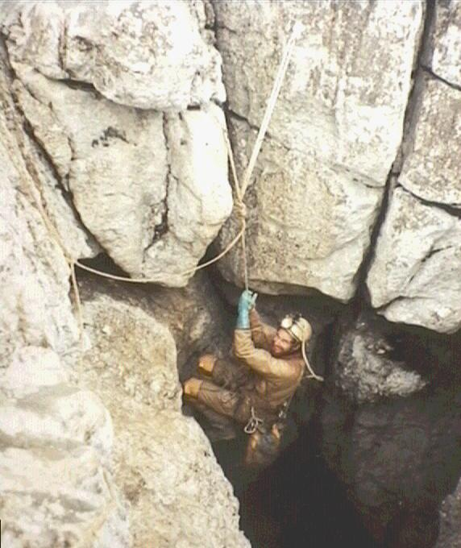
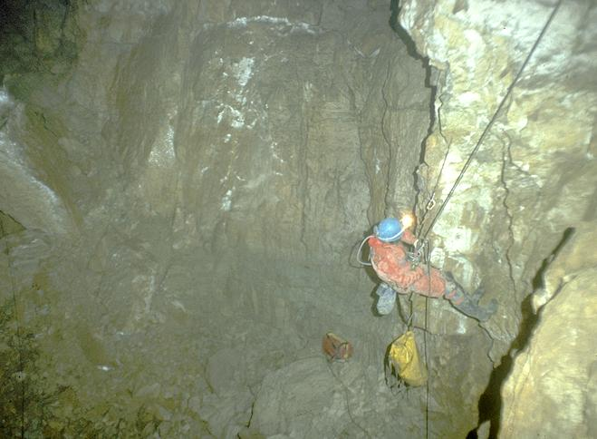
Kaninchenhohle, 1988 - 1996
extensive horizontal discoveries along with vertical gain: connecting up entrances across the system is a viable exploratory goal

Slide 10
1996

Slide 11
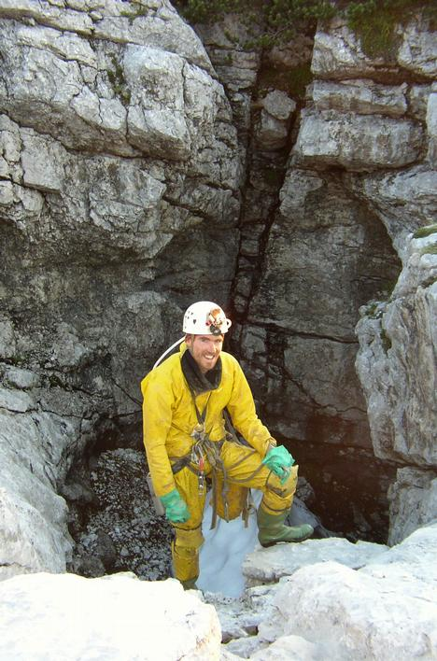
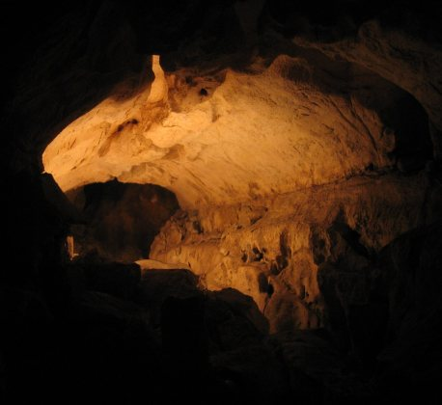
Steinbruckenhohle, 1999 - 2007
Entrance right next to Top Camp - handy
More deep stuff leading to another streamway and sump – Subway and Razordance

Slide 12
2007

Slide 13
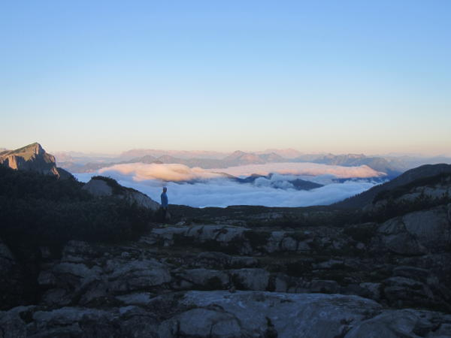
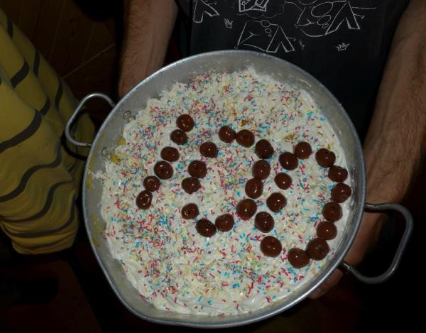
The millennial era: 2008 - present
Outreach of CUCC to other university clubs, particularly ULSA and UBSS
Attendance is on the up, the cave is getting BIG
What are we hoping to achieve?
Introduce as many new young cavers to alpine exploratory caving as possible in accessible but challenging caves
Keep making the system longer and deeper: currently the fourth longest and deepest (combined measure) in the world
Connect to neighbouring Schoenberg system to create an alpine ‘supercave’
Have fun and keep the computers dry

Slide 14
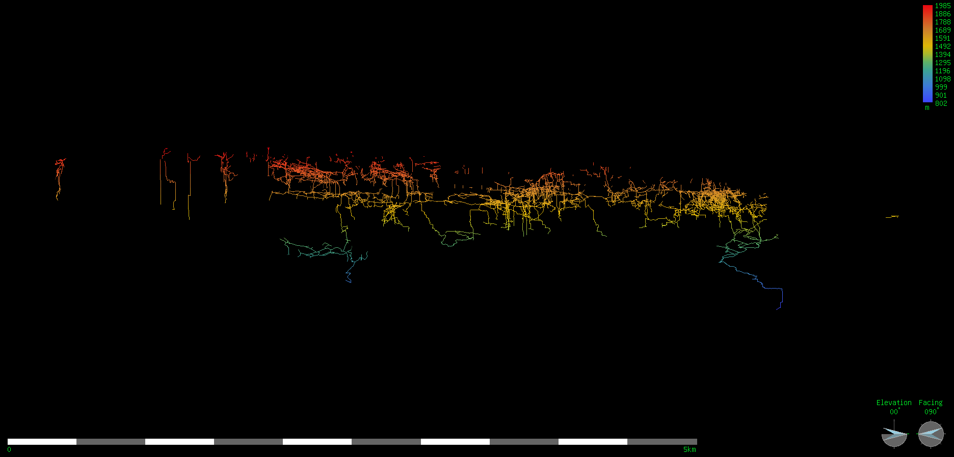
SMK system status, 2016:
120km long
1122m deep
Over 50km discovered in 10 years!
Where is all this new cave?
razor dance sump
stellerweg sump
Elevation, looking east

Slide 15
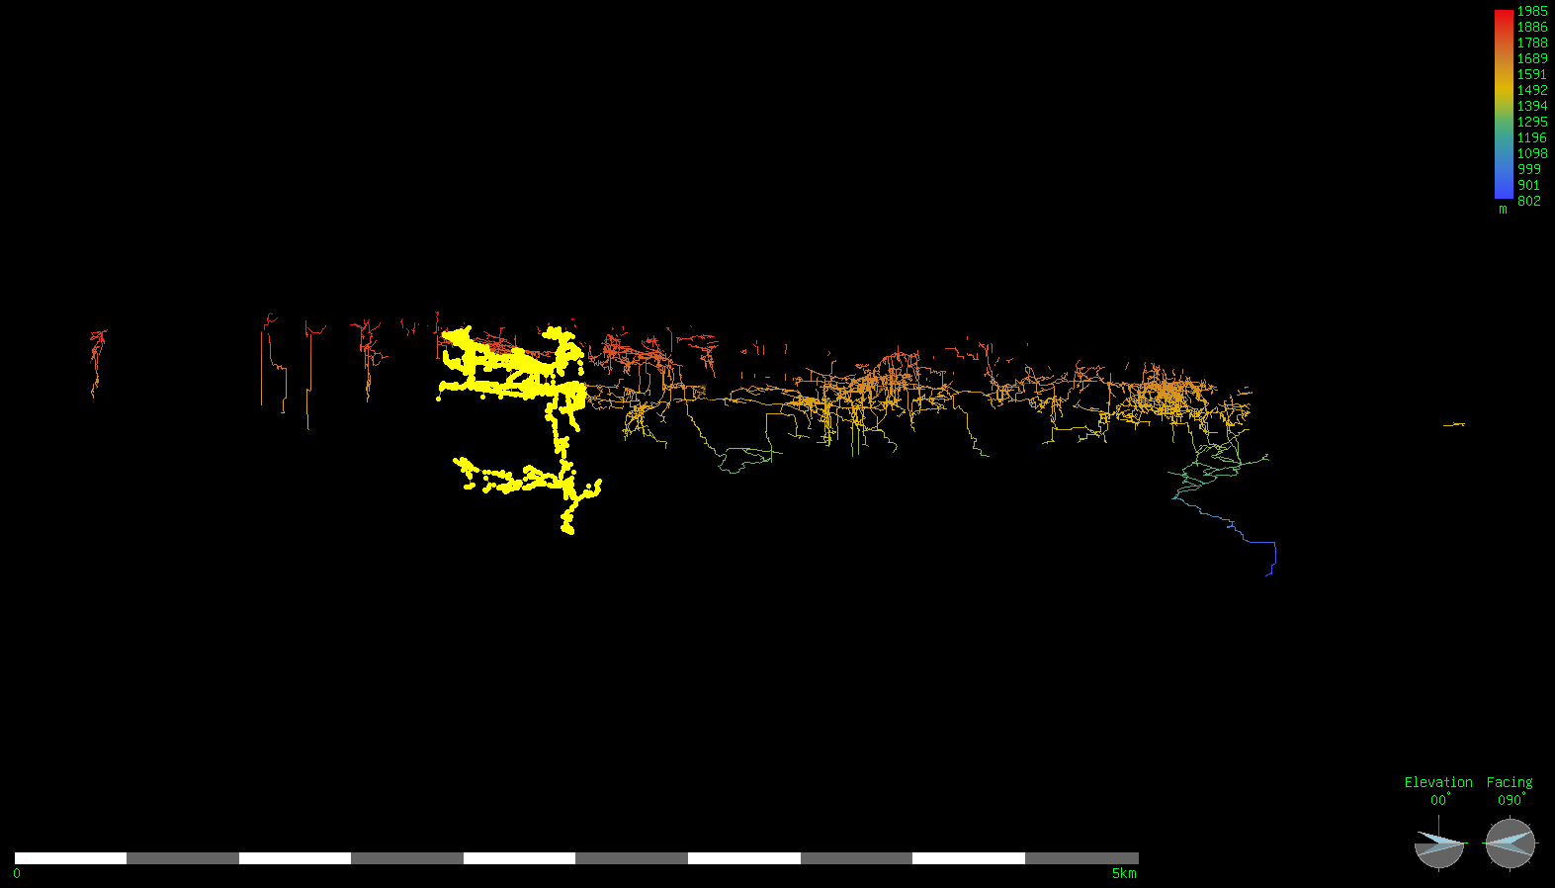
Tunnockschacht

Slide 16
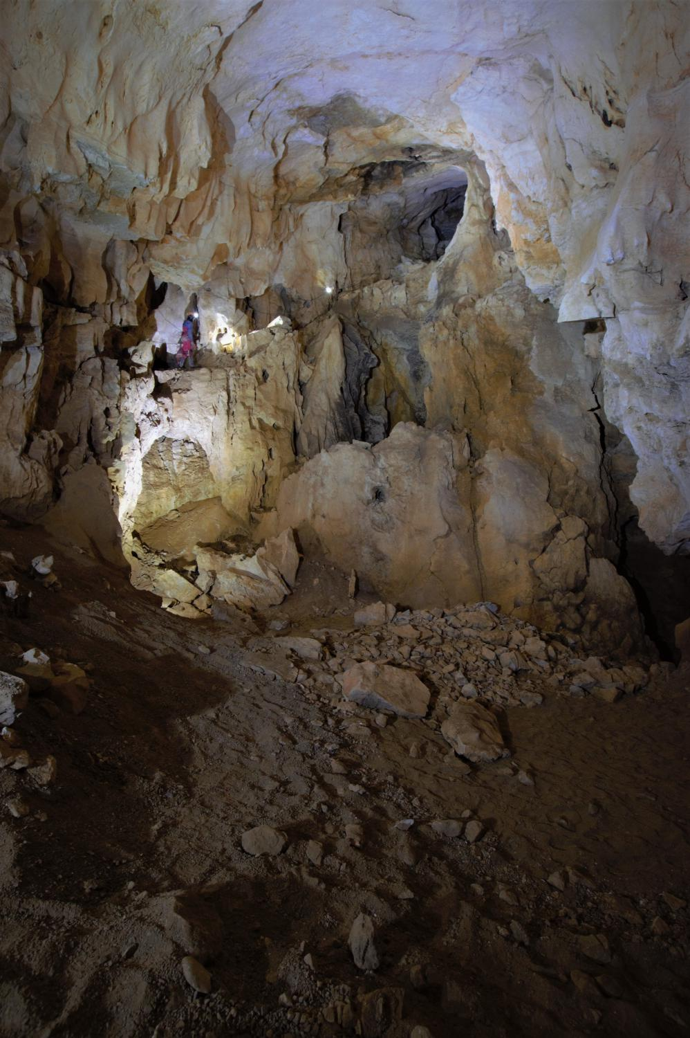
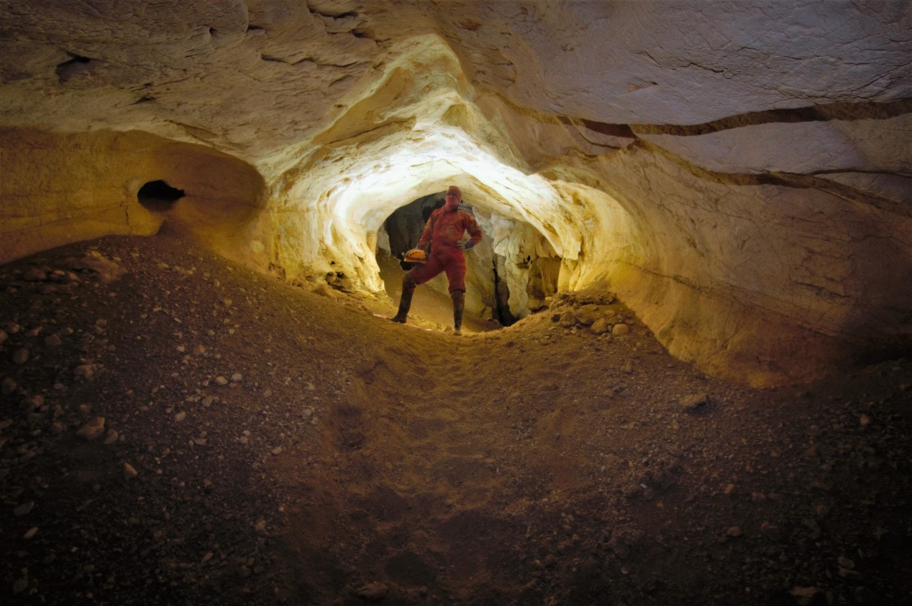
Tunnockschacht, 2006 - present
Over 20km long and 900m deep
‘Tunnocks Corp’: keeps merging and taking over other caves in SMK system
Explored high levels for a few years, before…

Slide 17
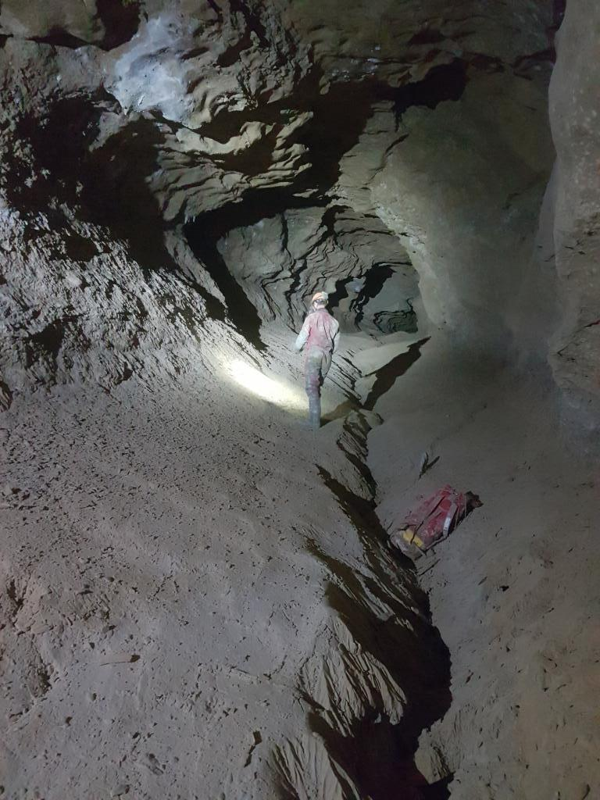
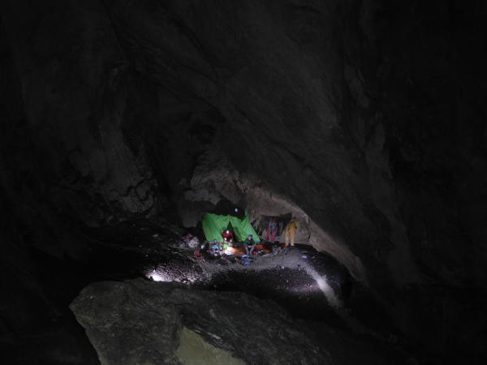
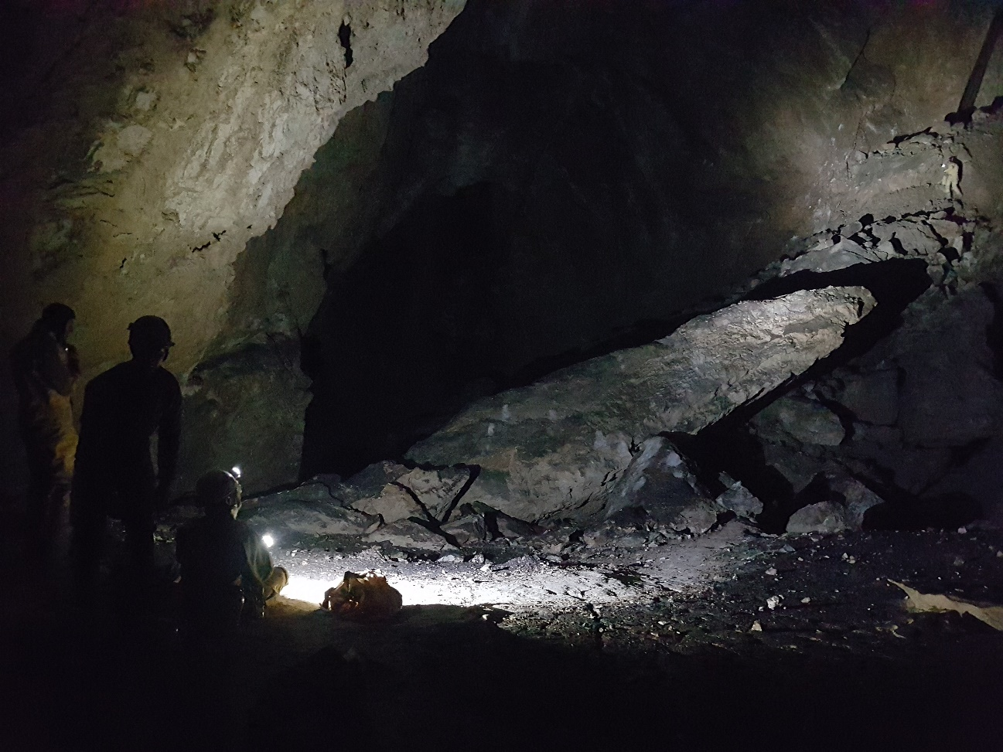
The Deep: Hydra
Camp Kraken: set up in 2016, lots of big finds
Slackers Passage: almost 1km passage found in 1 day, no ropes!

Slide 18
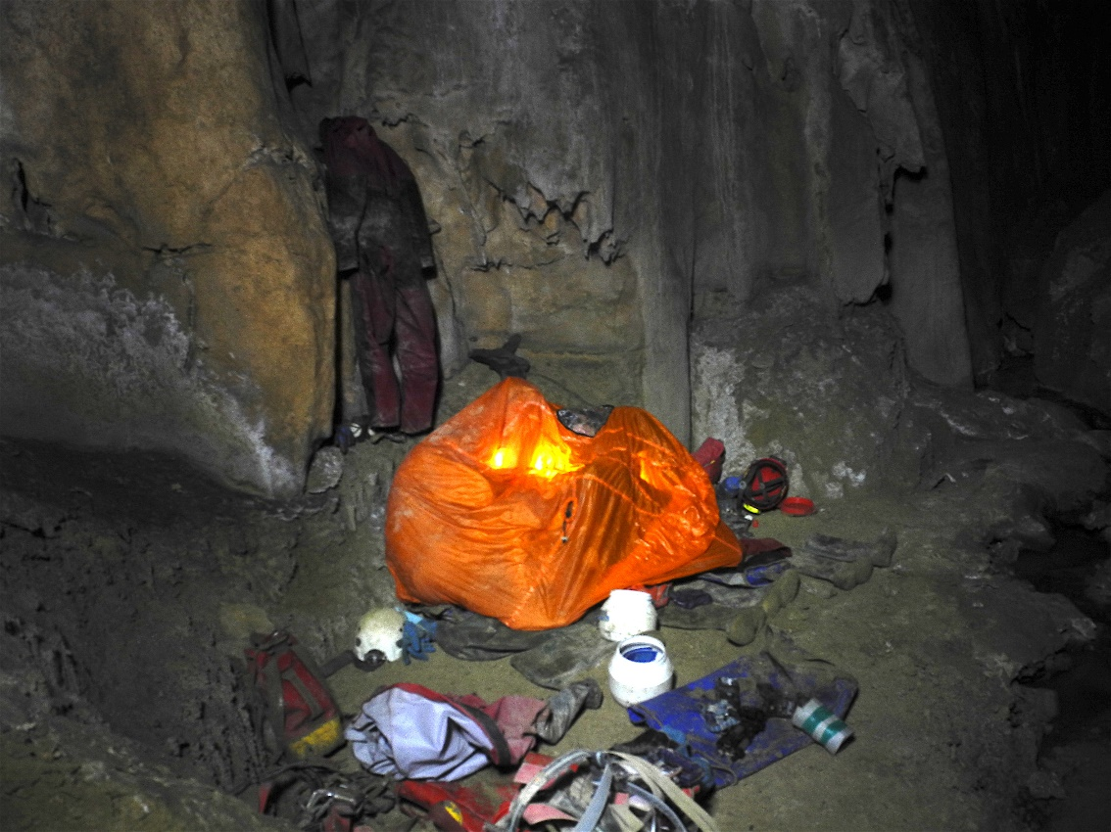
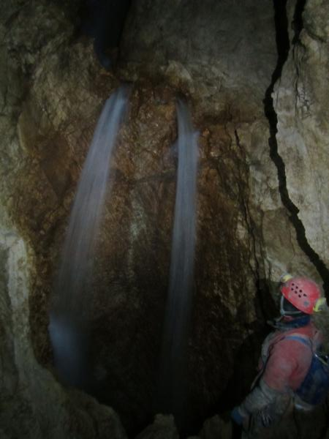
Hydra: Song of the Earth
Massive river passage, pretty unprecedented as caves in SMK are generally dry…
But they can get very wet

Slide 19
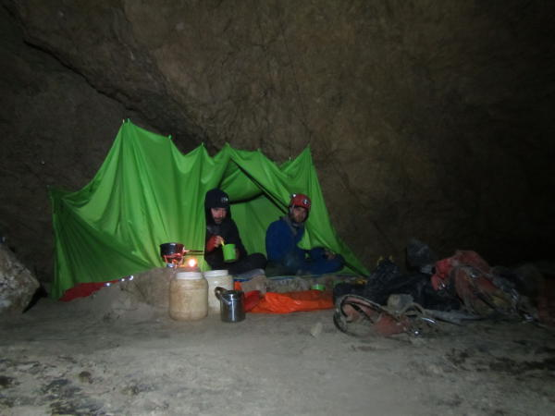
Hydra: where we stand
2017 – Big Lad

Slide 20
Hydra: where we stand
2017 – Loser Lido Sump
2017 – Beckoning Silence
?
?
?

Slide 21
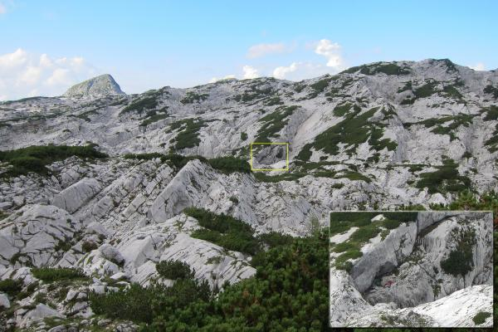
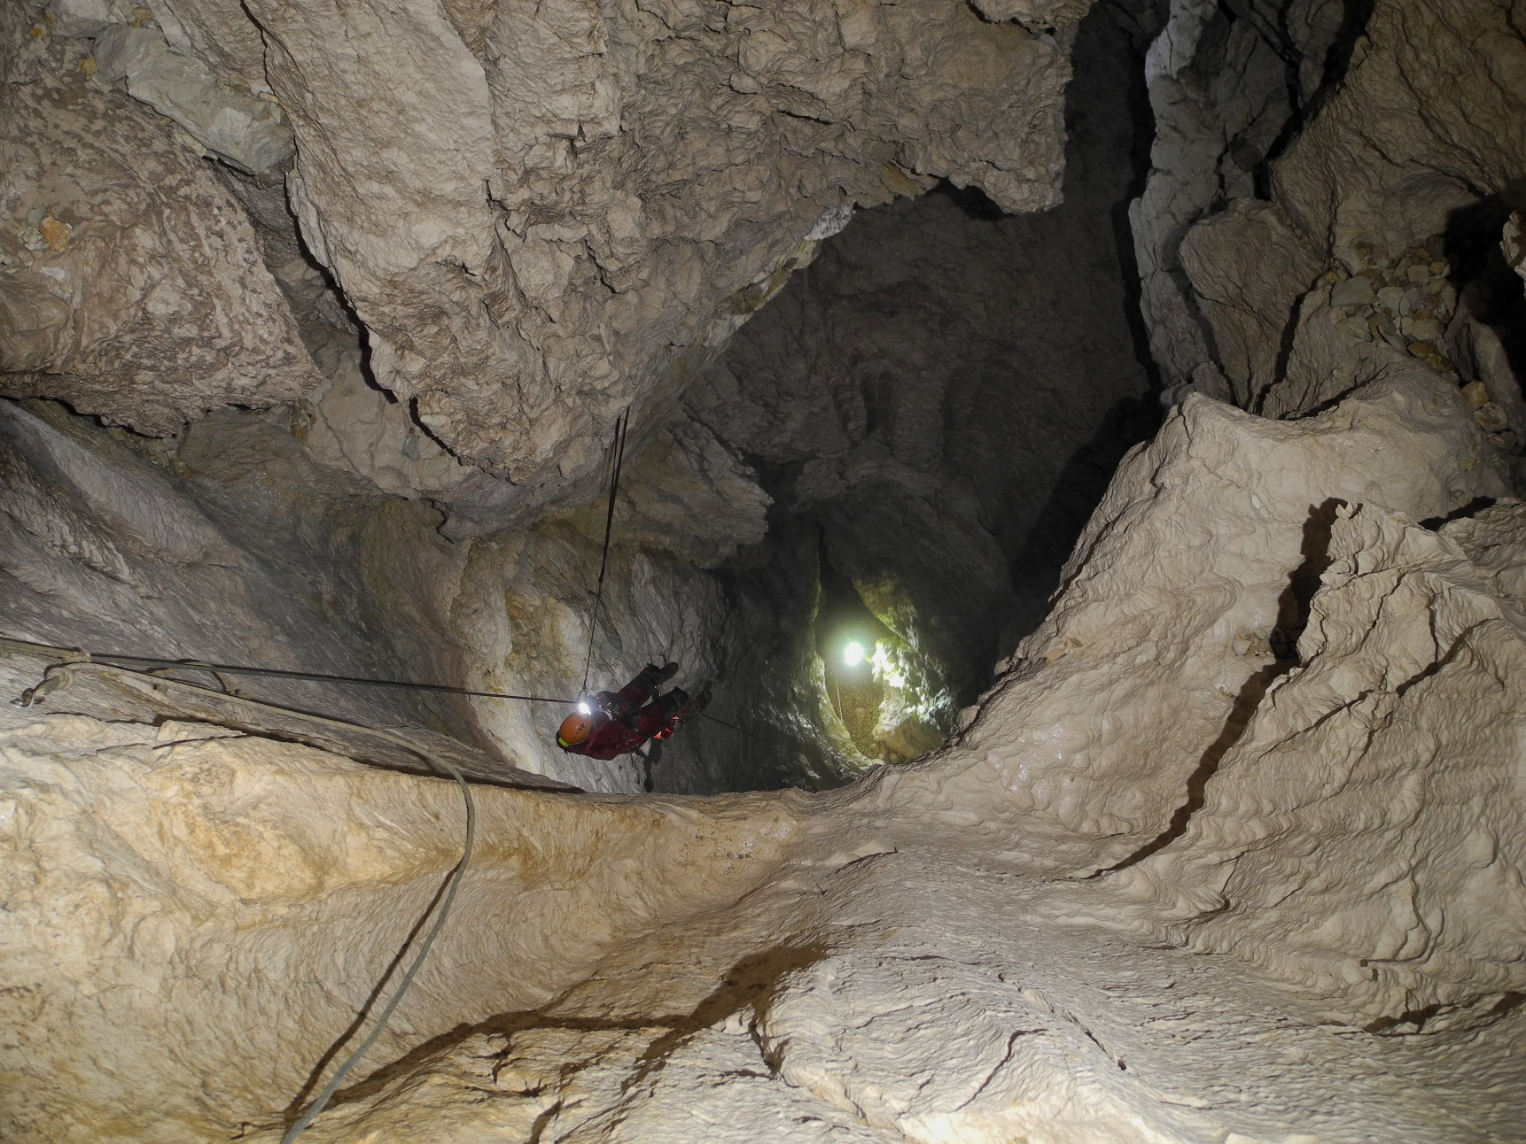
Second big cave in recent years: Balkonhohle
Entrance ‘rediscovered’ 3 times before actually bolting the entrance series in 2014
Length: 10.5km
Depth: 348m
Connected to Tunnocks in 2015

Slide 22
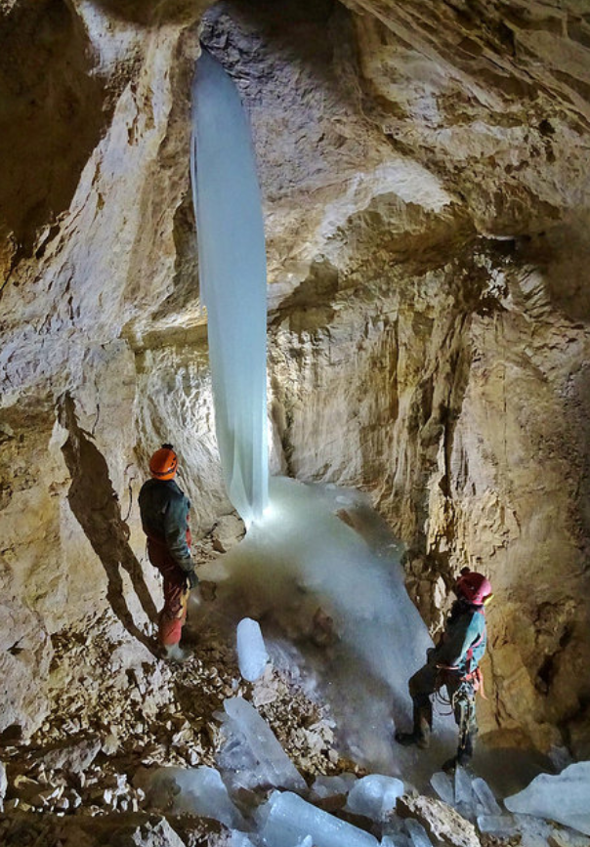
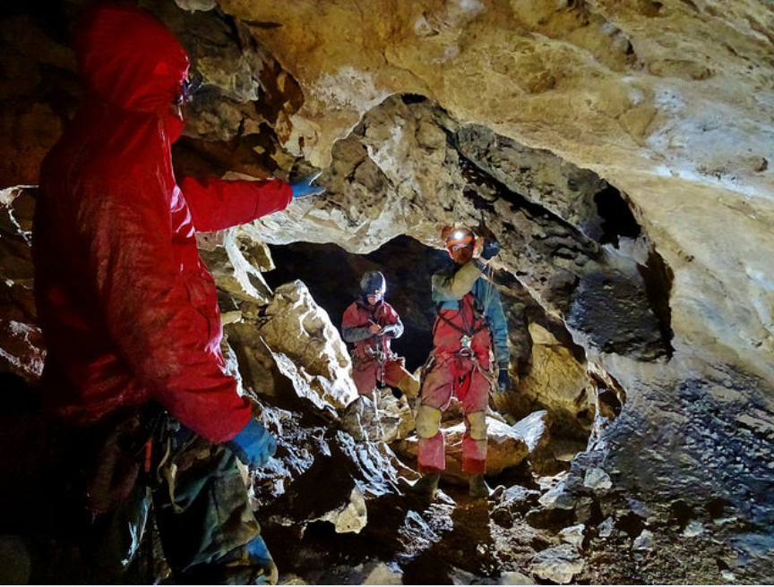
Pretty, beginner-friendly cave
Still plenty of leads to go at which are more accessible than deep Tunnocks

Slide 23
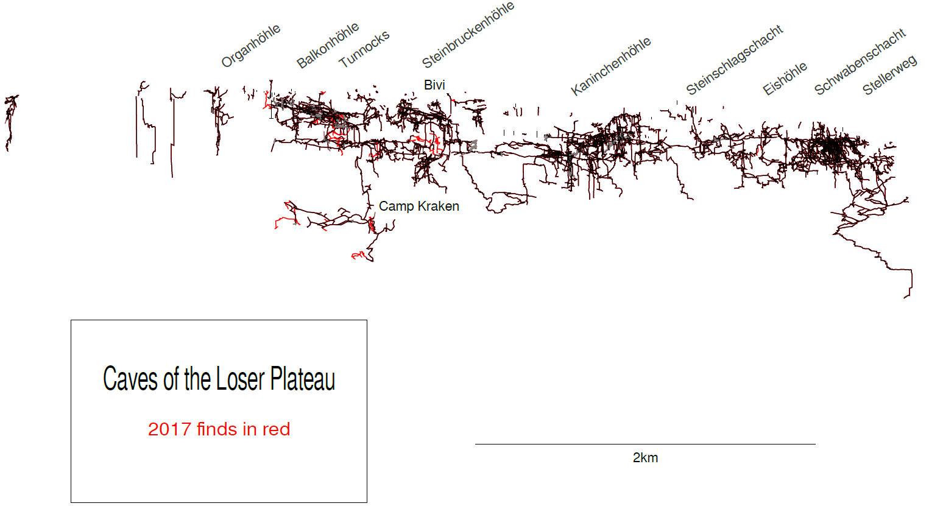
What have we here?

Slide 24
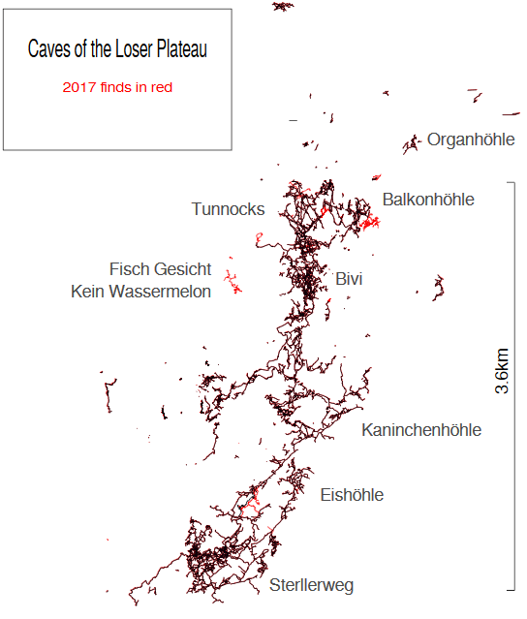
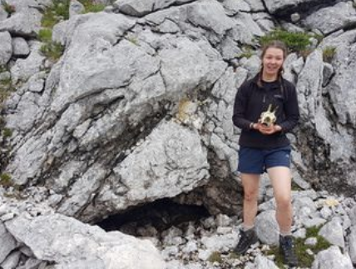
New Caves in the Wild West
Fischgesicht Hohle
Glucklich Schmetterlinger Hohle
In completely blank space, both over 500m long and 250m deep with only 3 weeks work
The next big connection?
Glucklich Schmetterlinger
Prospecting is good for you!

Slide 25
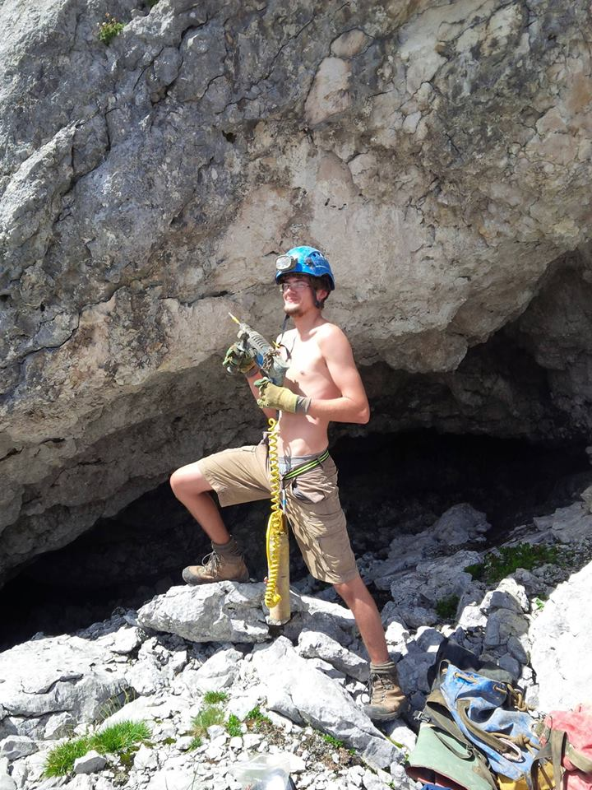
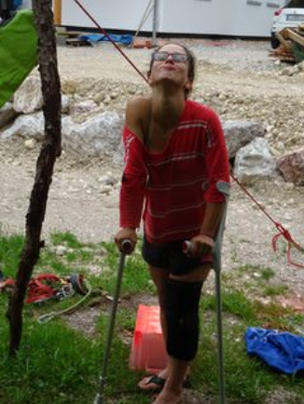
So, interested?
If this boy gimp can learn then so can you!
Biggest UK expedition abroad suitable for novice alpine cavers
Gets you very fit, Noons will feel like you have barely touched the sides
Need to be SRT competent before going to get the most out of the expedition, and ideally be able to recognise a disto and/or drill
Dates: 7th July – 19th August 2018
‘CUCC Expo 2018’ Facebook group
To finish, a valuable lesson for all novice alpine cave explorers…

