Slide 1
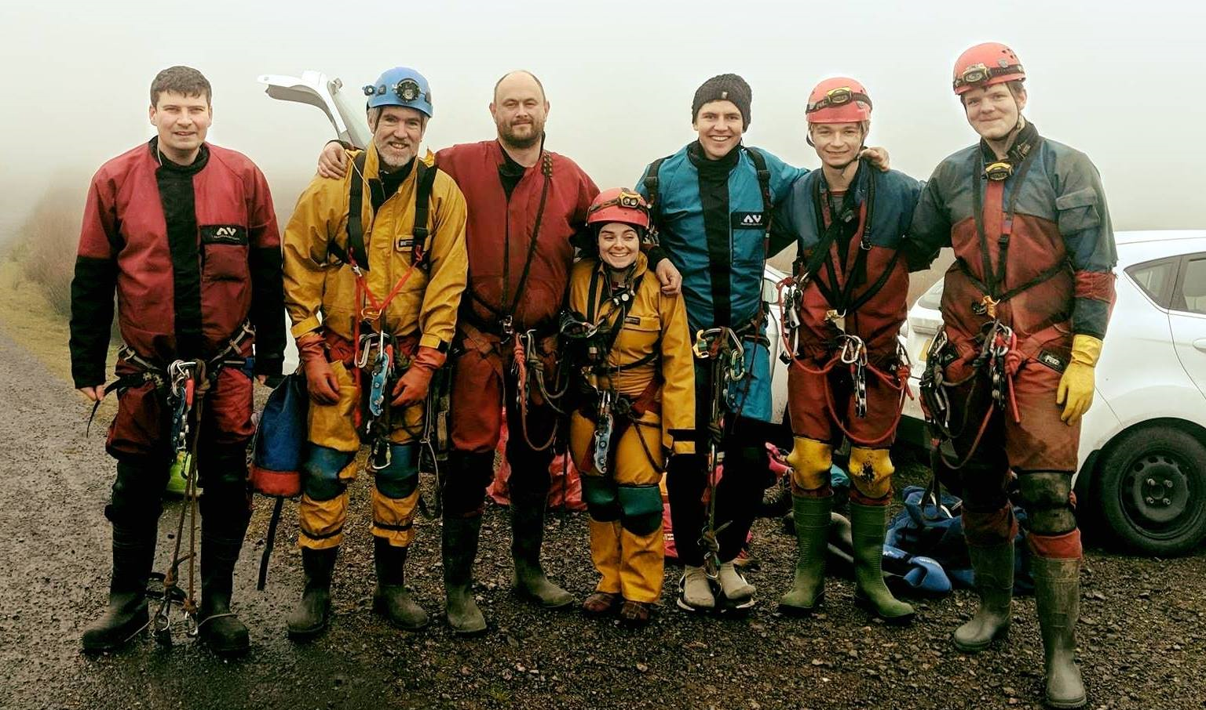
CUCC
Some cavers at New Year’s trip

Slide 2
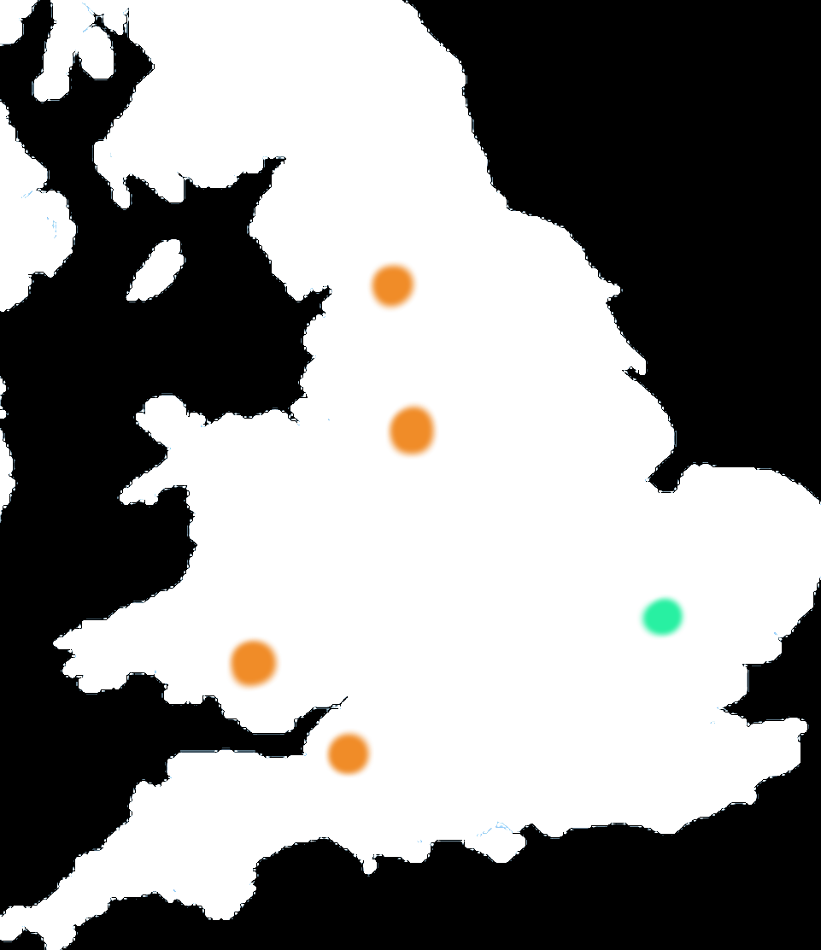
Caving regions of UK
4 main caving areas
in general:
Yorkshire
Yorkshire and Derbyshire:
- Great SRT caving
Derbyshire
Cambridge
South Wales
South Wales and Mendip
- No need for SRT
Mendip

Slide 3
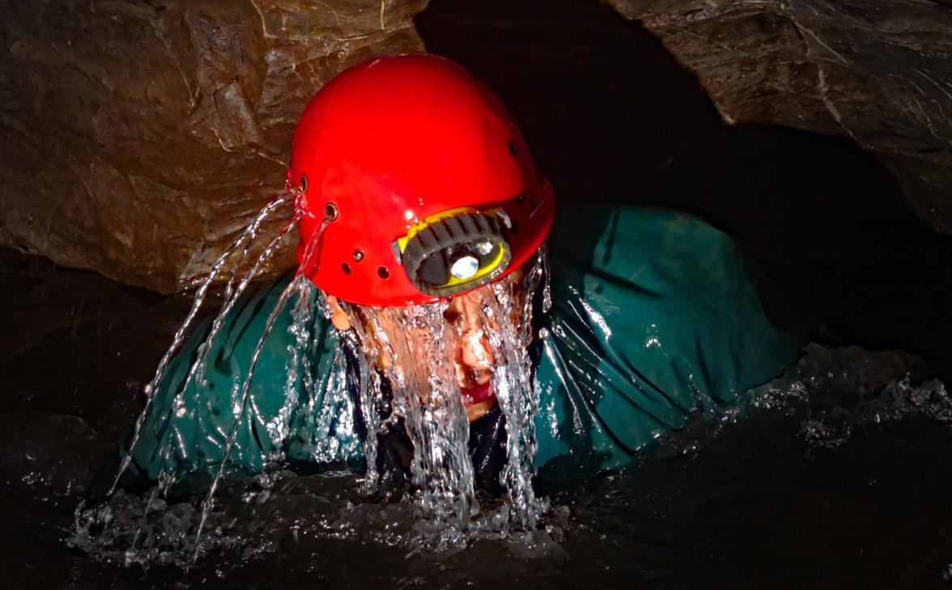
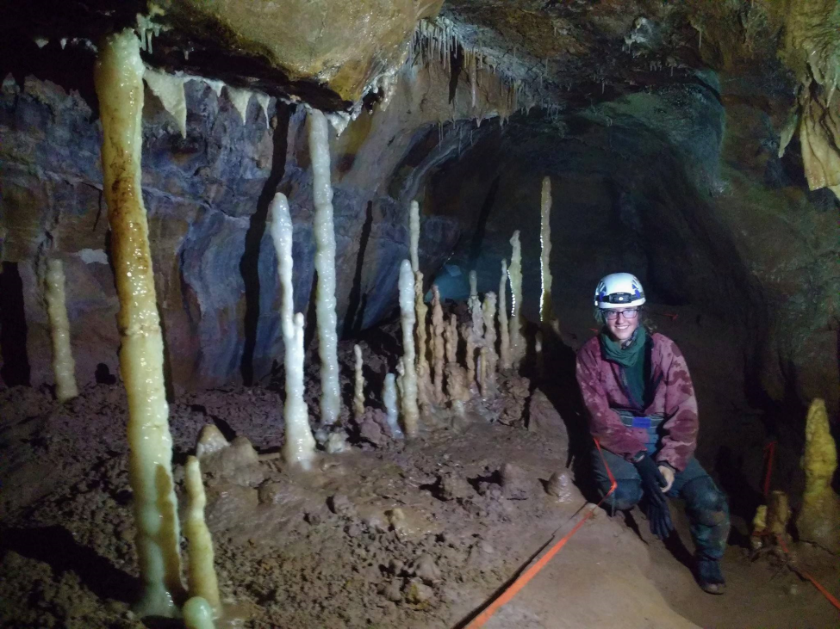
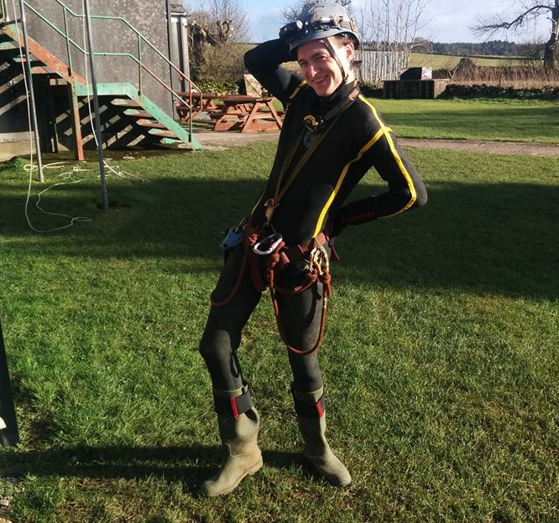
Southern caving regions
Usually wet trips, wetsuits are nice but not necessary.
Accessible to freshers.
Contain UK’s largest cave Ogof Fynnon Ddu of which vast majority is just walk in

Slide 4
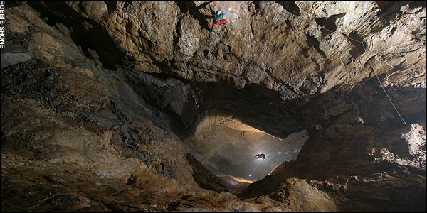
Northrern caving regions
Some spectacular SRT caving to be done.
Easier caves also exist in the area

Slide 5
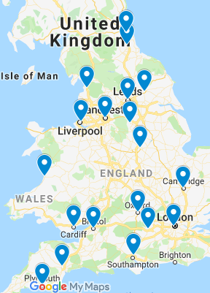
CHECC
Council of Higher Education Caving Clubs
Annual event where all university clubs meet up and go caving (but mostly a big party)
25 member clubs across the country
Pre-rigged caves
Lots of space for tents
Some contests with caving related prizes
Training in first-aid, cave rescue and other
Failed to find a picture from the party which is probably for the best

Slide 6
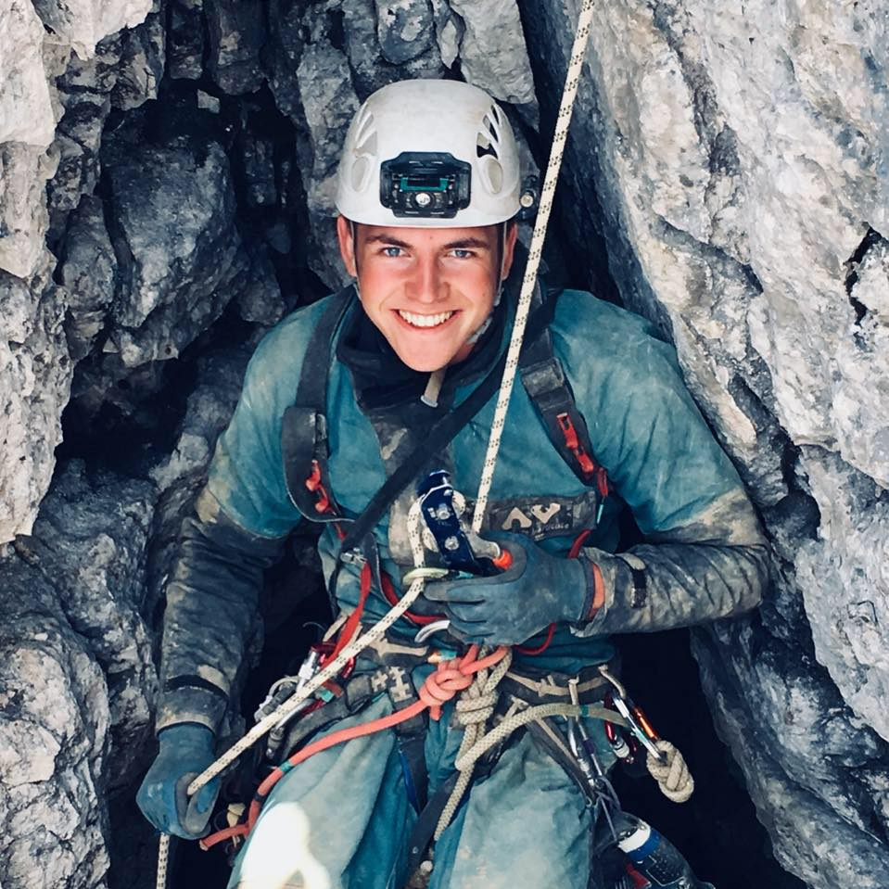
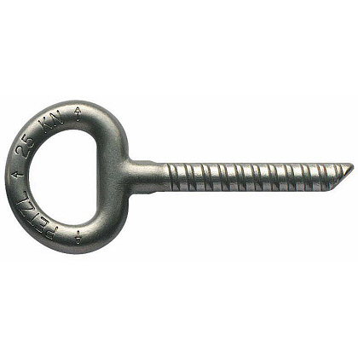
Rigging and ropes in UK
Most of the caves use resin anchors
Personal SRT kit can be borrowed from the club for practice

Slide 7
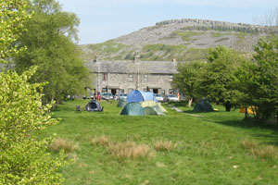
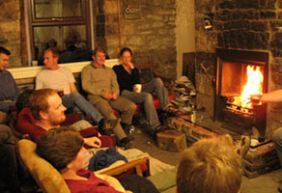
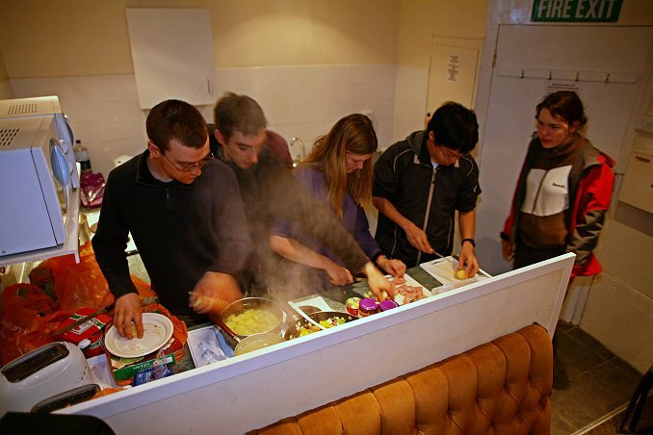
Caving huts
Local caving clubs run caving huts.
They provide:
Cheap acomodation
Large kitchen to cook together
Are close to caves
Have drying rooms
etc

Slide 8
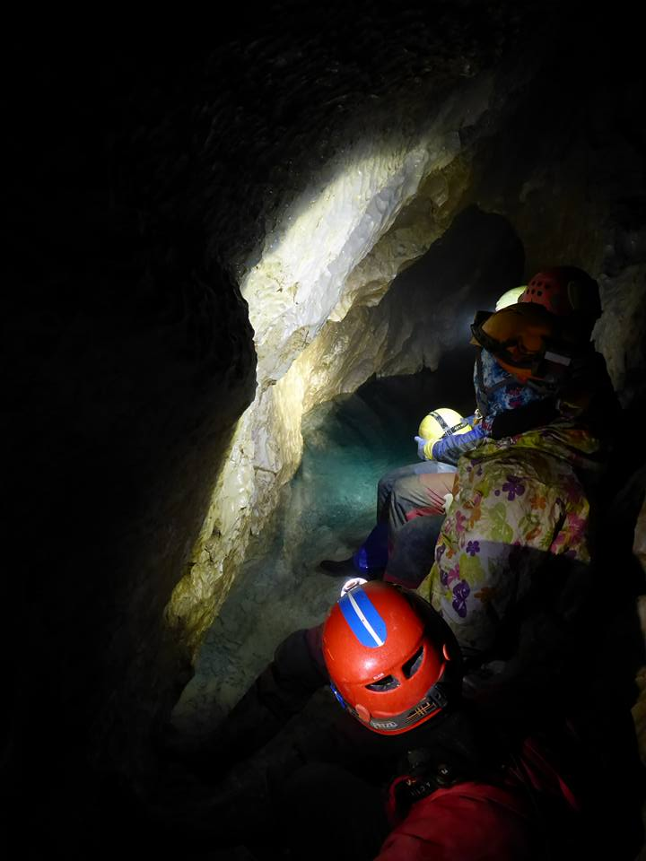
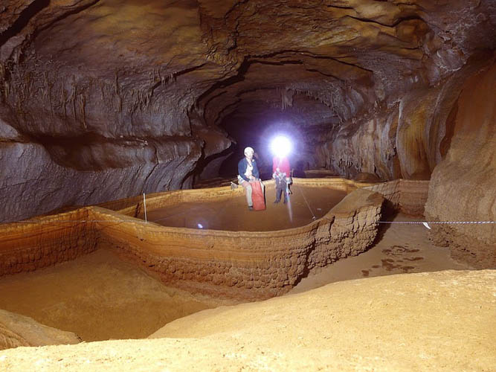
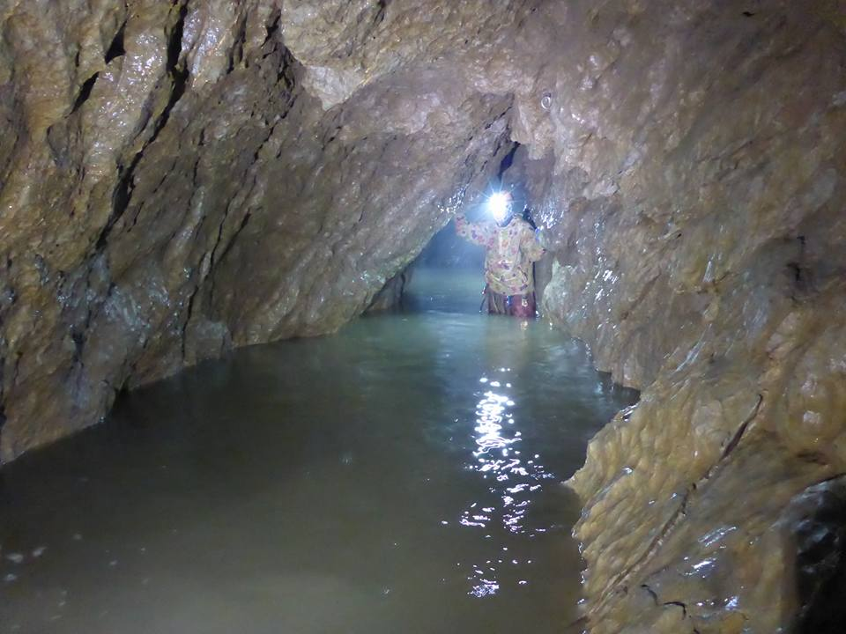
Foreign trips
Jaskinia Mietusia – Poland
Aven Noel – France
Jaskinia Mietusia – Poland

Slide 9
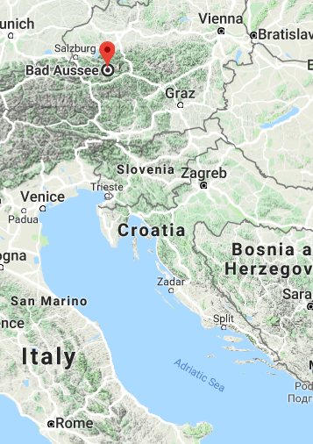
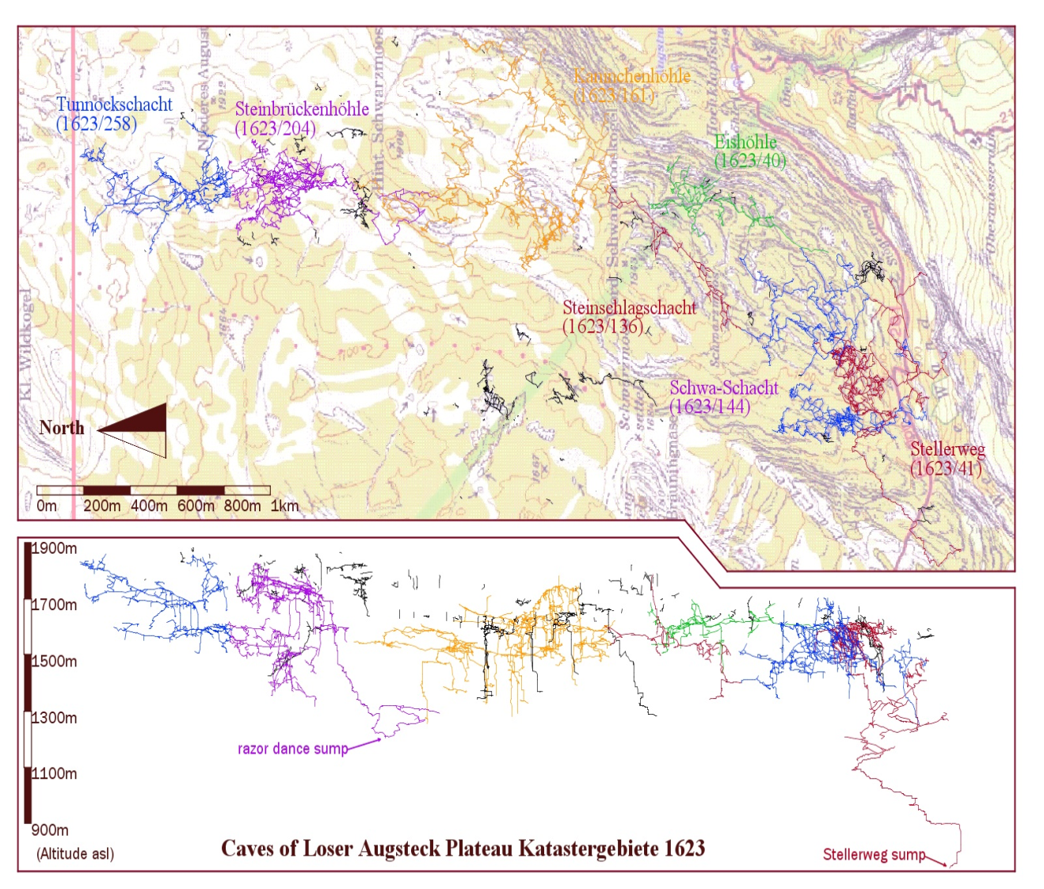
Summer expedition
Over 30 years of exploration
Over 100km long, and over 1km deep
Frequent underground camping
Austria Bad Aussee

Slide 10
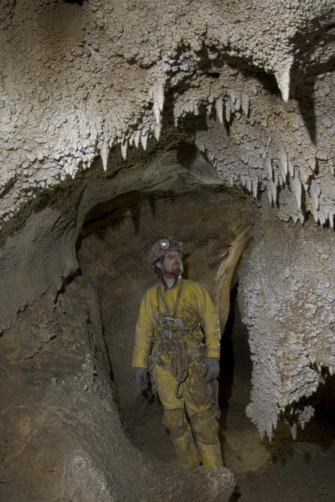
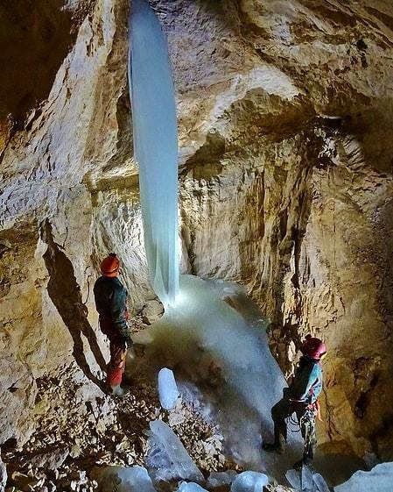
Summer expedition

