Slide 1
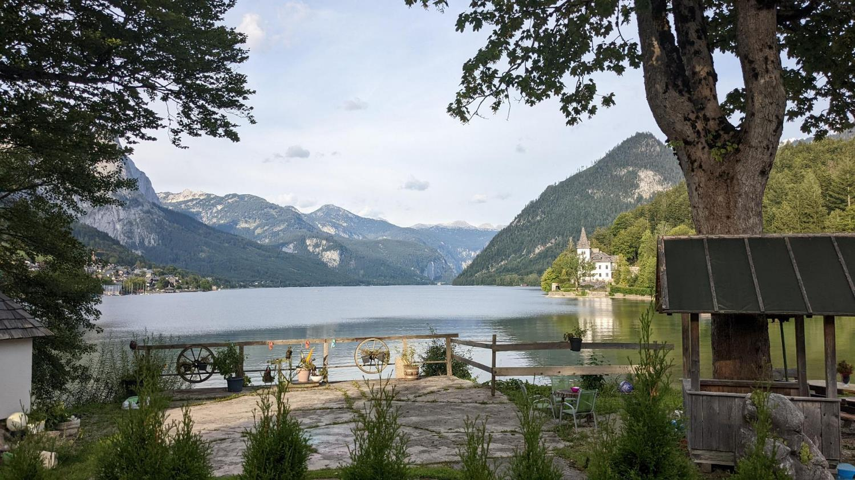
Loser Plateau, Austria
Paul Walko

Slide 2
What is this?
The Cambridge University Caving Club (CUCC) started exploring Schwarzmooskogel Höhlensystem (SMK system) in the 1970s.
SMK is currently 137 km (85 mi) long and 1125 m (3690 ft) deep.
https://expo.survex.com maintains anything and everything about the expedition efforts over the years.
Notes:
- “expo” refers to this

Slide 3
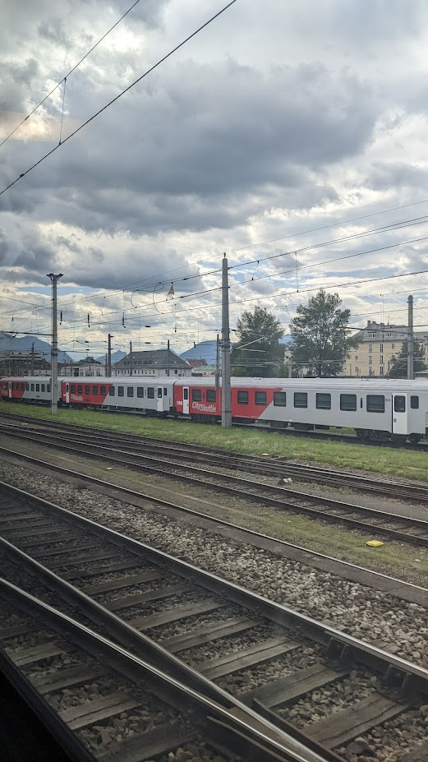
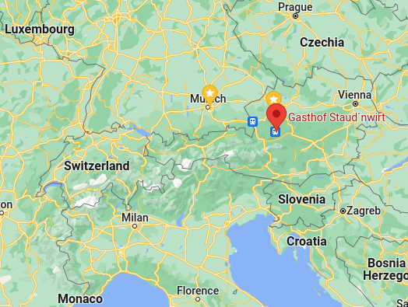
Getting There
Notes:
Timing planes and trains are hard, esp with workers on strike
Gasthof: “guest house”

Slide 4
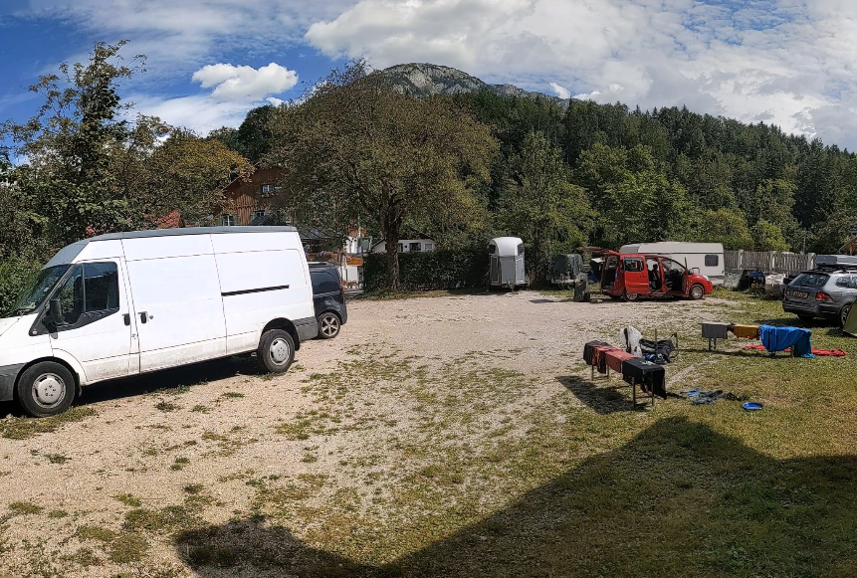
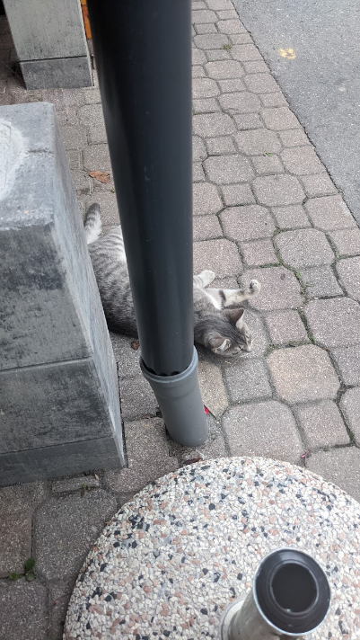
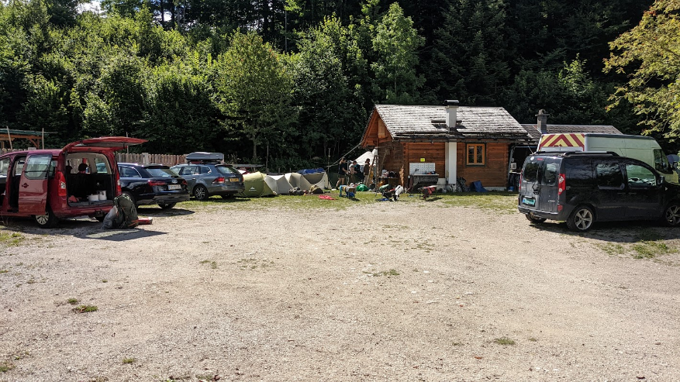
Basecamp
Notes:
cat!
Could just stay here and have a great vacation

Slide 5
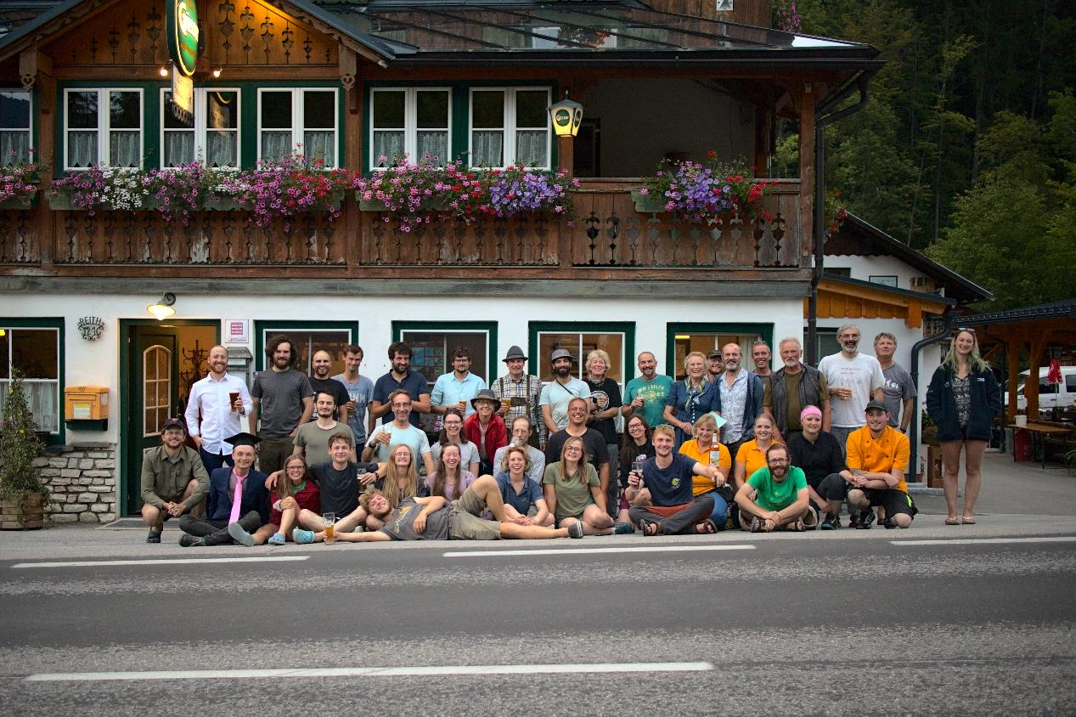
Eric C. Landgraf
Notes:
- Gasthof run by Helda, has been running it for a long time and knows many of us well
Spot me in the upper left
During week 3

Slide 6
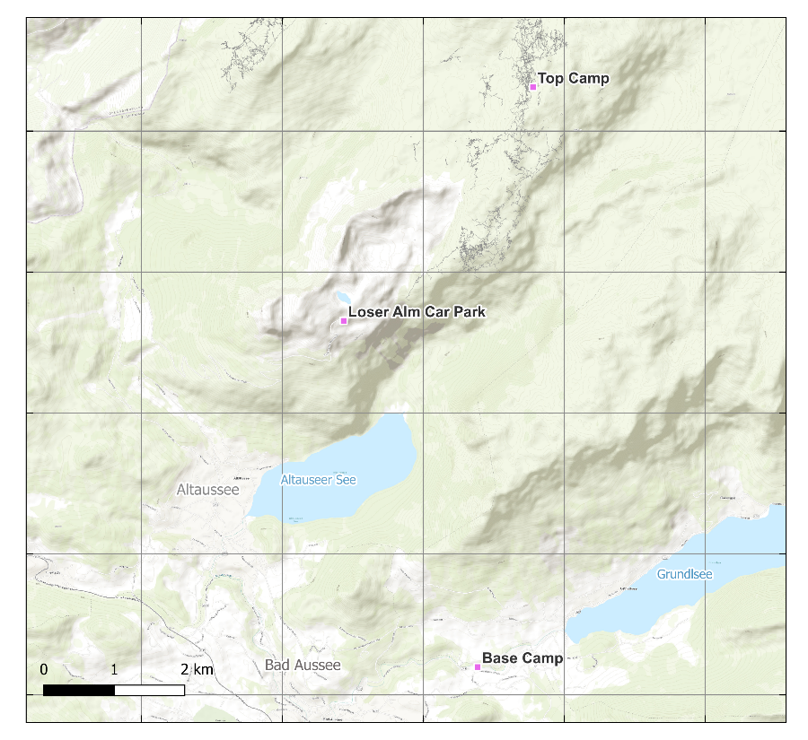
Nat Dalton
Notes:
- First time hiking can be long

Slide 7
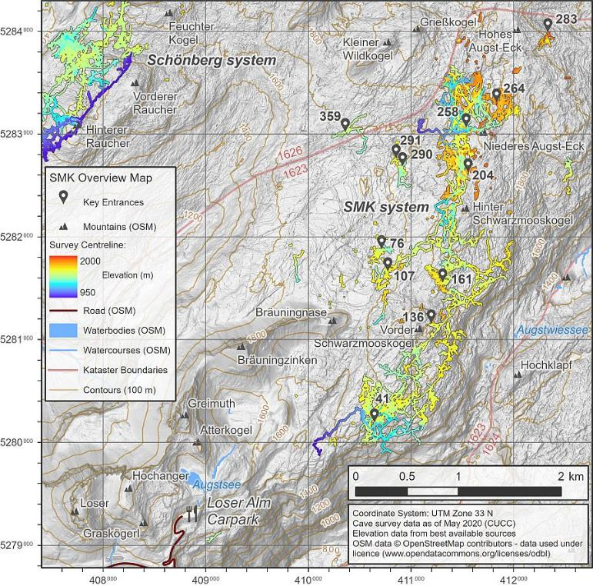
Nat Dalton
Notes:
Eventual goal to connect

Slide 8
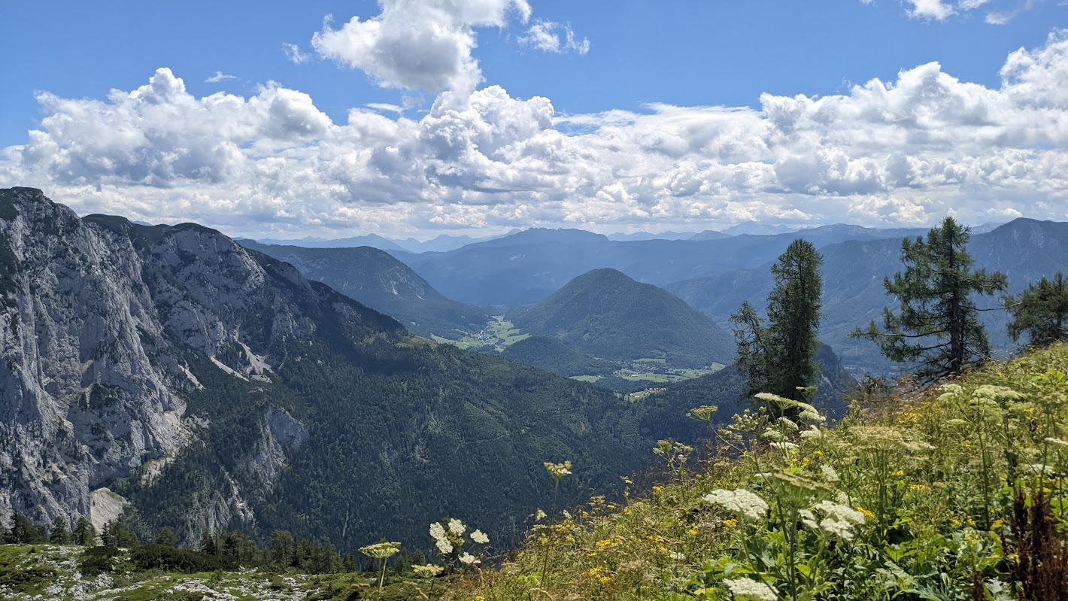
Topcamp

Slide 9
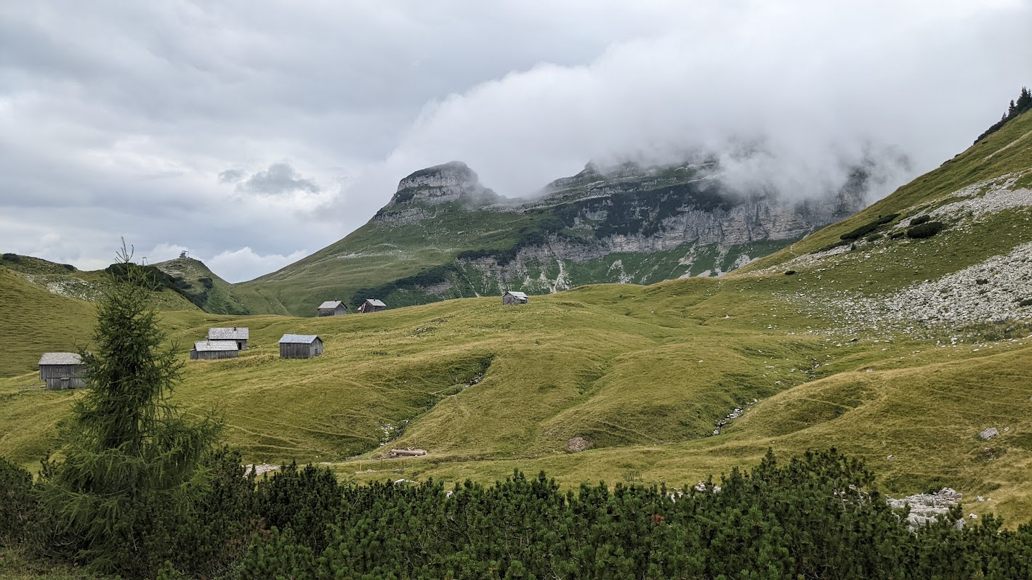

Slide 10
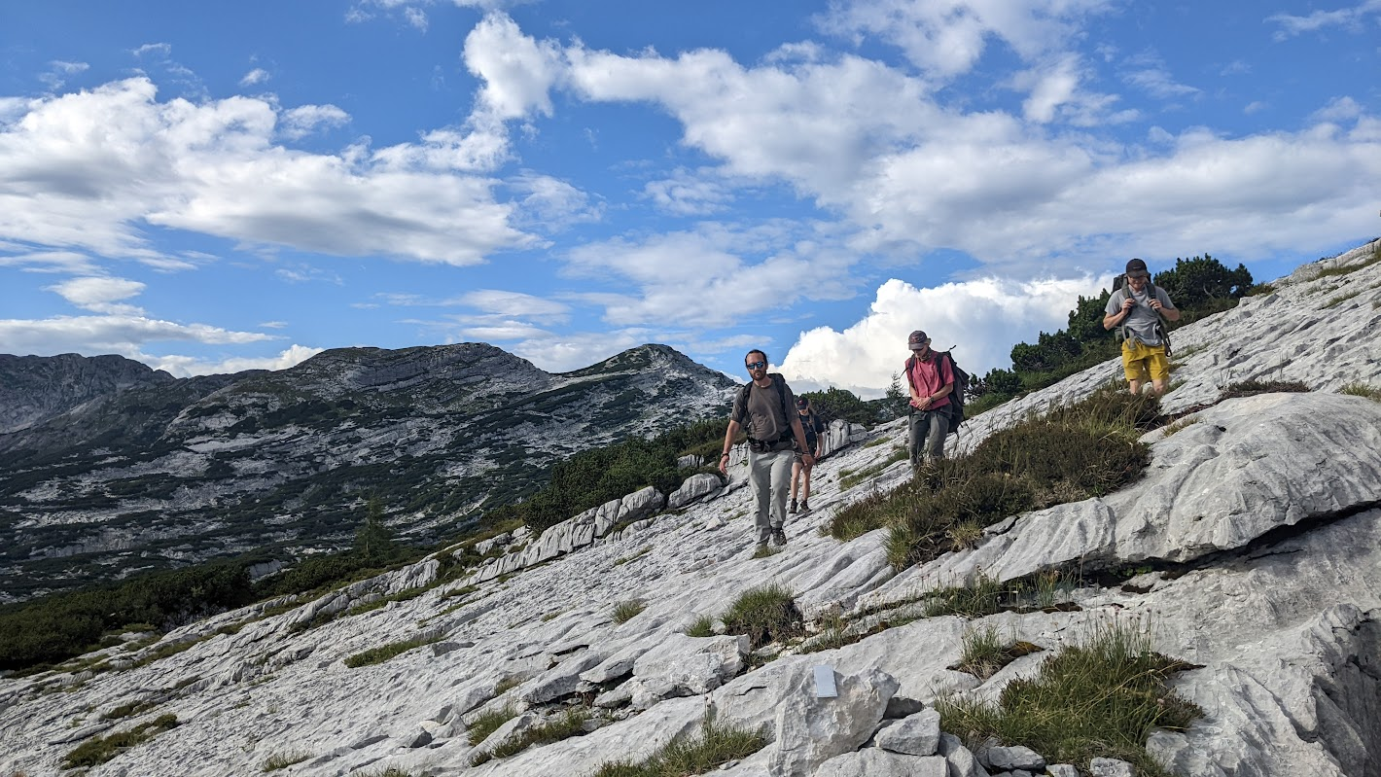
Topcamp
Notes:
Really neat terrain
Quickly shred shoes

Slide 11
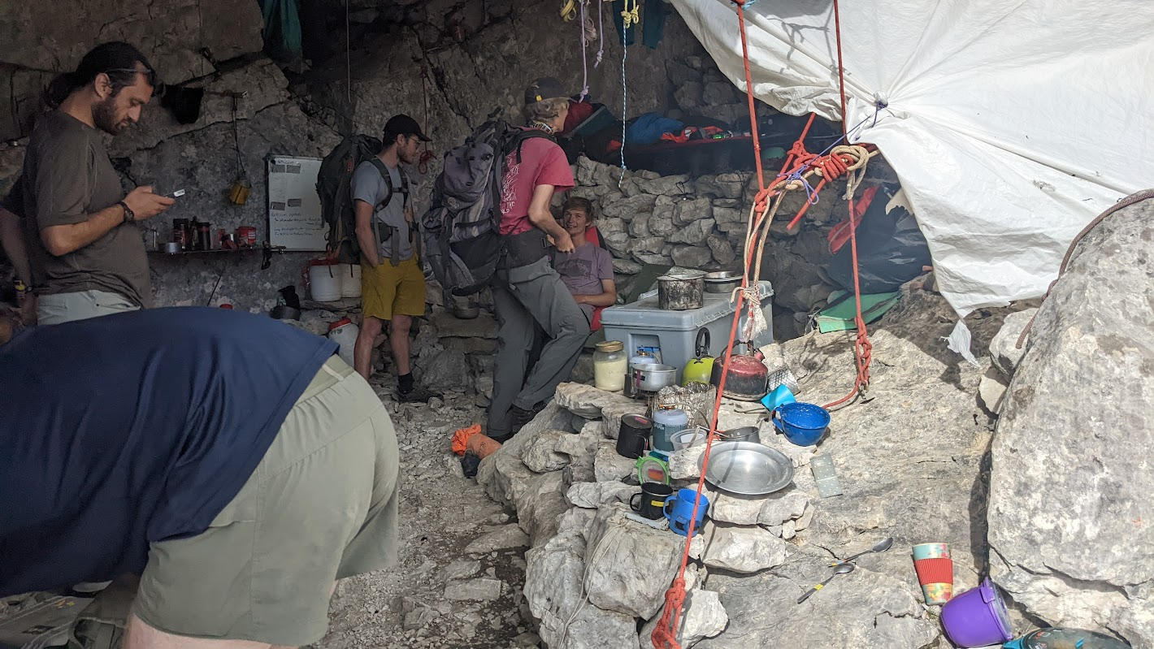
Topcamp
Notes:
Lots of time has been spent making this nice

Slide 12
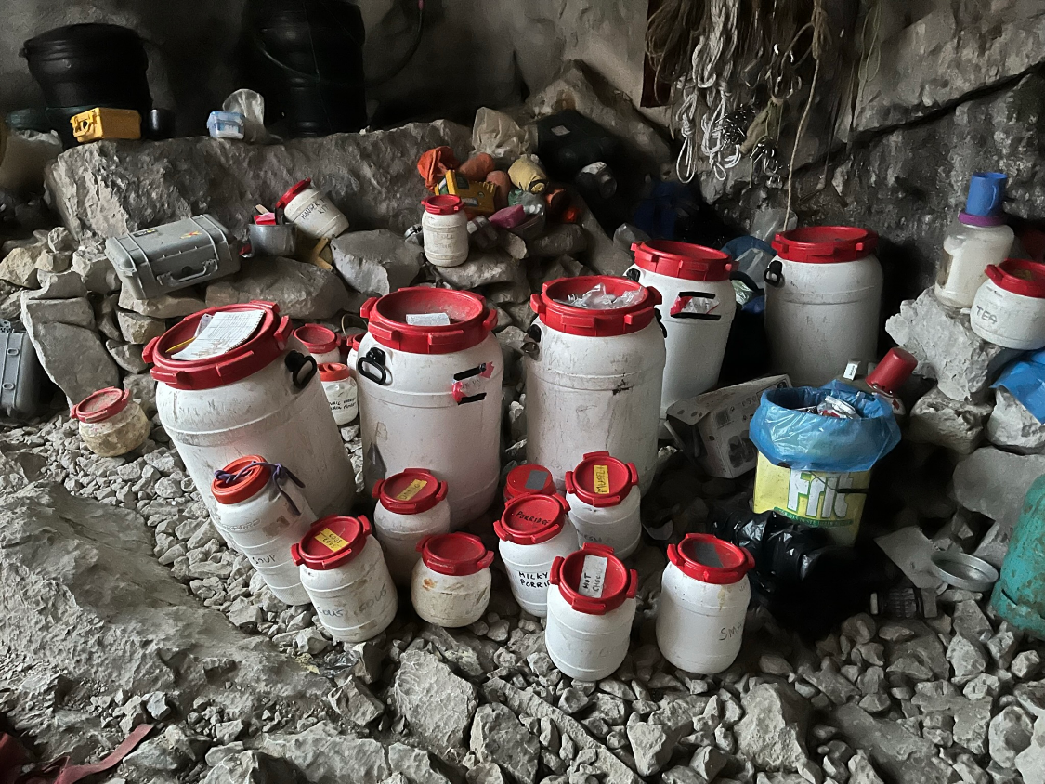
Notes:
Ramen, candy, curry
Milk powder
Custard
Mashed potatoes

Slide 13
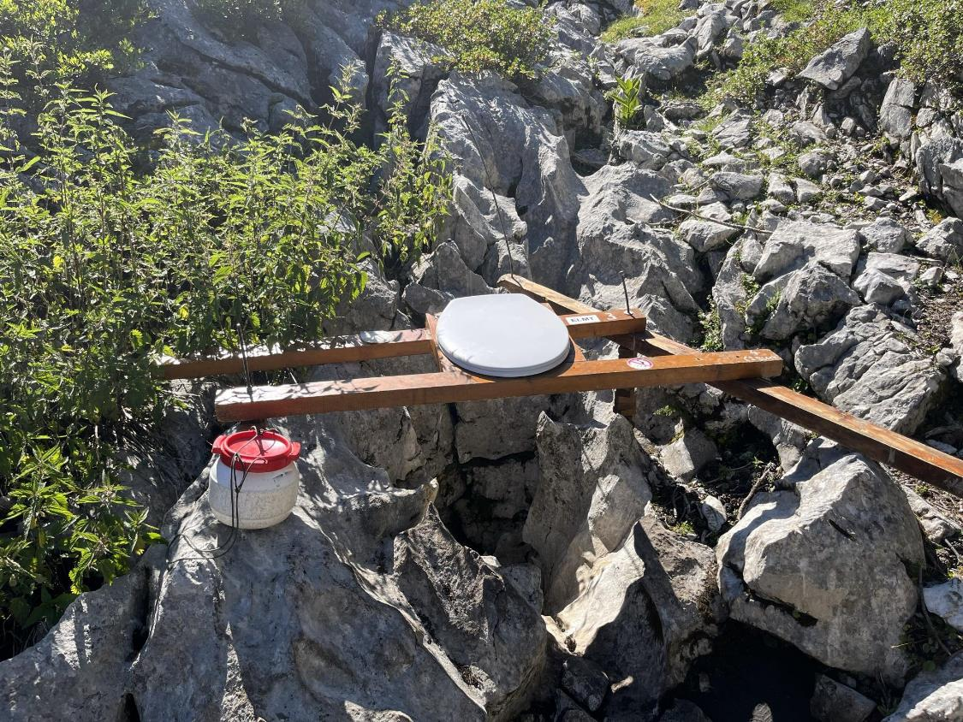
Notes:
No top camp would be complete without a toilet grike
Dropped drum
Breathtaking view

Slide 14
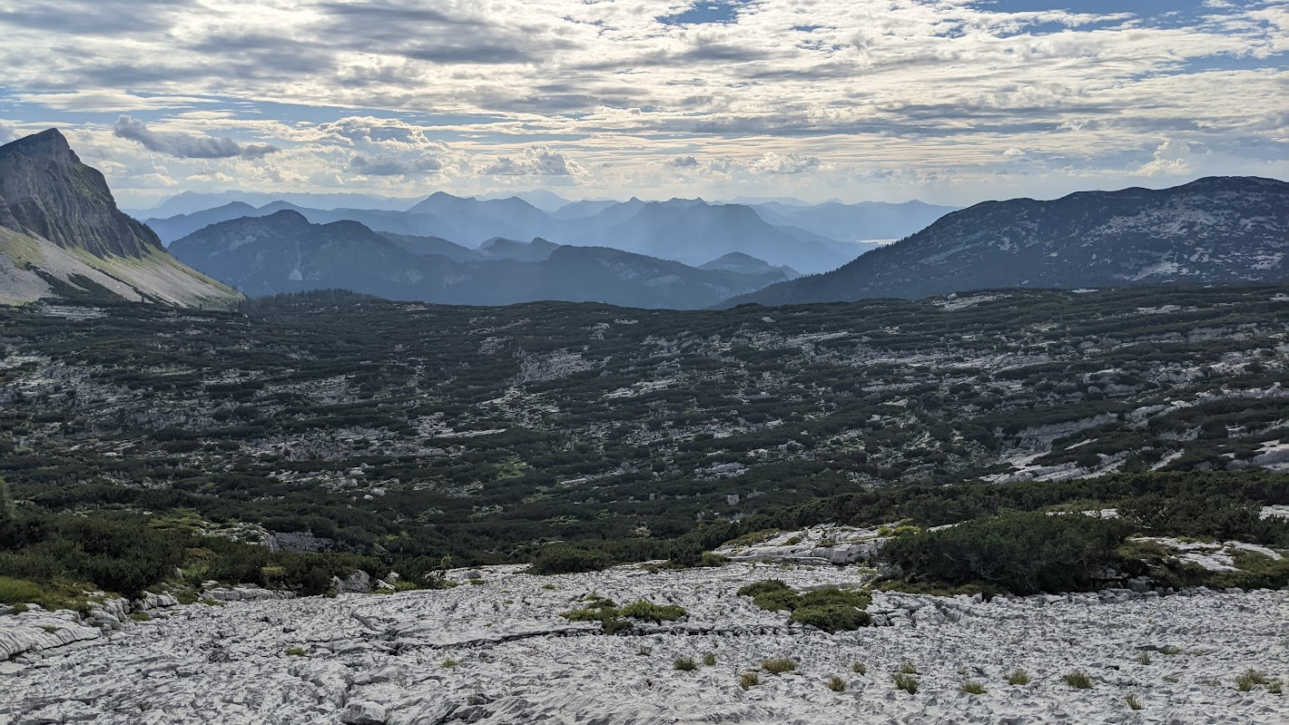
Notes:
View from topcamp
Dachstein

Slide 15
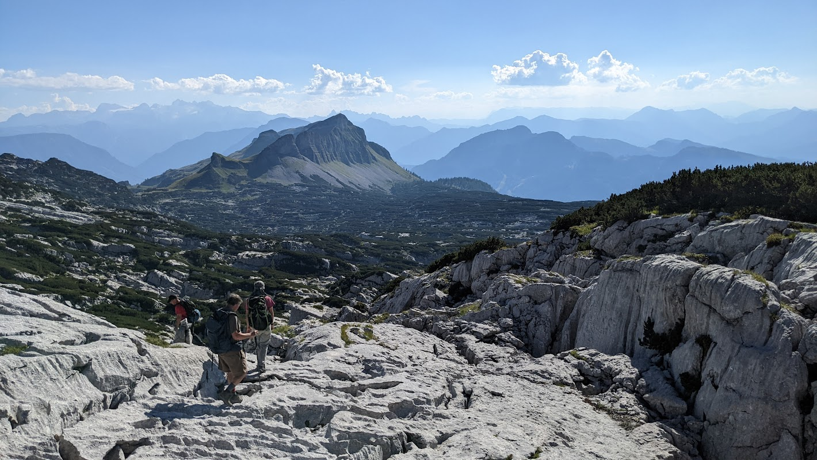


Dachstein (I think?)
Notes:
Dachstein

Slide 16
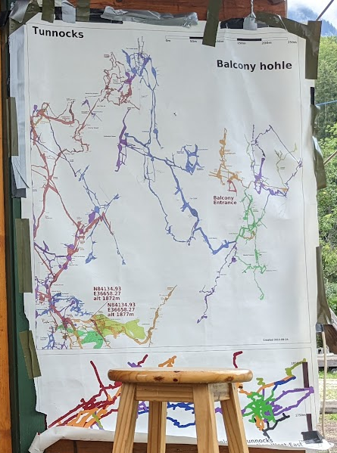
Balkonhöhle
Fischgesicht
Top camp
Notes:
Most caving done near top camp
30 mins to balkon or fisch, main efforts
Limited by rope

Slide 17
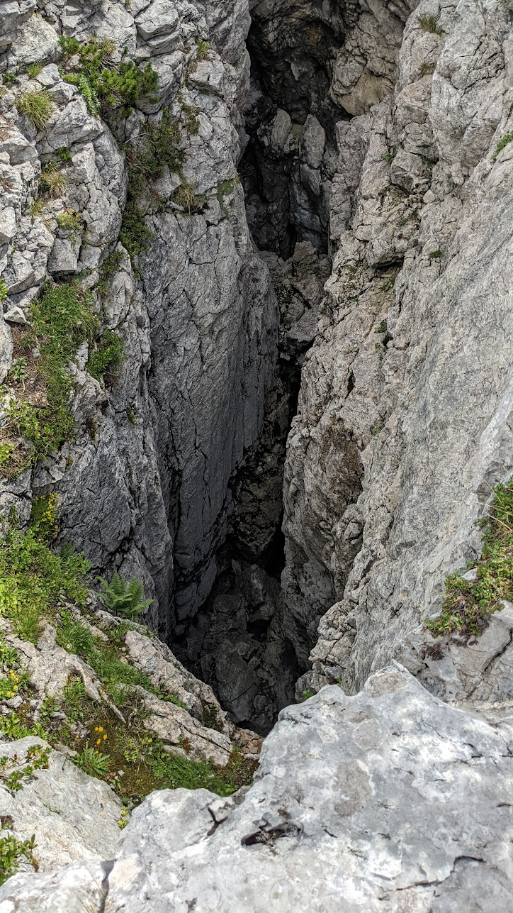
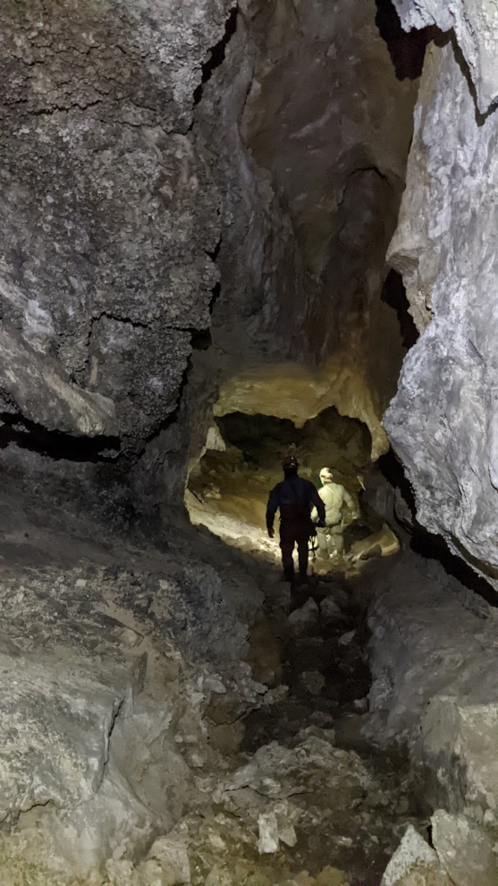
Balkonhöhle
Notes:
No mud, nice change from WV/VA
Cold, 34F

Slide 18
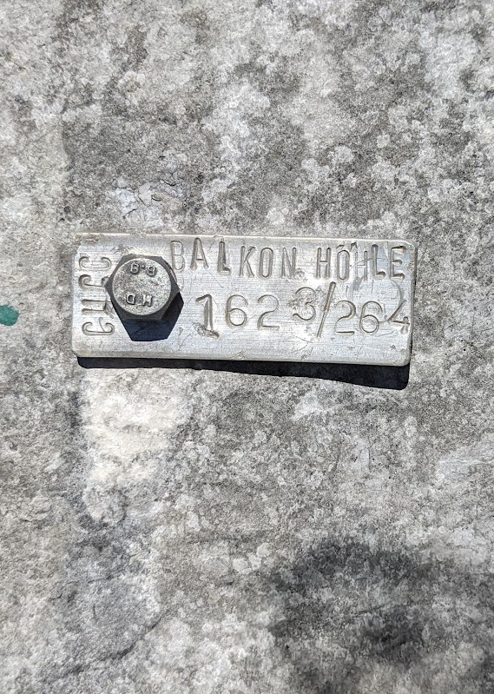
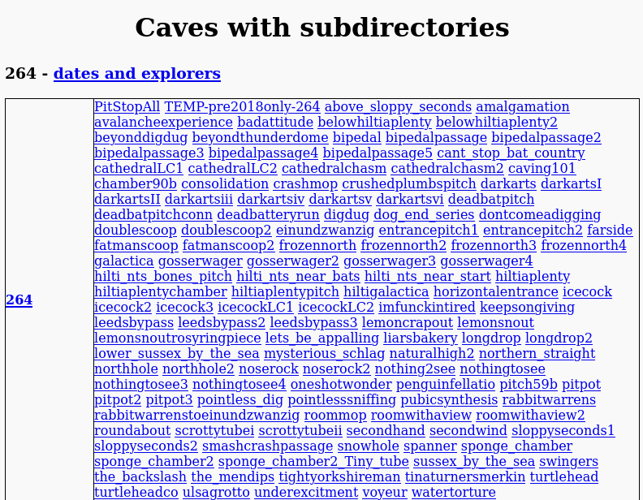
https://expo.survex.com/survexfile/caves/
Data is publicly accessible!
Notes:
- Austrian cave DB

Slide 19
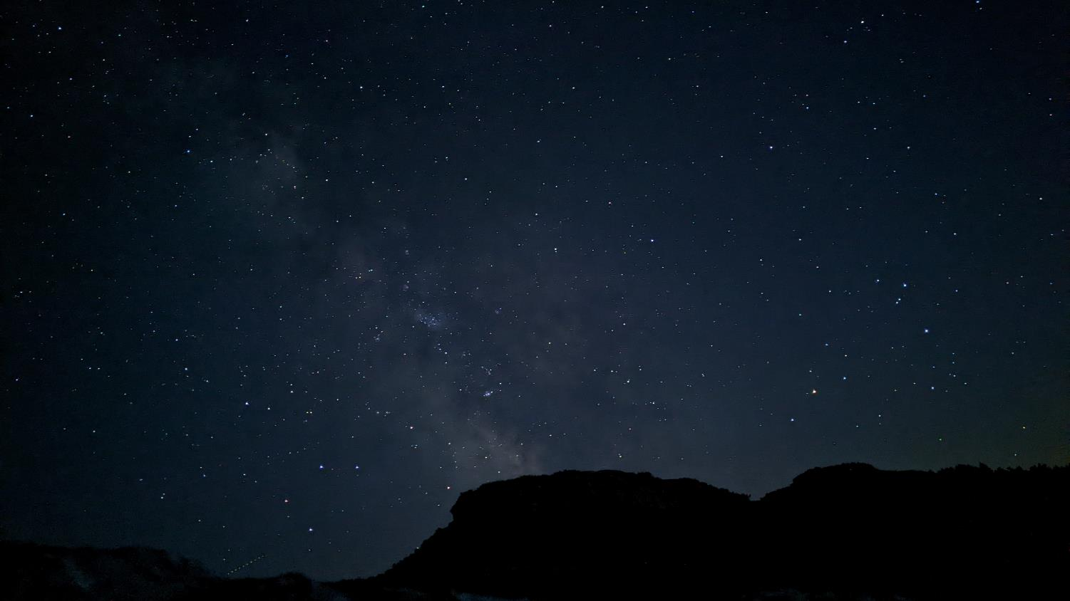
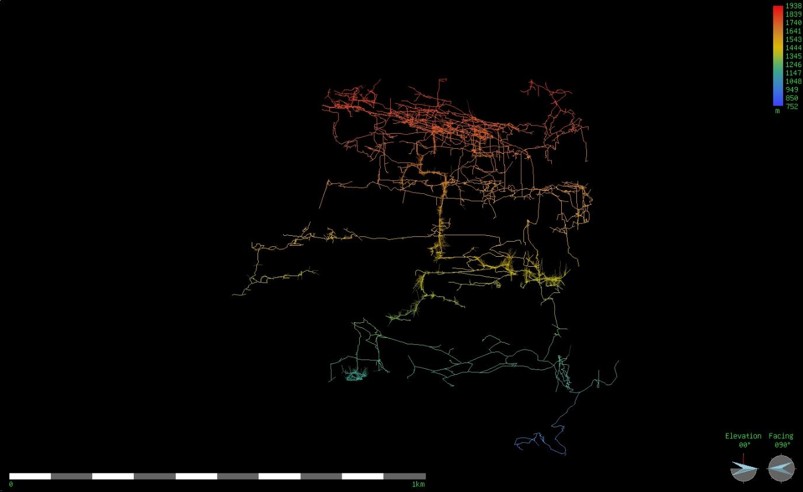
Balkon entrance
Tunnocks entrance
6358 ft
March of the Penguins
Mongol rally
2467 ft
Pitstop
Claytons Cockup
Tartarus
Procrastination
The Loser Lido
Kraken
1125 m (3690 ft) deep
Song of the Earth
0 mi
.6 mi
Notes:
Areas of balkon
I only went to red line, not deep at all, 300-400ft

Slide 20
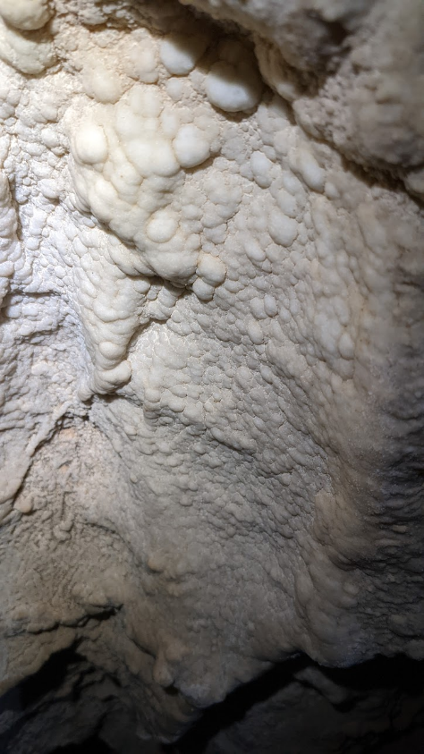
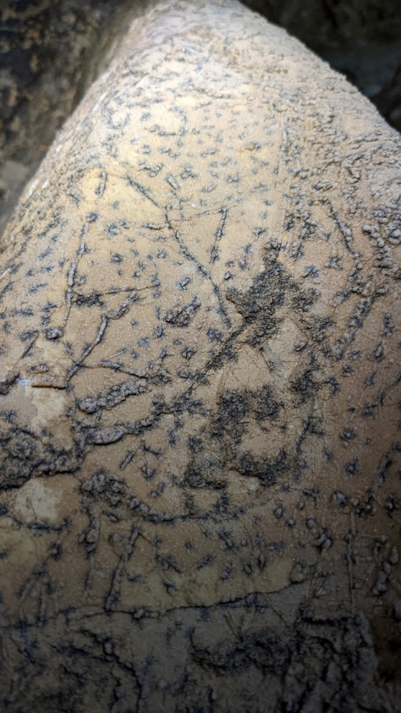
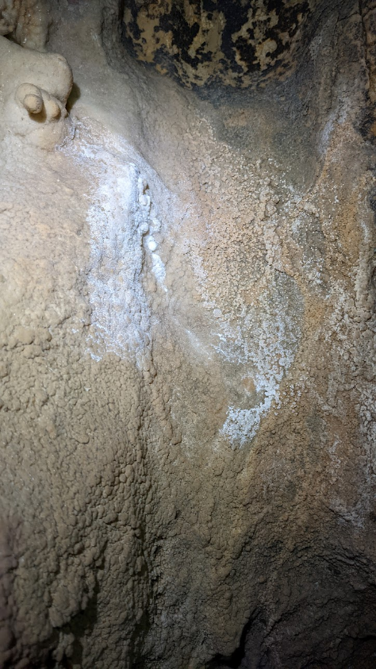
Notes:
Cool formations
Few and far between

Slide 21
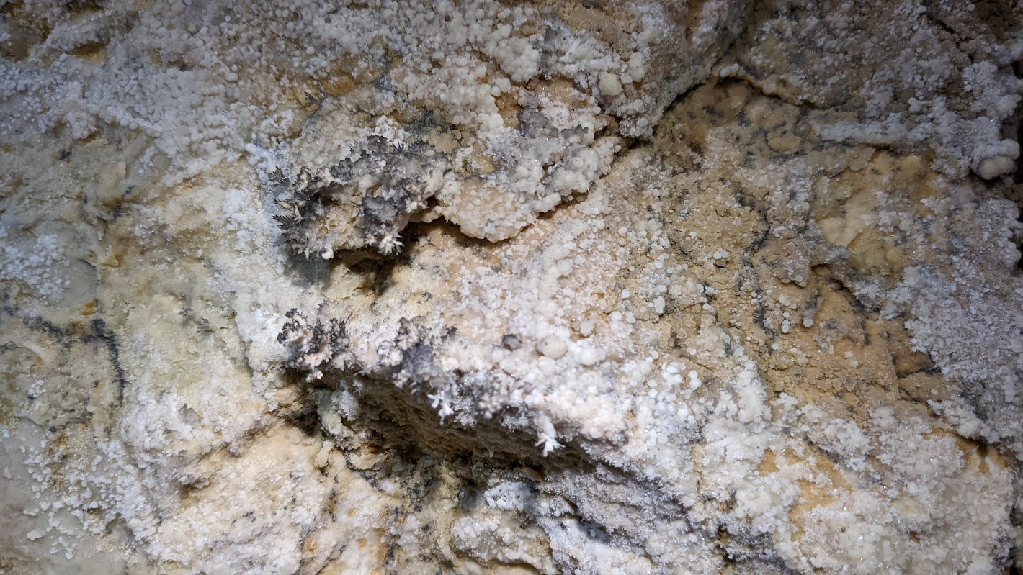

Slide 22
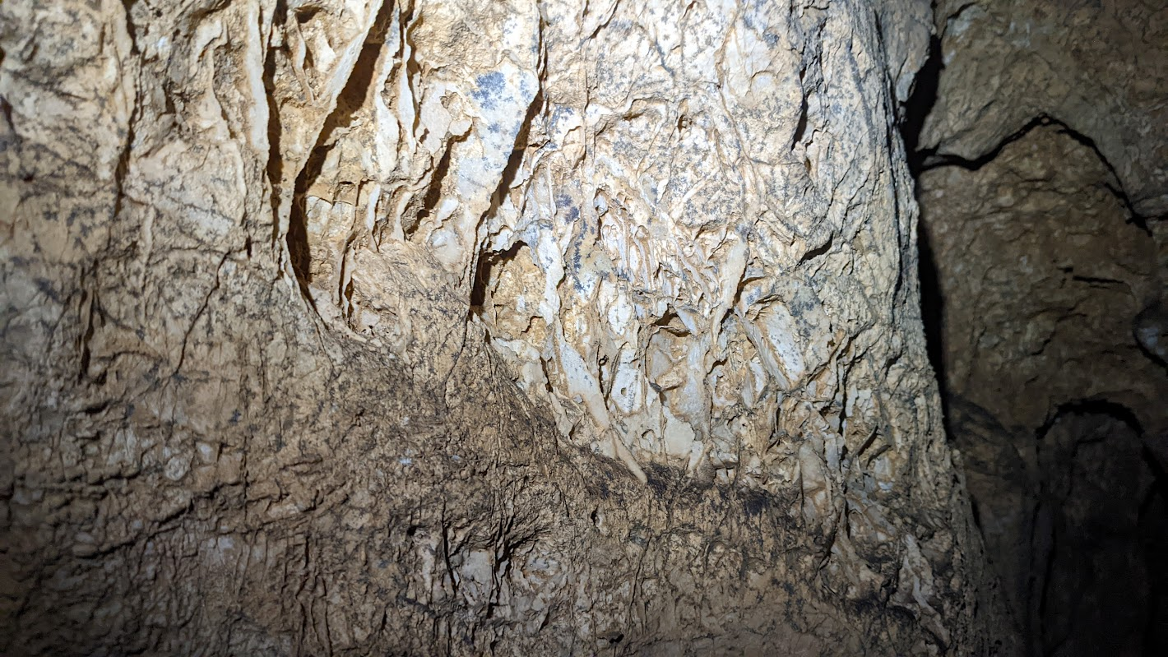

Slide 23
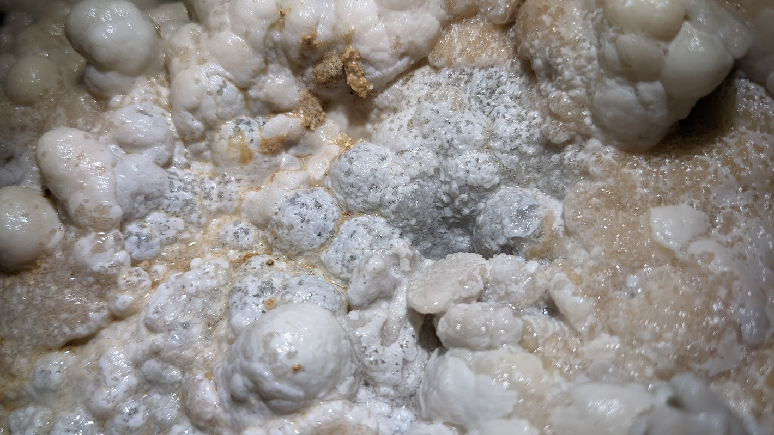
Notes:
- pearls
- Tons of leads still

Slide 24
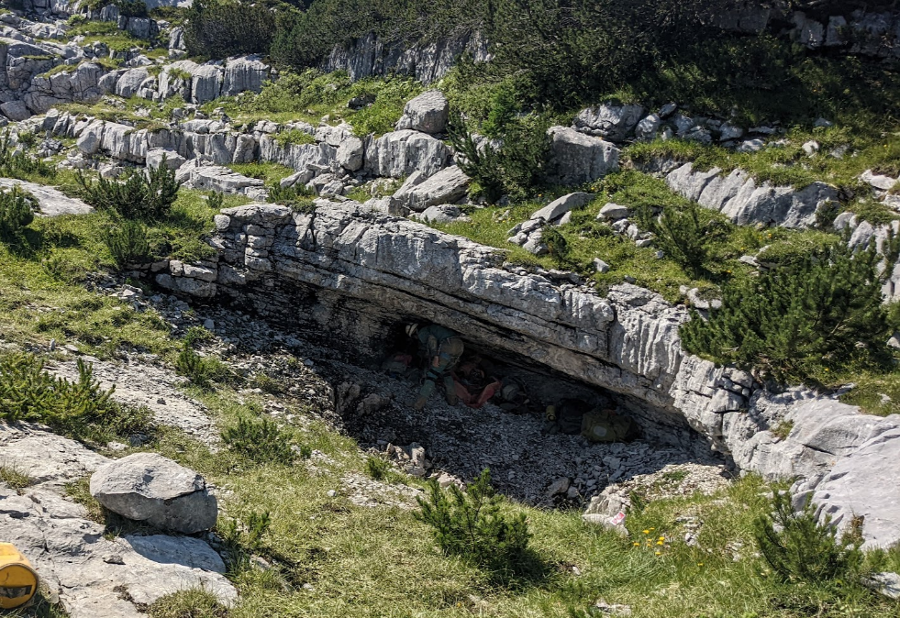
Fischgesicht Höhle <-> Glucklich Schmetterlinghöhle
Notes:
Nice place for gear
Previously ice plugged, also means rock can be less stable

Slide 25
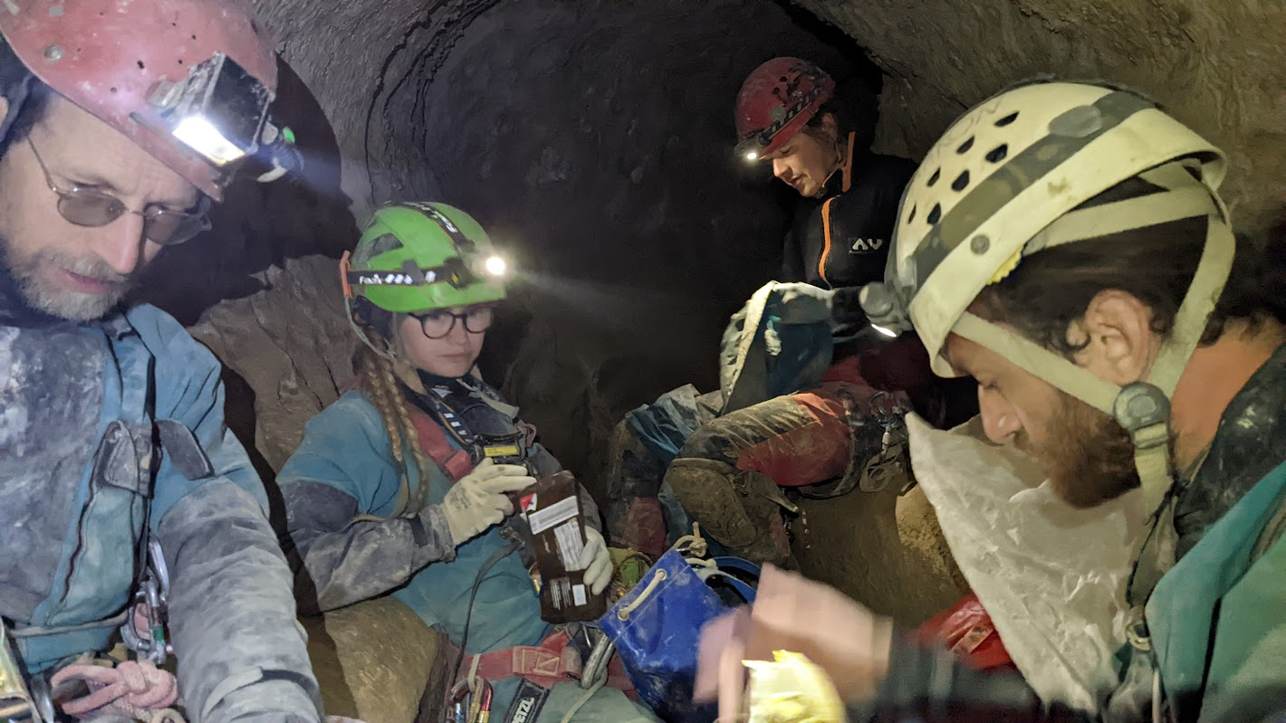
Notes:
- Still no mud
- Dry ramen

Slide 26
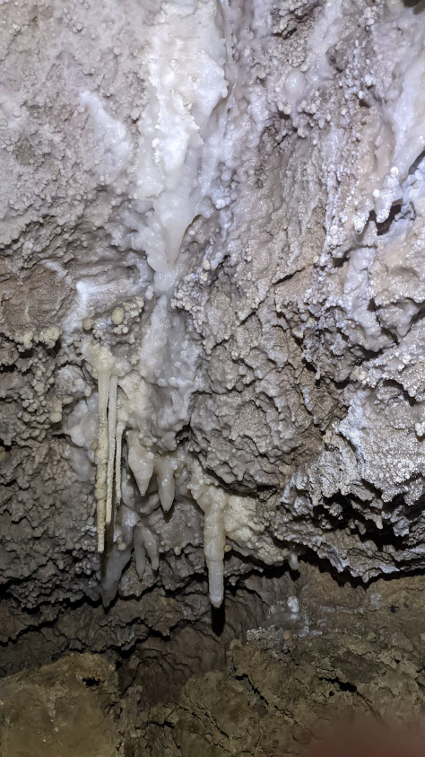
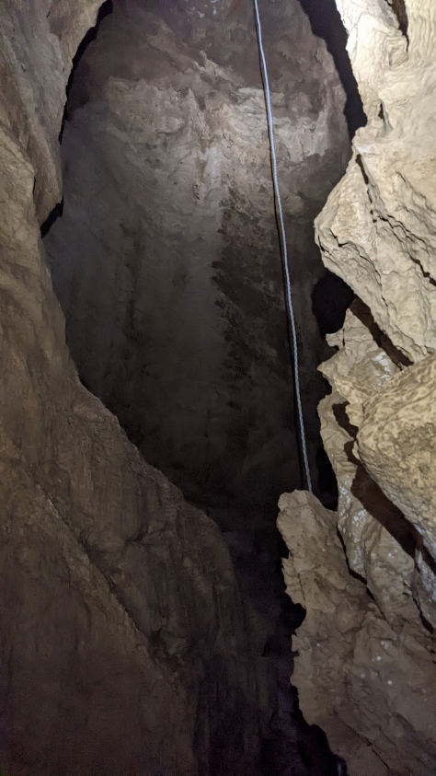
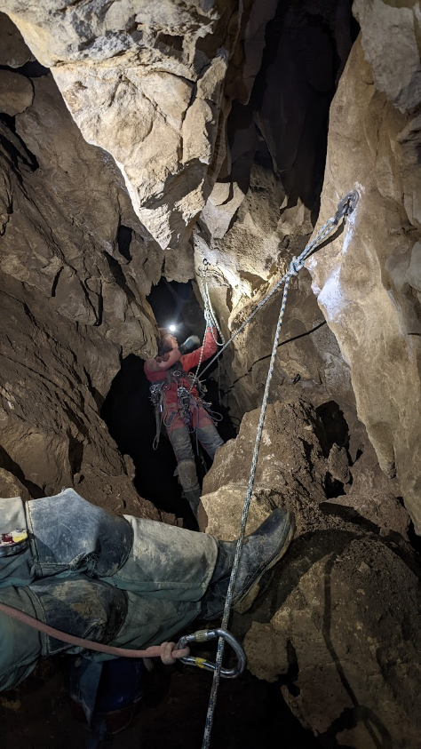
Notes:
- Made it deeper to 400m, 1200ft, around there

Slide 27
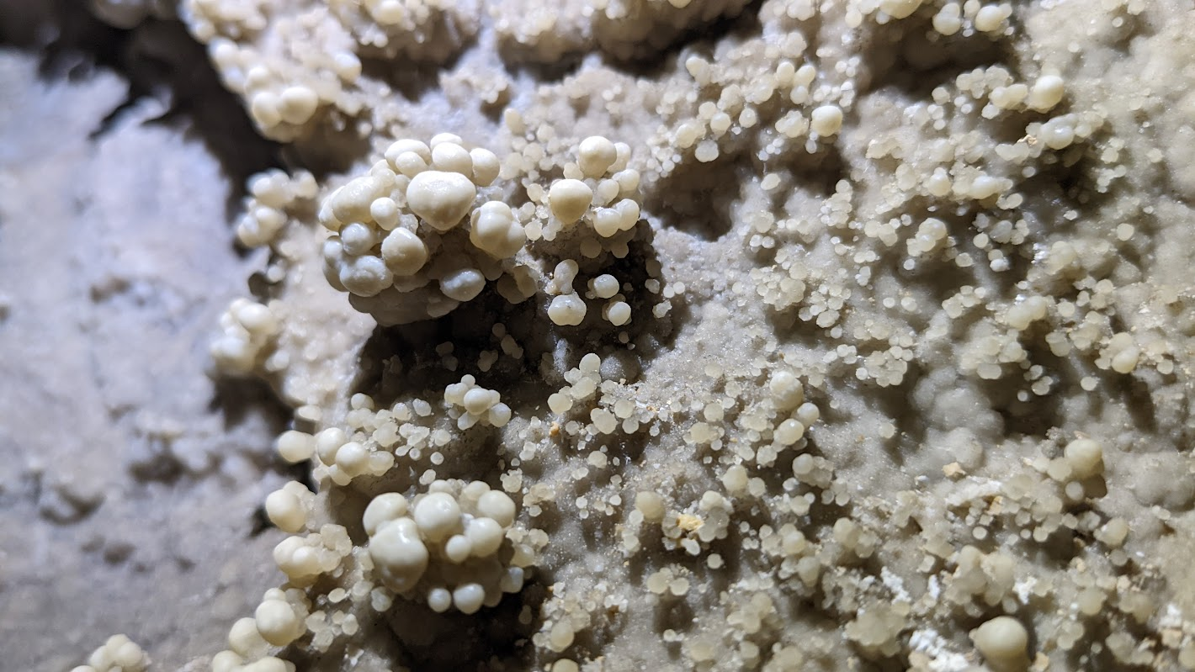
Notes:
nerds

Slide 28
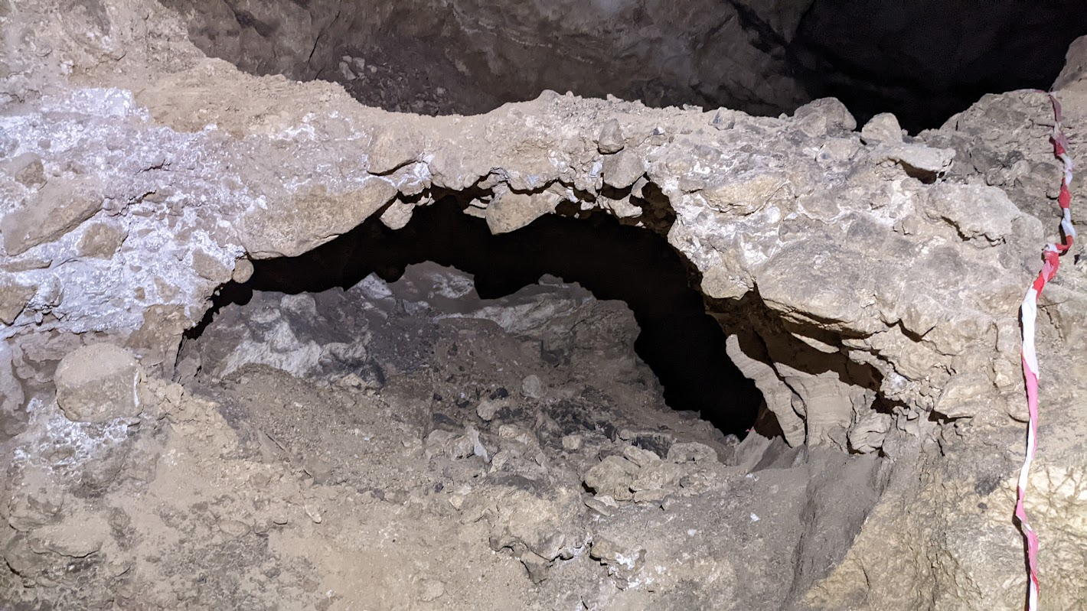
Notes:
Natural bridge
LOTS of climbing, very different coming from some caves around here

Slide 29
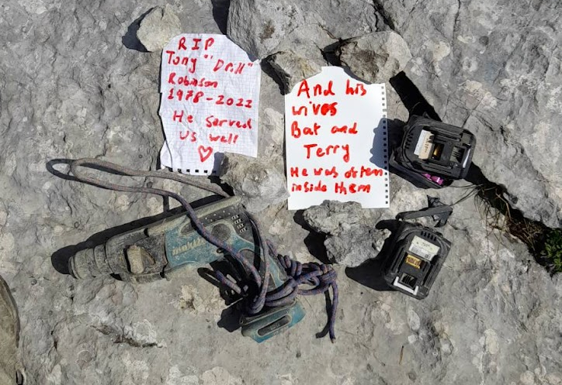
What do you do when you drop a drill?
Rob Watson

Slide 30
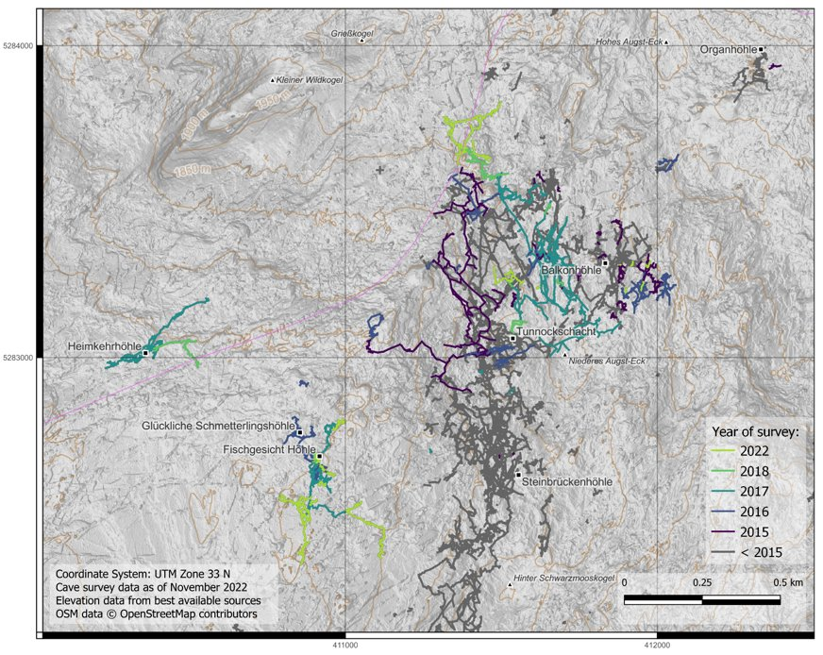
Stats
Over 3.8 km (2.4 mi) passage surveyed by 37
Balkonhöhle gained 1.5 km (0.9 mi)
Fischgesicht connected to Glucklich Schmetterlinghöhle and made them deeper
  Still not SMK
Nat Dalton

Slide 31
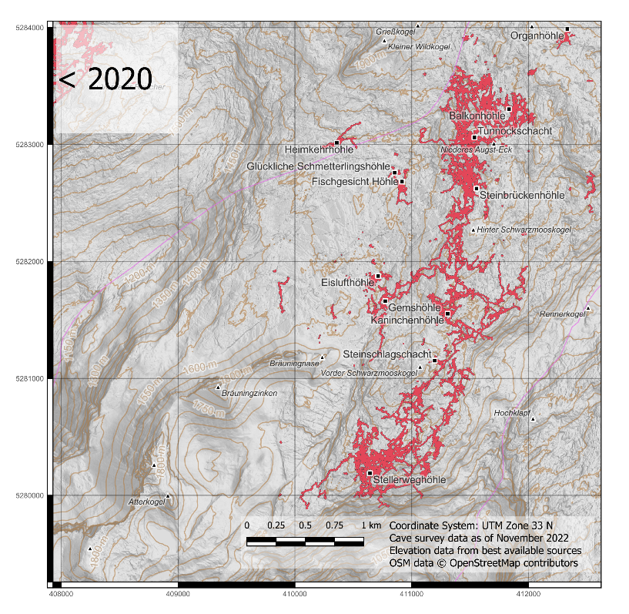
Nat Dalton

Slide 32
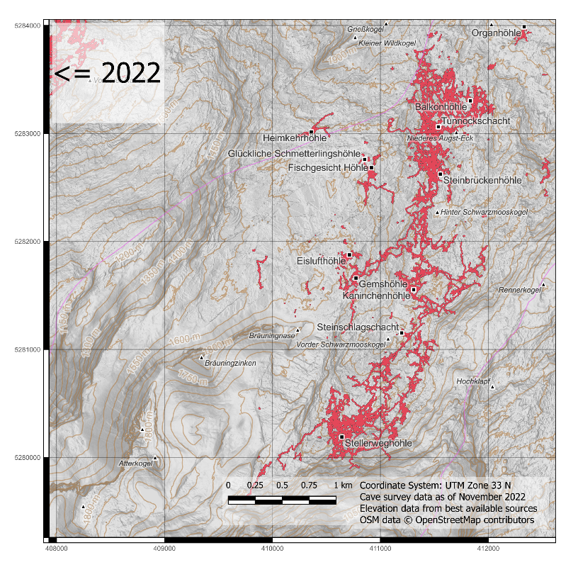




Nat Dalton

Slide 33
6512 ft
2618 ft
0 mi
.6 mi
.6 mi
0 mi

Slide 34
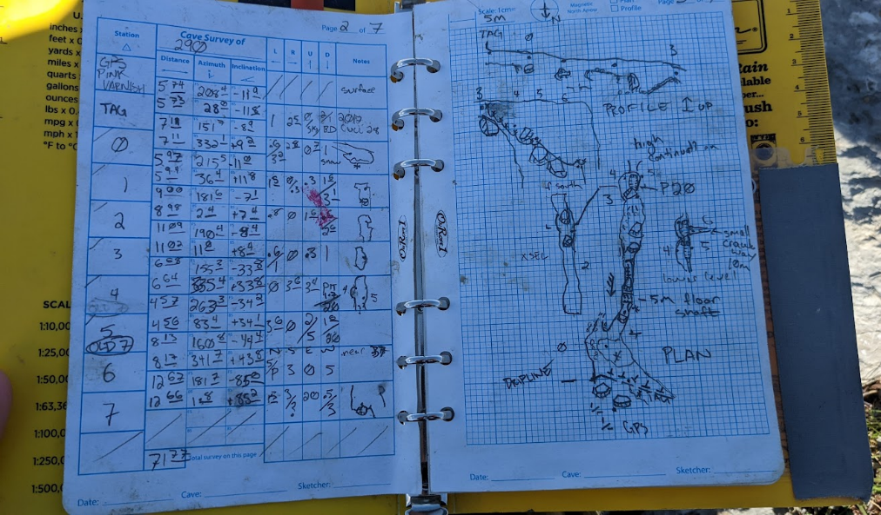
Data Management
Notes:
- Quite a few nerds

Slide 35
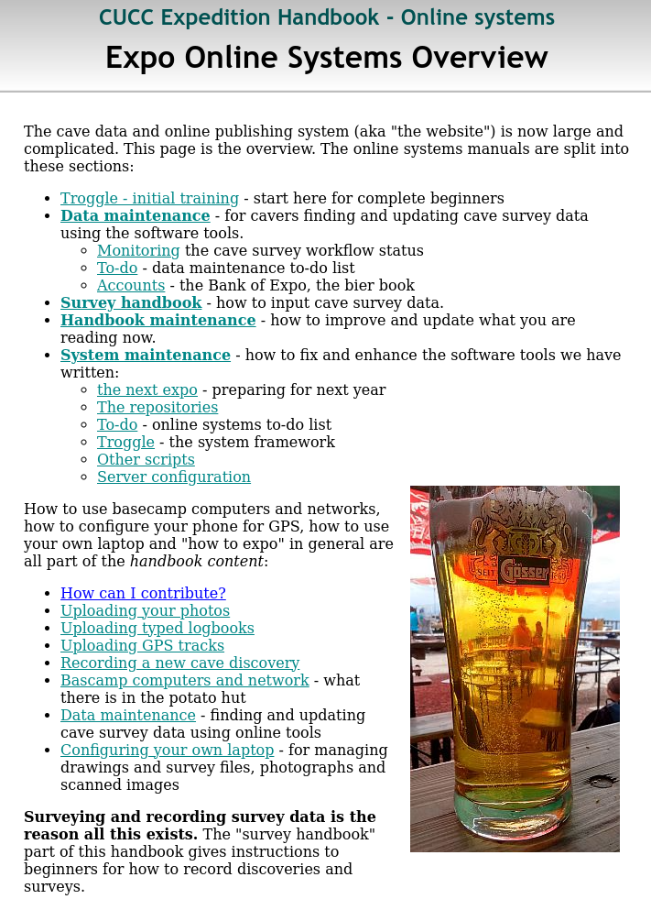
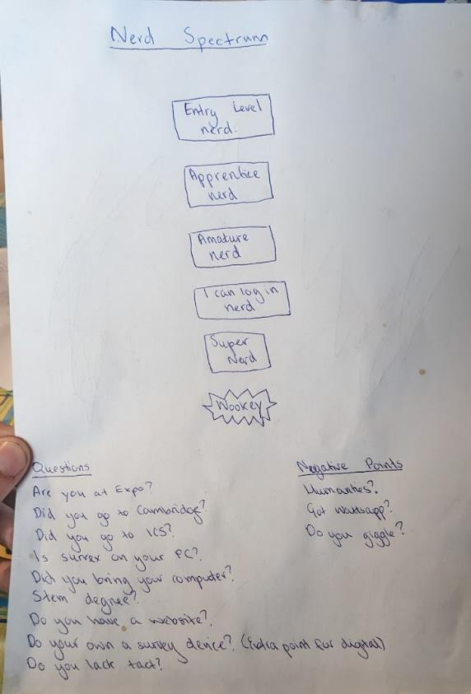
Notes:
- Wookey – huge open source advocate and runs a lot of expo data management

Slide 36
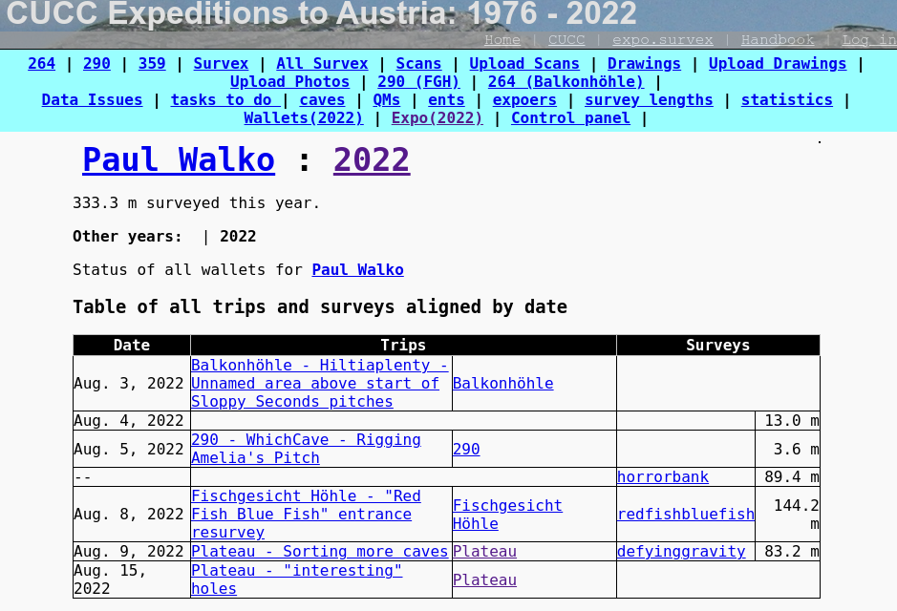
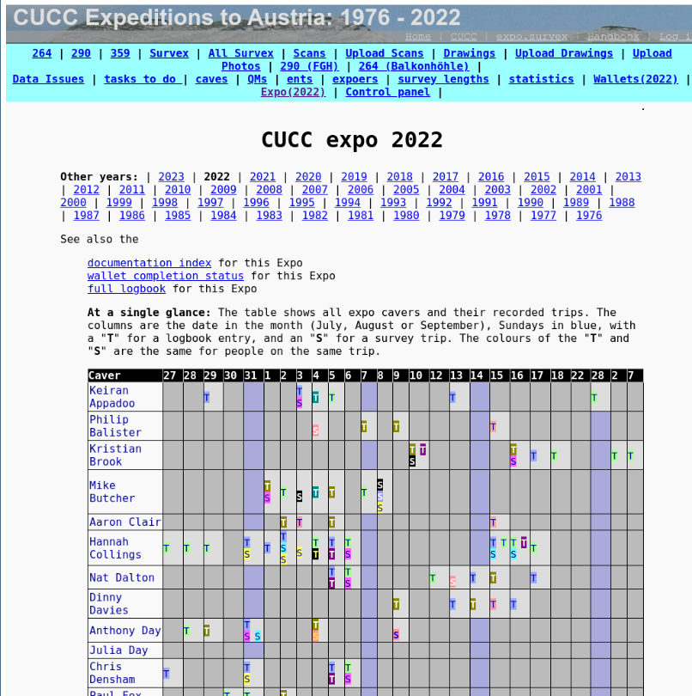
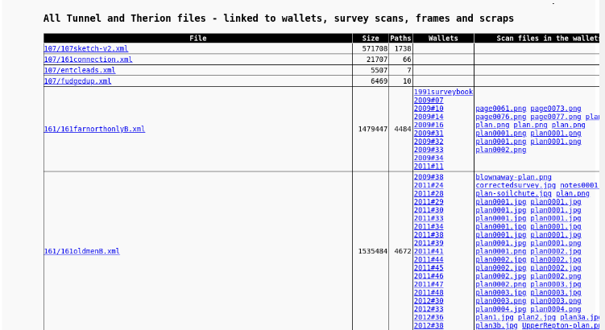

Slide 37
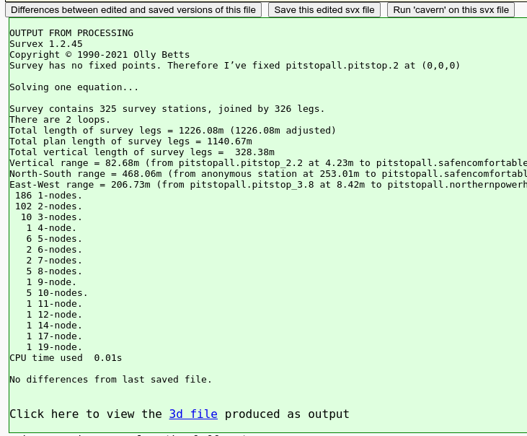
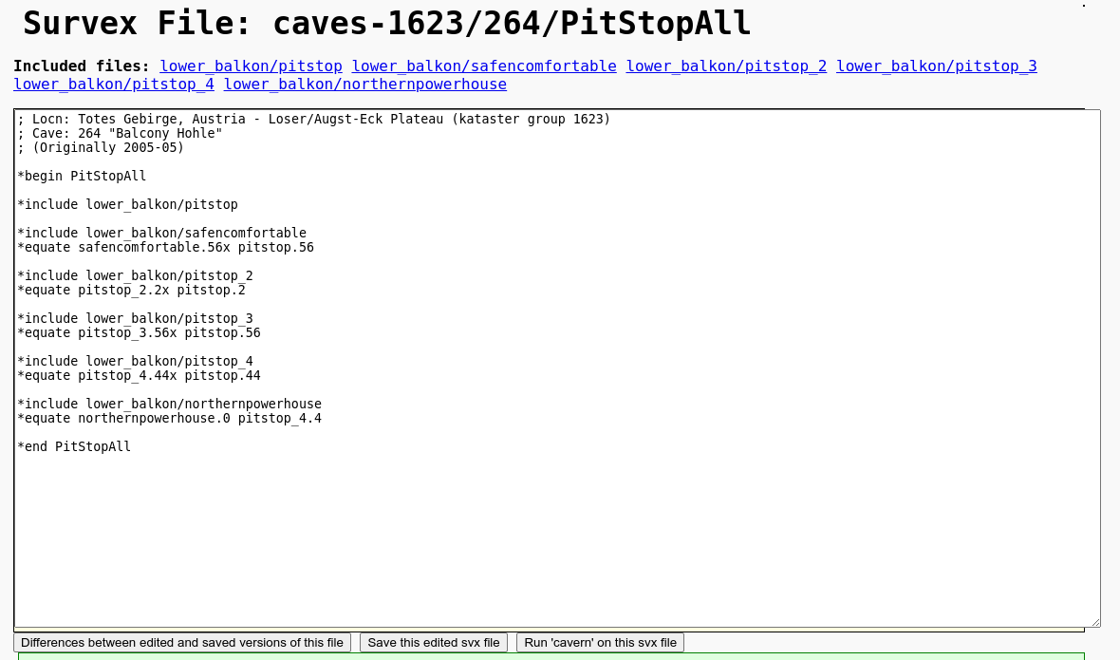
On-Demand Lineplots
Notes:
- 4G on plateau

Slide 38
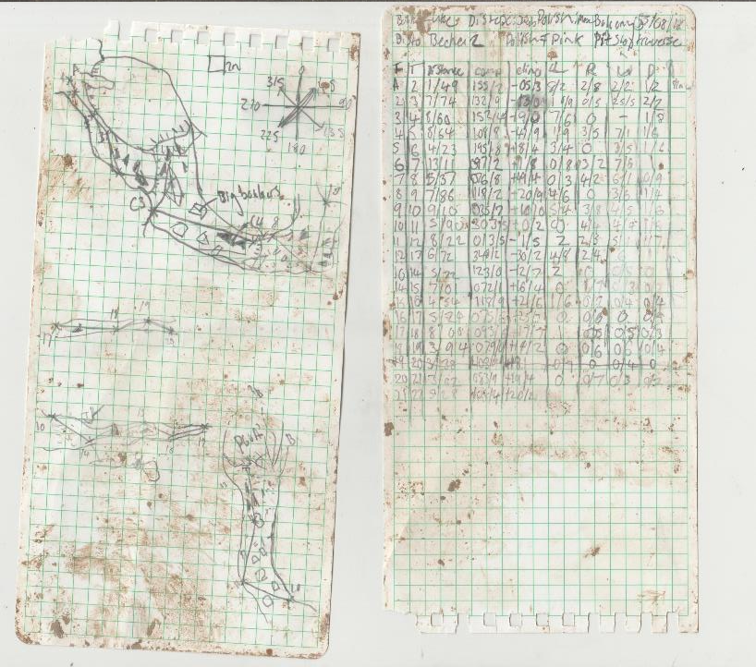

Notes:
No scale
First time surveying for many, cold

Slide 39

Topcamp Pt 2

Slide 40


Slide 41



Notes:
- Carry out lead battery

Slide 42

Prospecting

Slide 43



Notes:
Ice plugs, still need to be documented

Slide 44


Slide 45


Notes:
It's me!
Ice plug

Slide 46

Notes:
Copper?

Slide 47


Basecamp Kitchen
Notes:
Fries and eggs

Slide 48

Notes:
Lots of food and dishes

Slide 49

Notes:
- Berge in Flammen “Mountains on Fire”
- Viewpoint

Slide 50



Slide 51
Future Goals
Continue pushing Balkonhöhle
Connect Fischgesicht to SMK
Push Heimkehrhöhle
Notes:
- Limited by rope

