Slide 1
Exp
By Brendan Hall
Corrected: 1 March 2020

Slide 2
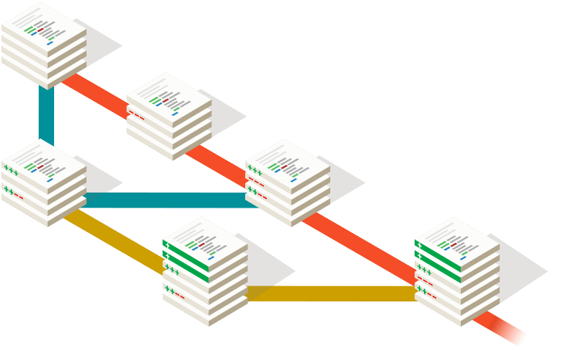
Git: A decentralised version-control system.
This guide is for windows users who have no idea what they are doing and want to get started reading and writing to expos git repository.
Firstly you’ll need to install some software:
PuTTY - https://www.chiark.greenend.org.uk/~sgtatham/putty/
This will allow you to create and use access keys which will let you read and write to the git repository on the expo server. You will need to send these to someone who can add your public key to the server.
If you want a nice GUI interface to interact with you’ll also want to install a git client, in the past we’ve used Tortoise – this is fine but lots of sexier git clients exist. I personally really like: GitKracken and GitHub Desktop both free.
https://www.gitkraken.com/
https://desktop.github.com/

Slide 3
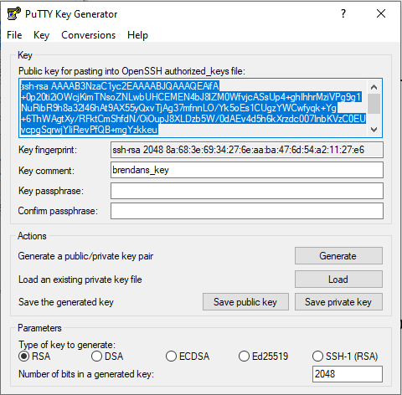
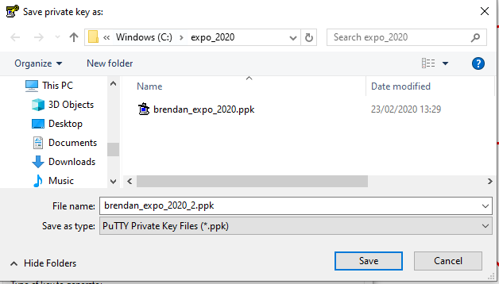
Open PuTTYgen
2. Change this to something that identifies you.
4. Copy and paste your public key into a text file and email it to Wookie, Tom Crossley or someone and they’ll add it to the expo server. Also save this somewhere safe in case you need it again.
1. Click ‘Generate’
This will generate a public and private key for you.
3. Save your private key somewhere by clicking this button. You probably don’t need a passphrase to protect it if you’re computer is pretty secure anyway, but sup to you.

Slide 4
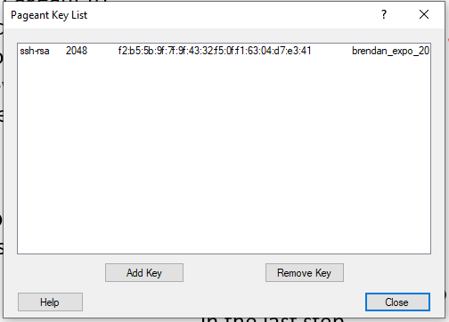
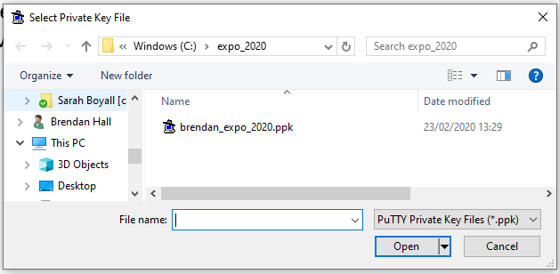
When someone gets back to you to let you know your public key has been added you should now be able to read and write to the git repository.
1. First you’ll need to use Pageant to make your private key accessible to you git client software, you run this in the background whenever you are accessing the git server.
2.When you open Pageant it doesn’t show up in the Taskbar, instead it shows up with all the tiny icons in the bottom right hand corner of your screen. Right click this to add your private key.
4. You should now be able to see that your private key has been added to Pageant.
3. Find the private key you saved in the last step.

Slide 5
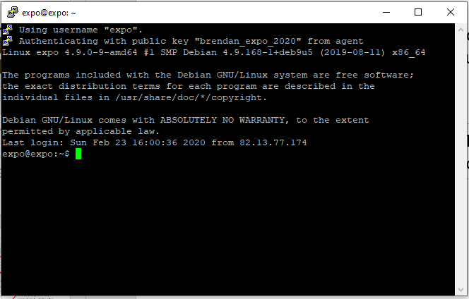
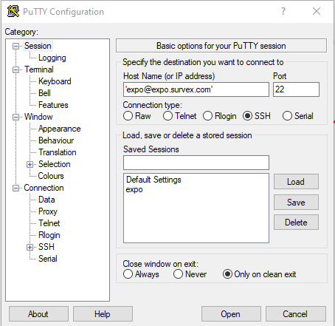
Now the expo server has your public key, pageant has your private key and pageant is running in the background your git client will be able to use your private key to access the git repository on the expo server. The next step is to check if you can actually connect to the server.
1. Open Putty.
2. Type: expo@expo.survex.com
Into the Host Name (or IP address box)
3. If it works you’ll see something like this.
3. If not check you’ve definitely
got pageant open.

Slide 6
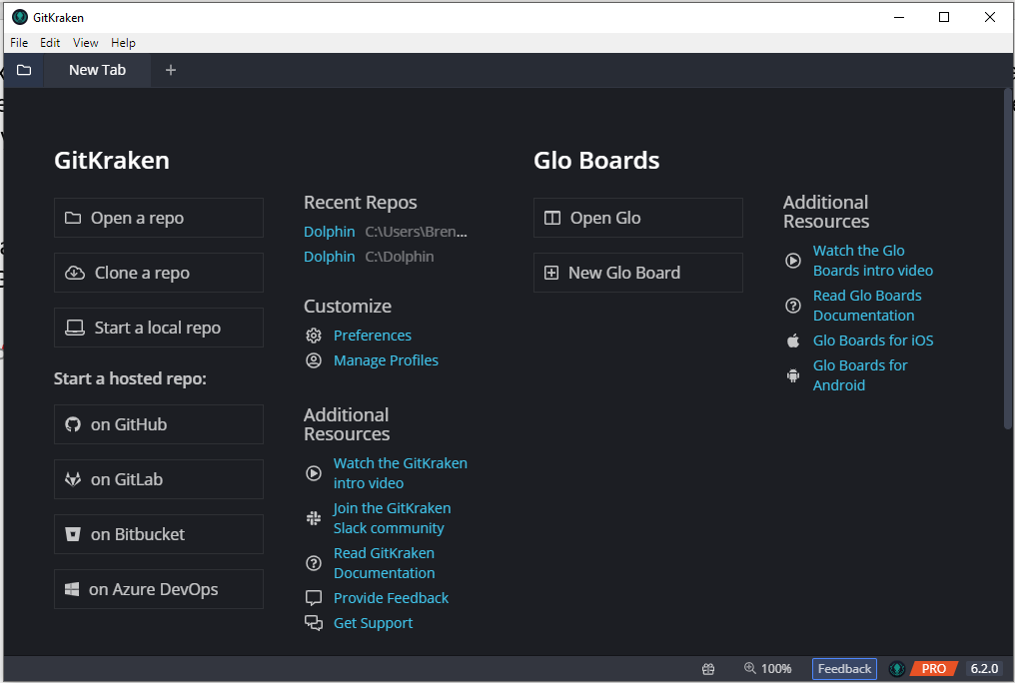
Open your git client in this example I’ve used GitKracken, you’ll need to allow your git client to use pageant (your local SSH agent).
1. Go to preferences.
File -> preferences
2. Check you’ve gotten your git client to use a local SSH agent, in our case Pageant.

Slide 7
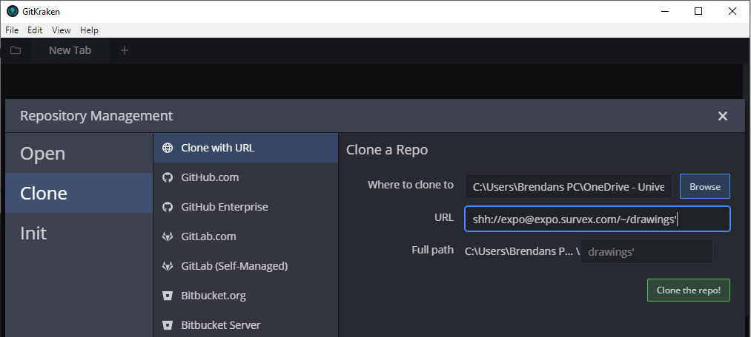
Now to clone the latest repo from the expo server.
2. Choose somewhere to save the repo.
3. Type: ssh://expo@expo.survex.com/~/drawings
In the URL box
1. Click clone repo
4. In this example we’ve cloned the ‘drawings’ repo, but in the future we’ll have more repos for different things including a test repo for you to practice using git.

Slide 8
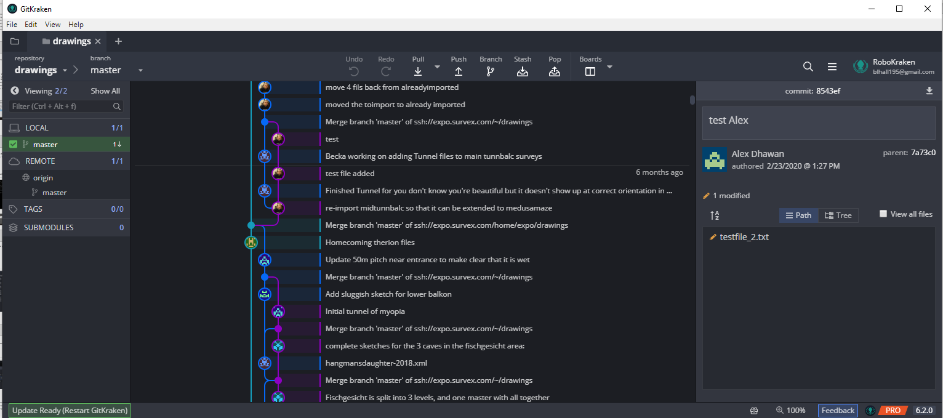
Congratulations you’ve cloned a expo git repo!
From this point onwards you’re probably better off referring to one of the many online resources that teach you how to use git.

