Slide 1
Expo survey analysis 2024
Nat D

Slide 2
Skills

Slide 3
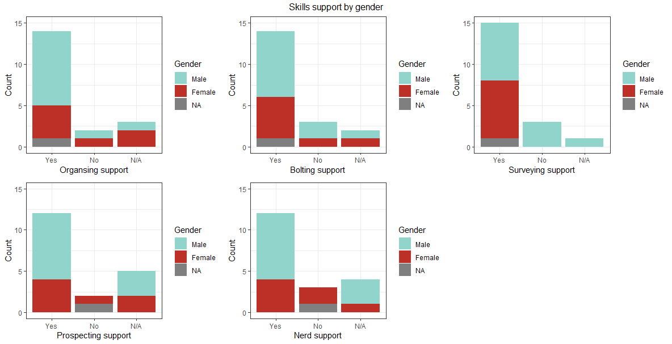

Slide 4
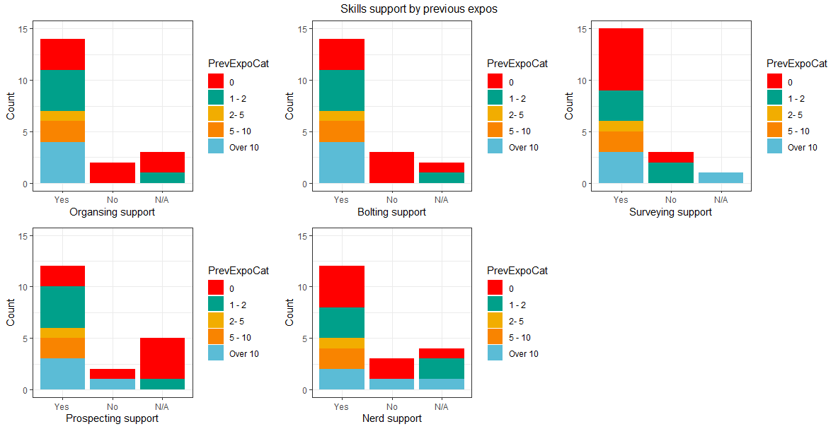

Slide 5
Mentorship and training

Slide 6
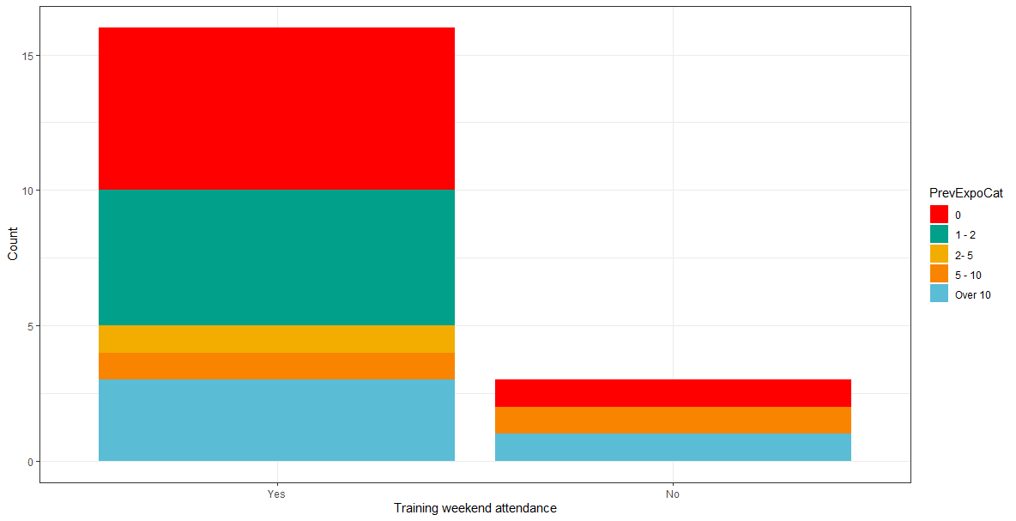

Slide 7
Training not covered @ training weekend
Expectations (useful bag size)
Survey device calibration
Informal knowledge shares (pitched at indivduals level)
Rescue (callout) scenarios
What non-caving kit to bring
Data entry

Slide 8
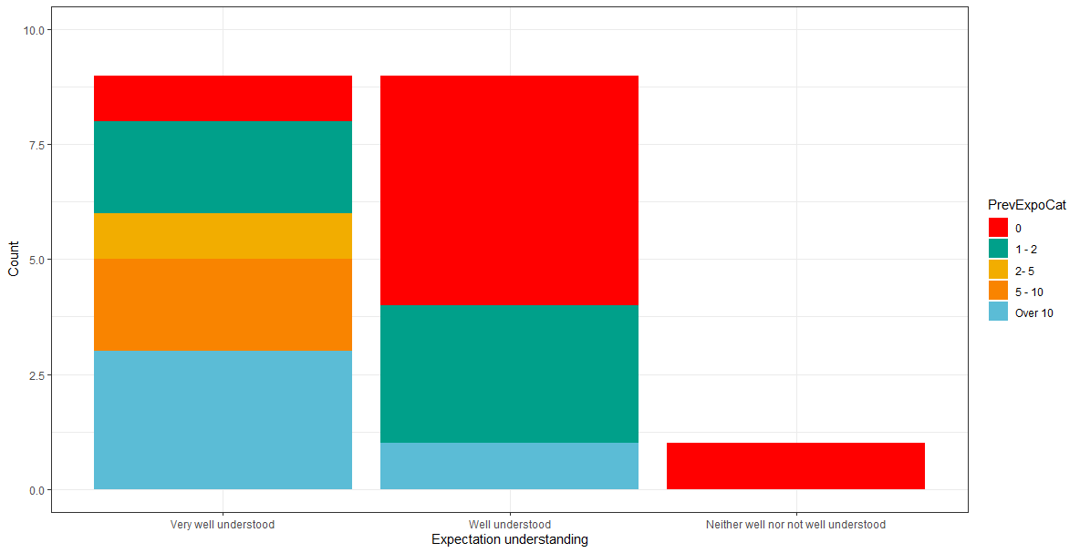

Slide 9
Mentorship
Around 85% of people with a mentor spoke to their mentor before expedition
Around 55% of people with a mentor caved with their mentor on expo

Slide 10
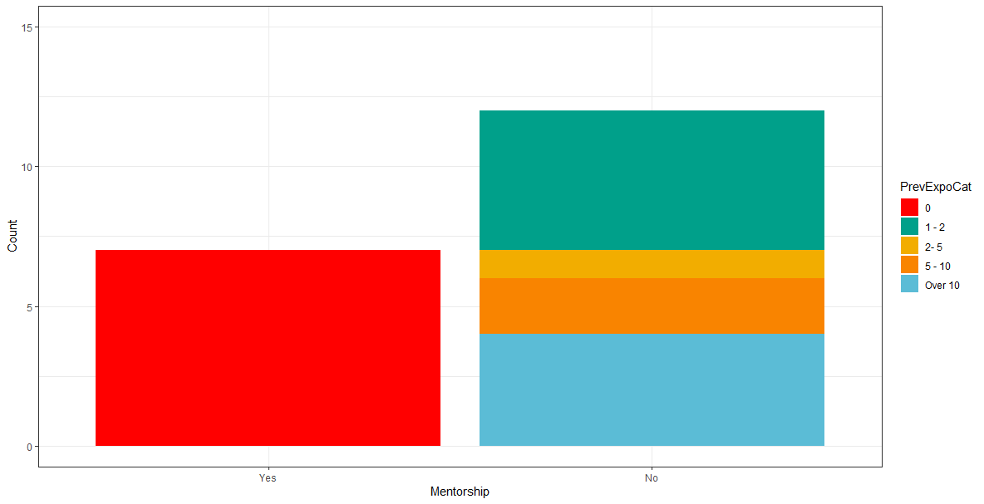

Slide 11
Mentorship improvements
Allocate mentors ASAP (e.g. closer to training weekend)
Make sure people know their mentors and are well suited (with aligned skills/ambitions)
Mentor needs to be willing to focus on mentee rather than own personal goals
More active mentoring
Multiple mentors per mentee
Better temporal distribution of new folks across expo
More structure (?)

Slide 12
Caving safety

Slide 13
Caving safety
Most trips (but not all!) checked weather most of the time (but not all!)
Most trips (but not all!) took appropriate gear most of the time (but not all!)

Slide 14
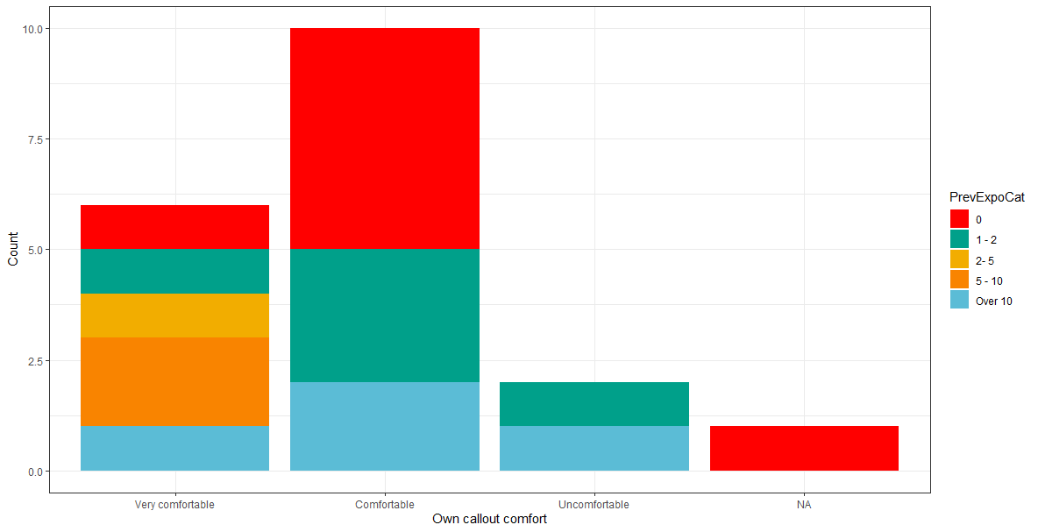

Slide 15
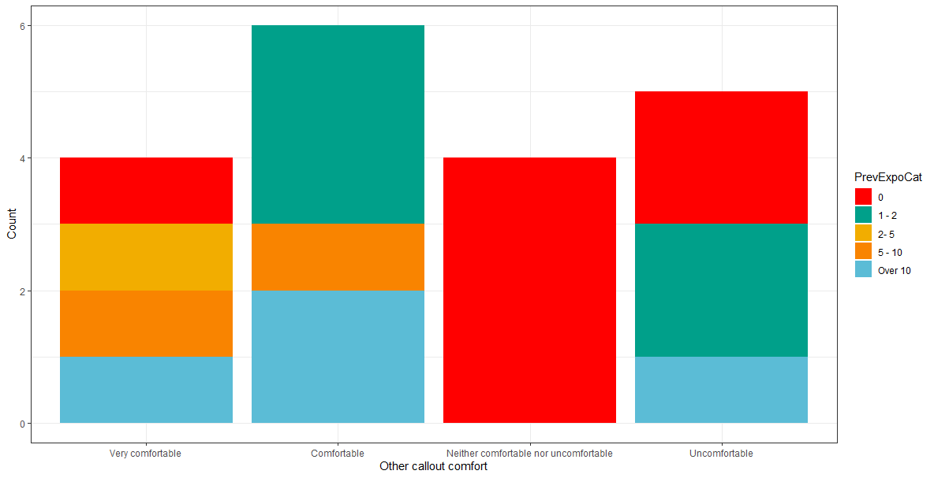

Slide 16
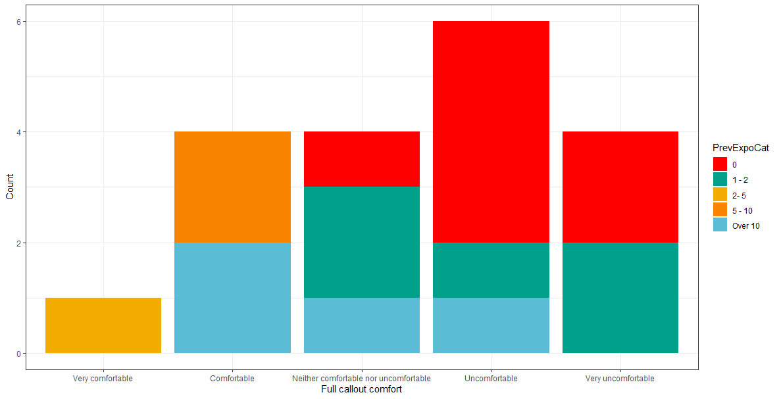

Slide 17
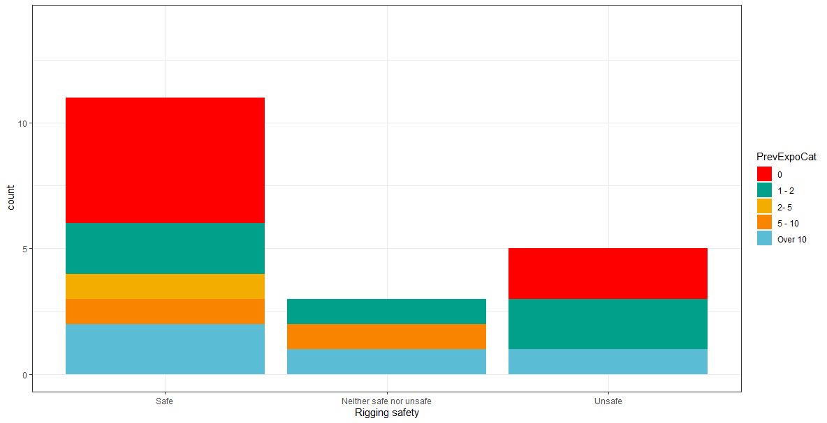

Slide 18
Rigging
Balkon rigging mostly OK, Homecoming rigging worse (awful in places)
Single bolts rebelays could be turned into y-hangs
“Traverse lines in ***[Homecoming] were terrifying”; loose traverses
Rope rub
Water and about how to avoid it (especially when rigging in the dry)
Trade routes only rigged by people who have been on a derig who “know the pain of many bags on slack traverses and on loose or tight hanging rebelays”
“Issues cascade as novices become accustomed to the low standards and then copy what they see”

Slide 19
Wrap up

Slide 20
Other feedback
Need some shallow cave
More work on expo drills needed/sorting gear sooner and/or with bigger budget
Bigger budgets for rigging gear
Food could be improved
People should be on expo for either rigging or derigging (either without enough people is miserable)
2 camps made things harder
Communicate callout expectations
Some trips without much experience (=rubbish bolting)
Inexperienced people not getting on trips/feeling like a burden
Website is overwhelming

Slide 21
What worked well
Keen new people with the right skill/experience level
Underground camping set up worked well
Meshes good
New drills good
Lots of caving
Mentorship scheme (but needs tweaking)
Retrospection
Top and garlic camp worked well

