Slide 1
How to use Tunnel
Find it here:
https://bitbucket.org/goatchurch/tunnelx/downloads
Download the .bat and the .jar files and save them somewhere like “c/program files”

Slide 2
How to Tunnel
Tunnel is some really good borderline fun cave drawing software created by Julian Todd (CUCC).
Once you get use to it it’s more like playing an online flash game, than drawing up a cave passage.
It allows you draw cave passage & later warp it if you need to close a loop.
Use the inbuilt tutorials to teach yourselves the fundamentals, this guide will teach you how to set up a section of cave to draw on top of.
The only limitations I can think of when using tunnel, is that it doesn’t do elevations very well & there are no keyboard short cuts for things like delete & back.

Slide 3
Nodes and lines
A node is a square point on the tunnel drawing,
Every node must somehow be connected to the drawing,

Slide 4
The Tutorials
This manual talks you through how to draw up a cave, in order to learn how to use the software you will need to go though
the built in tutorials. They don’t take long and teach you all the fundamentals.

Slide 5
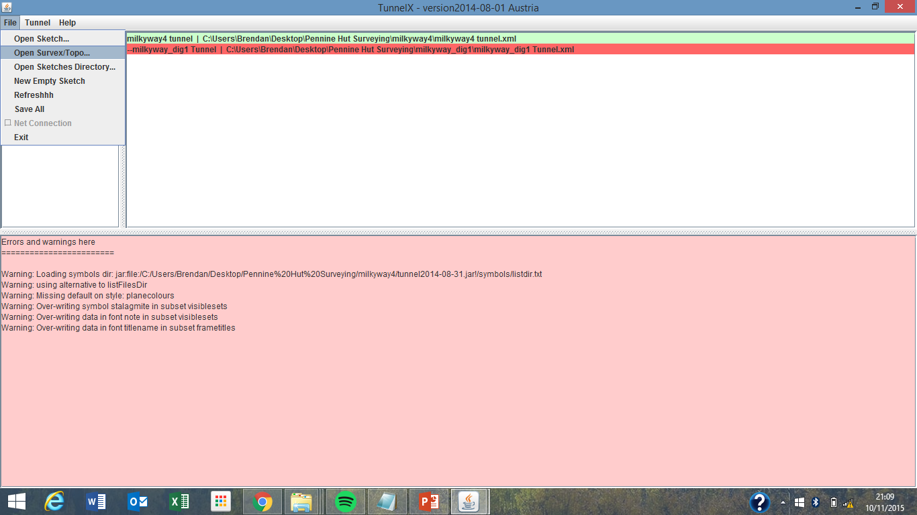
Import a survex centerline file

Slide 6
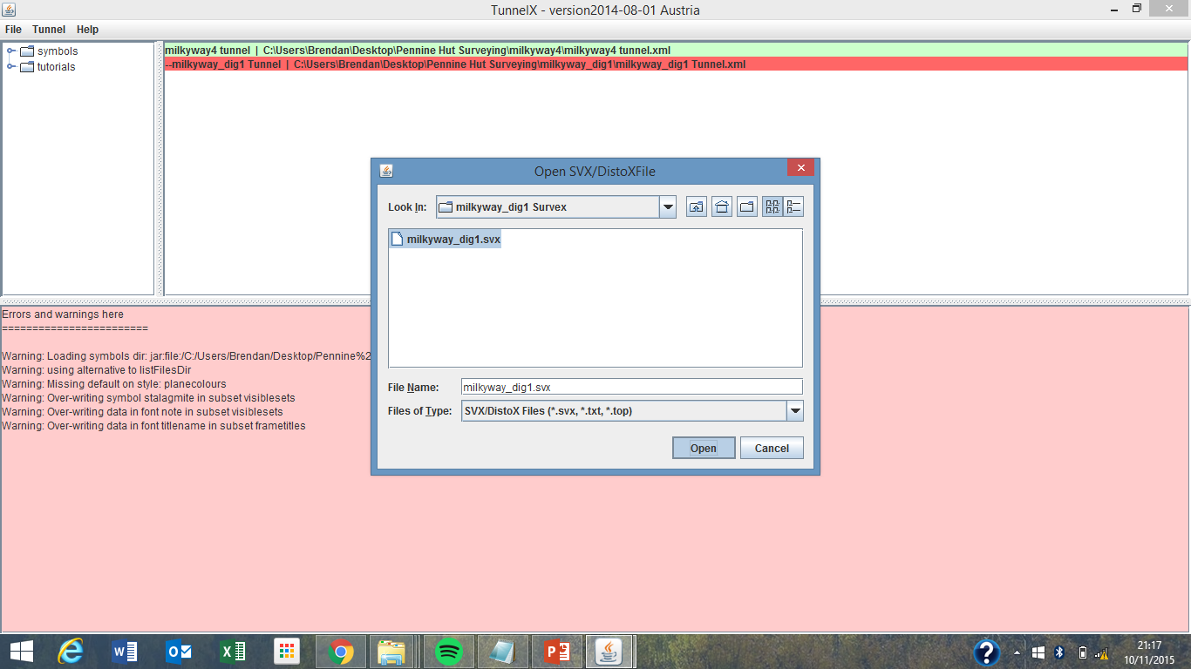
Select and open a survex file

Slide 7
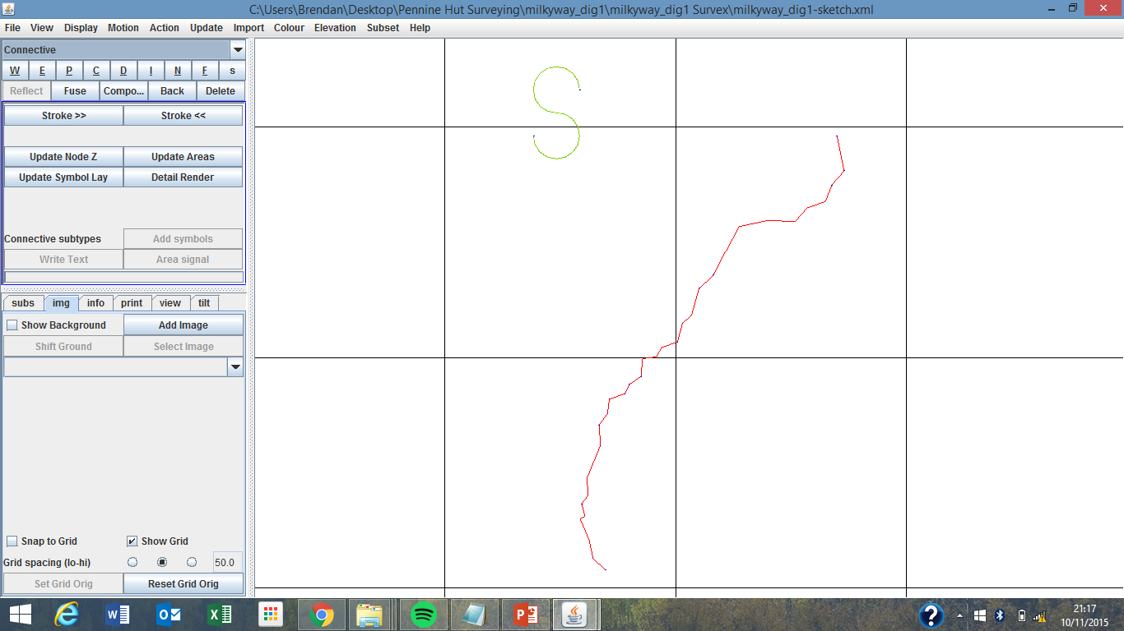
Ignore the ‘S’, it’s just there “because it has to be” as far as I know.

Slide 8
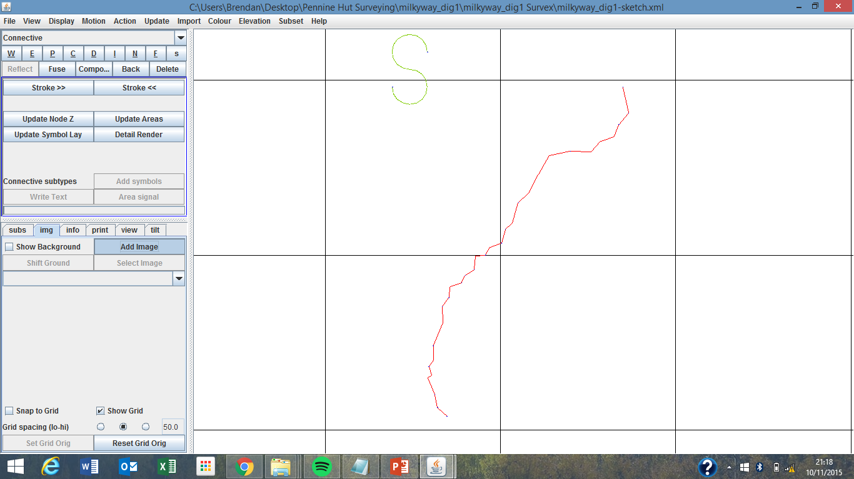
Add a sketch to the background to draw on top of. Note the section has to be drawn to scale so it matches the centreline
exactly, this can be done by printing out the survex file and drawing on top of it using the sketches. Or importing an Image
from a PDA.

Slide 9
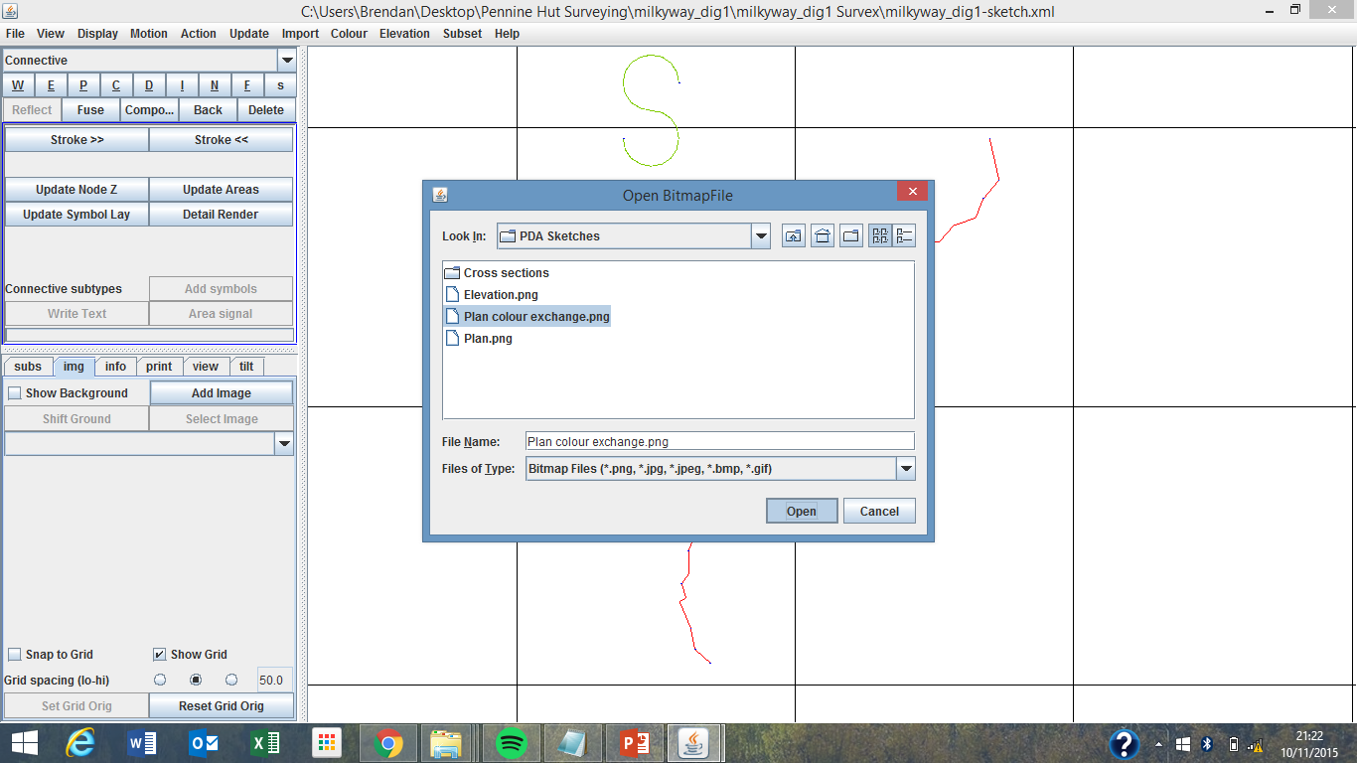
I think the sketch can be in any format, I’ve only used JPEG and PNG so far.

Slide 10
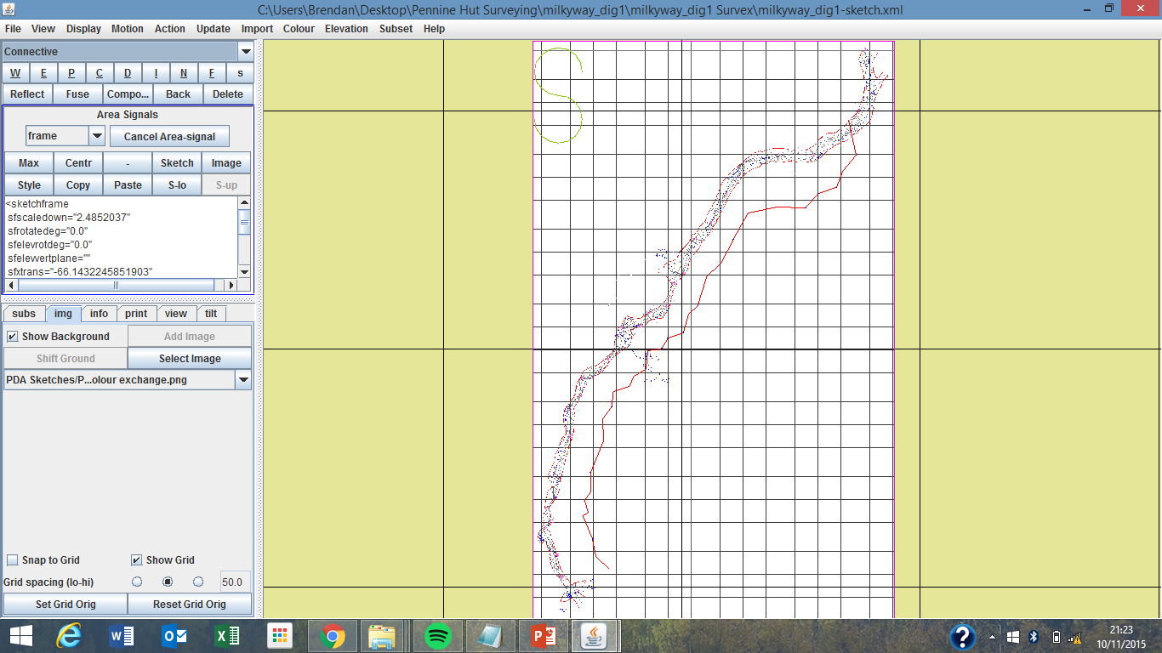
Now you need to match up a point on the sketch so it matches up with the centreline –
see the next page to learn how to do this.
Zoom:
next page
Using a
Connective
Line. Julian: “N for
Co n n ect”

Slide 11
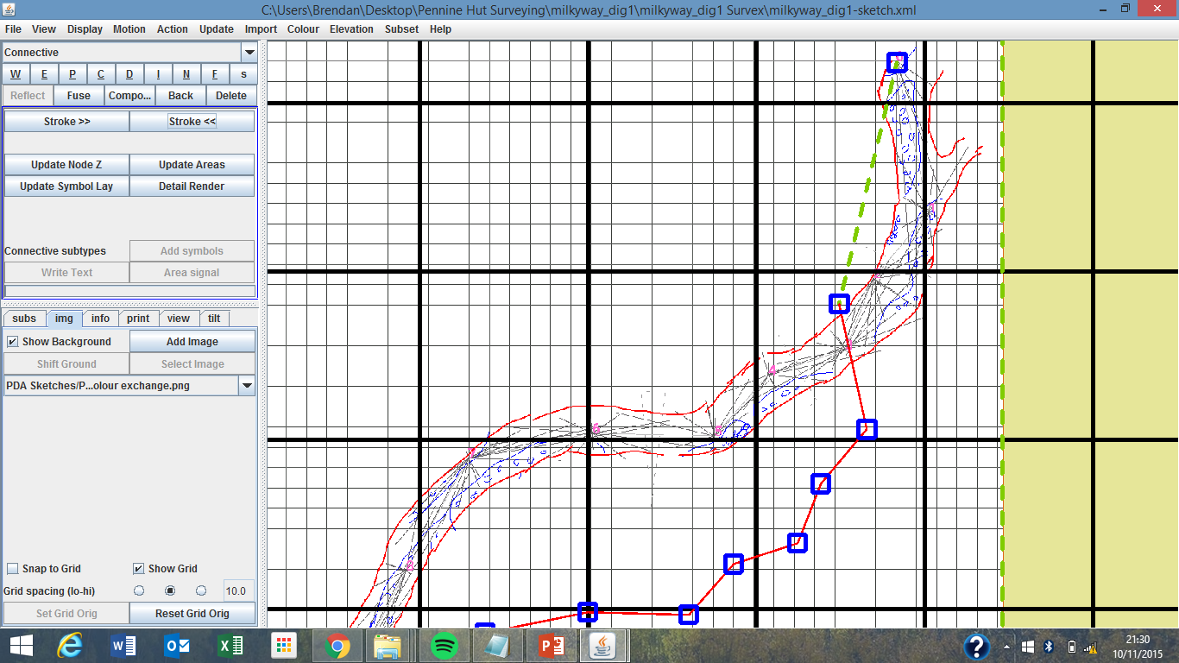
To move the sketch over to the centreline, connect the first station on the sketch to the first station on the centreline.
remember to hold down ctrl in order to connect 2 nodes (connecting squares) together.
Note: you need
To hold down ctrl when you are
Attaching a line to a
Node
Node =

Slide 12
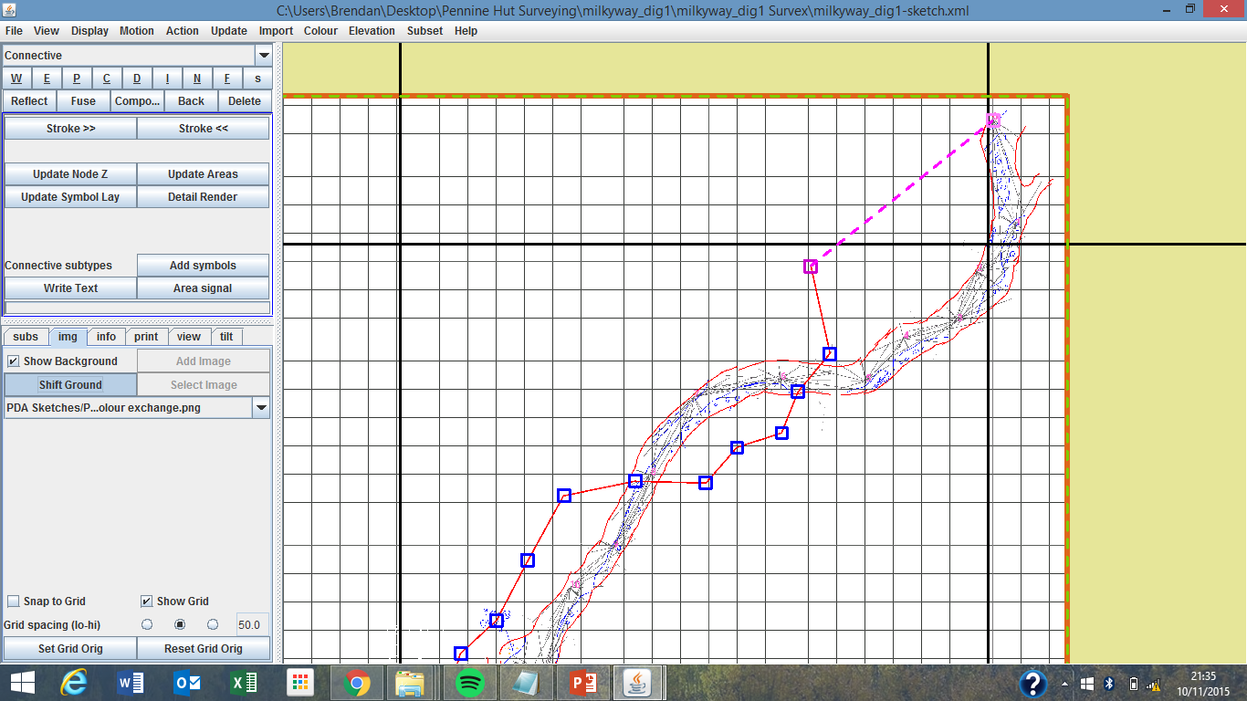
Shift Ground
Make sure
the connective
line has been
selected, (right click
the connective line)
it will show up
pink if when it has
been selected
like in the example
Then Click “shift Ground”
this will drag the point
you have selected on your
image over to where you
have selected on the survex
centerline (in red)

Slide 13
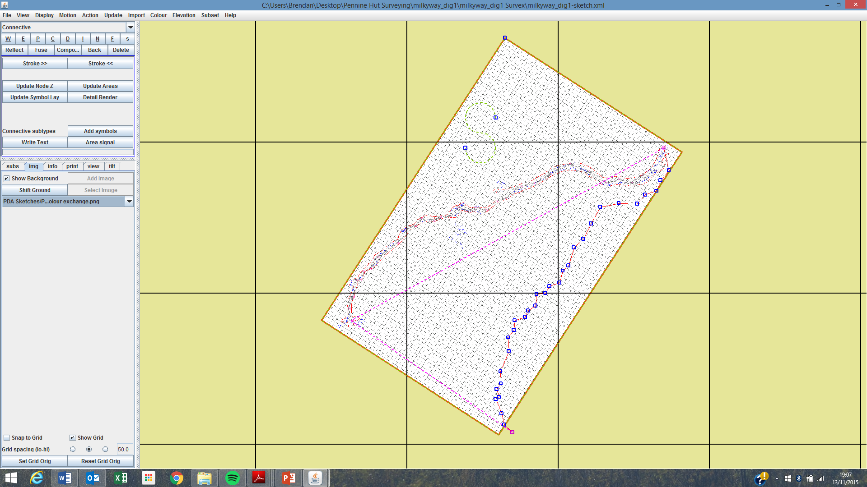
Scale and Orientate
Using the connective line (N) join the survey station you just matched
Up with the last point in the sketch
Join this point with the last point
On the survex centreline
Station 1
Last station on sketch
Last station on survey
Note: you don’t necessarily have
to use the first and last station
in the survey, although it is probably
the best option. This method works
With any two stations.

Slide 14
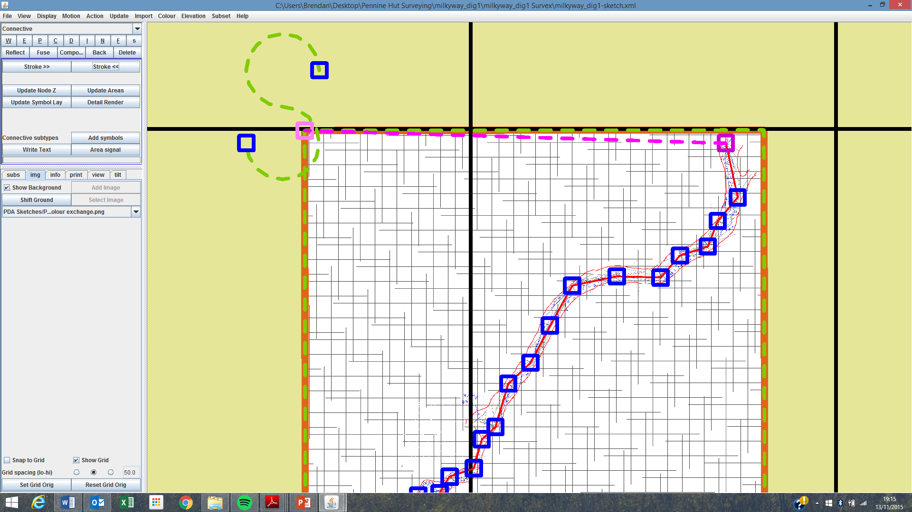
Now your sketch lines up with the centreline, you need to make sure it connected to the survey. Just connect the
Corner node of the sketch with a station on the centreline.
Note: be carful to
not accidentally
change the bounding
box of the sketch
into a wall (Blue line)
this would become
a problem later when
you try to “fill areas”
and the whole sketch
is filled.

Slide 15
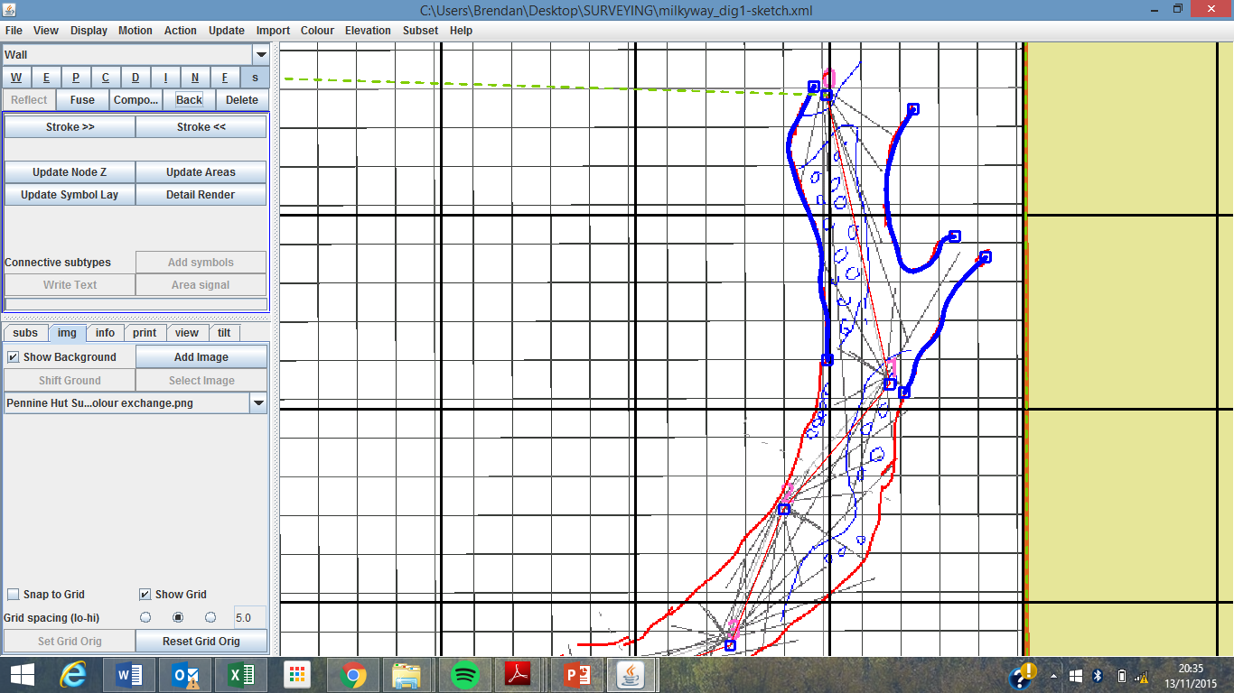
Time to actually start drawing the cave, make sure everything else is deselected by right clicking off the sketch. In the next
Few slides I will go through some of the things taught in the inbuilt tutorials. Although the following steps will be easier if
You complete the tutorials yourself.
Some pointers
change the style of the lines
by choosing from the menu here
You can disconnect the
cursor from the drawing
line by clicking back.
In order to change the thickness of
the drawing lines click “stroke”
To remove the background
from the tunnel drawing
click this button
Double click at the
end of a line to finish drawing
a section of wall

Slide 16
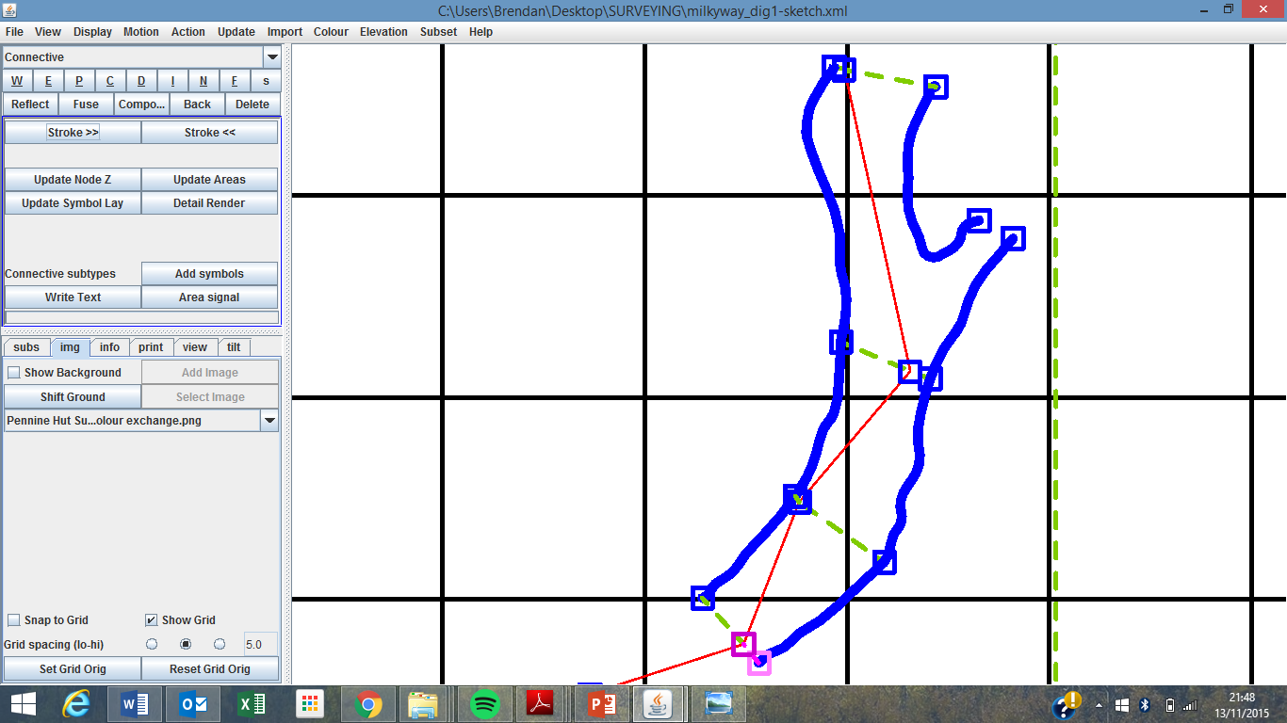
When drawing the walls it is important to connect the walls to the centreline, this allows the passage drawing to be warped
Later on if there is a loop closure.
Remember, hold down ctrl
when joining nodes together

Slide 17
In order to add detail to the cave you may need to insert a node in the middle of a section of wall, Remember everything
needs to connect to everything else if the software is to accept the details you insert as part of the cave
Right click the wall you want to insert a node into.
Holding down Ctrl and Shift, left click where you would like to insert a node
To check you have
Inserted a node correctly, right click
either side of the node, they should highlight seperatly

Slide 18
1
2
3
4
To draw in an area of detail in the passage, select the “detail line” option
In order to check you have sectioned off an area properly click:
Update Node Z
Update Areas
Update Symbol Lay
Detail Render
In that order & the area will be sectioned off
Begin drawing in the area and finally connect it into another node on the wall to section it off

Slide 19
It is possible to fill The area with features Such as sand, pebbles, Boulders ect.
1. Select a node connected to the area, and draw a
connective line into the area
2. With the connective
line selected, click “add symbols”
3. Select the things you would like to put in the area, you can pick more than one, here I have selected, sand, mud and pebbles.
4. Again right click off the sketch, and update: node, areas, symbol lay + detail render to check it looks right.
Do this for all the areas of your sketch, you can even draw in trenches/rivers, just remember all the details you draw need to be connected to a node on the wall.

Slide 20
Sometimes you may want to draw your own details in the cave passage/chamber, for example a huge boulder, it is possible
To do this by drawing the boulder/feature with a “detail line” then connecting it to the rest of the passage with an “invisible line.
1. Draw in the feature, using a detail line, e.g. here the feature is a cube boulder thing
3. Update nodes, areas, detail render ect. And it should look something like this.
2. Connect the feature to the rest of the drawing with an “invisible line”, otherwise it will look like this when you fill the rest of the passage in. (As tunnel doesn’t know which layer the feature is on)

Slide 21
2. This allows you to fill in the rest of the cave passage.
Once your done creating all the areas/details, section off the ends of the cave.

Slide 22
How to “stitch” cave passages together
Step 1: open the survex file of the entire cave/as much as has been mapped so far.

Slide 23
Step 2: open up the rest of the sketches you have made for that cave

Slide 24
3. Double click on the file for the master cave survex file here. And it’ll show up in the main window.
4. Click once on the sketch file you want to import onto the main tunnel file.

Slide 25
5. Click preview down sketch and it’ll give you a preview of what the sketch will look like once it has been imported onto the master survex file.
6. If you like the look of it Import the down sketch.

Slide 26
7. Continue this process for the rest of the cave…

Slide 27
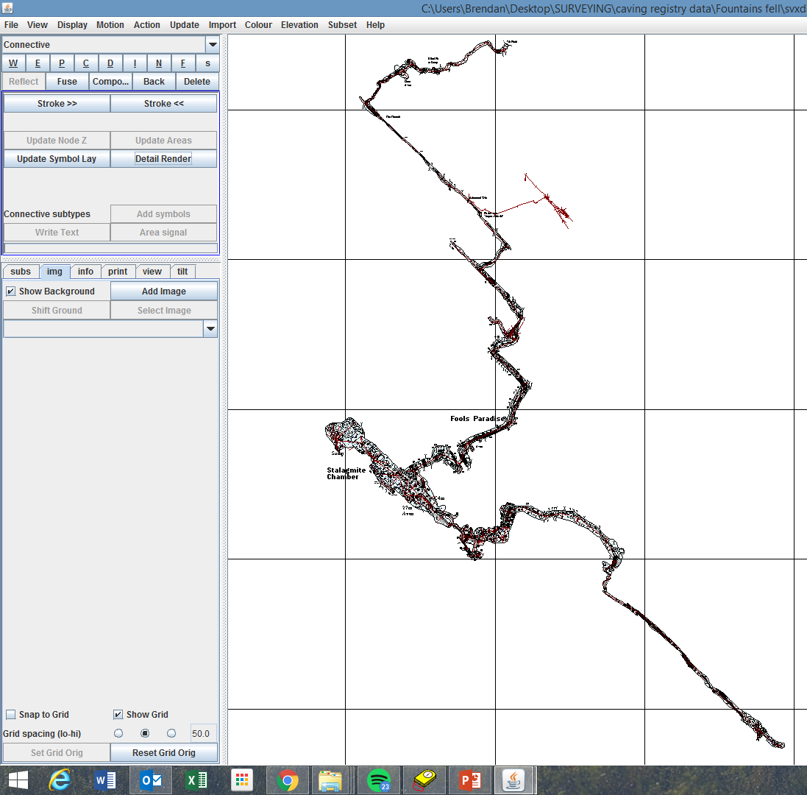
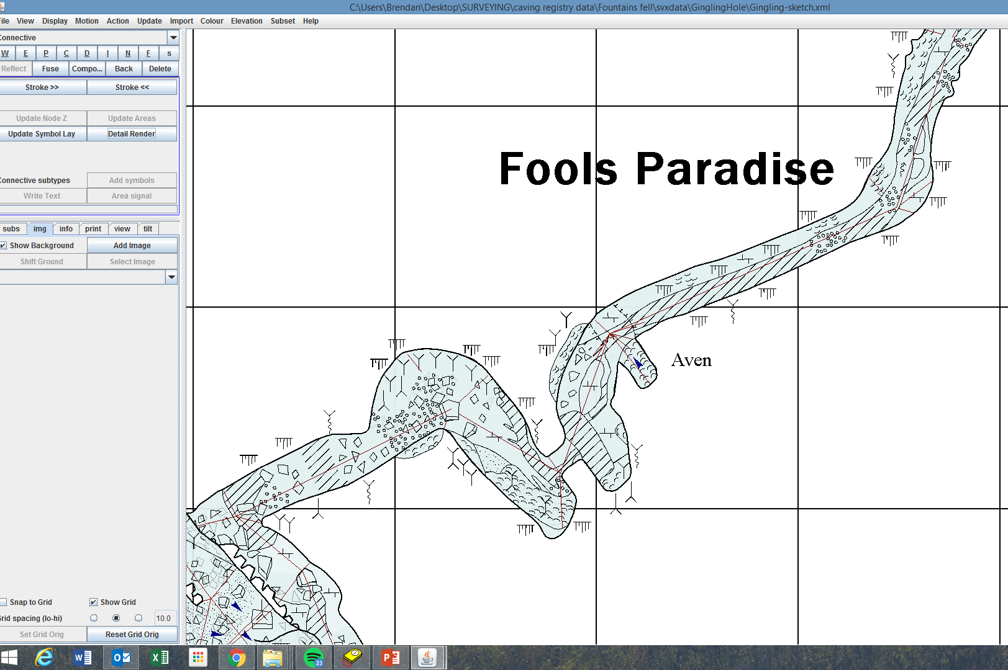
Good Job ☺
8. Update…detail render and stuff and you’ll end up with a file like this
9. Zoomed in it’ll look pretty good.
10. You may need to do some botching/editing to get the “seams” in the separate files to fit together nicely.

